Slide 1
Payments Basics: An Overview
Presentation

Slide 2

Agenda
Definition
Key Terms
Scheme
Clearing
Settlement
Payment Flow
Message Standards

Slide 3
What is a Payment?
A payment is the transfer of money from one party (such as a person or company) to another.
Payments are transferred by means of electronic messages
Mostly SWIFT network is used to transfer International Banking Payments

Slide 4







Sample Payment Flow
MT103 (50 EUR)
MT103 (50 EUR)
Mr. Edward
Debit Party
Barclays, UK (BARCGB22)
Debit Party Agent
Mrs. Elaine
Credit Party
XCT BANK-1, Belgium
(XCTABEBB)
Credit Party Agent
Mr. Edward wants to transfer 50 EURO to Mrs. Elaine.
Mr. Edward have an Account at Barclays Bank while Mrs. Elaine have an Account at XCT Bank -1.
Mr. Edward initiates a Payment via Mobile Banking, Internet Banking or Cheque Transfer.
Barclays Bank process the request from Mr. Edward while debiting his account with 50 Euro and crediting 50 Euro in its Internal Account.
Barclays Bank, to narrate this whole story, creates & send a message MT103 over SwiftGateway.
From its Internal Account, Barclays Bank transfers the amount in XCT Bank -1’s Vostro Account at Barclays Bank.
SwiftGateway validate the file and forward it to be received by XCT- Bank-1.

Slide 5
Key Terms & Parties

Slide 6
Key Terms
Debit Account
Account from which the payment is to be made
Credit Account
Account to which the payment is to be made
Reference Id
Identification details of the payment
Settlement Day
The day on which the transfer of funds occur.
Settlement Amount
The amount of the transfer.
Settlement Currency
The currency of the transfer.

Slide 7
Key Terms
Credit Transfer
A Credit Transfer is a payment debiting a bank account and crediting another bank account
Direct Debit
Direct Debit allows a creditor (e.g. biller) to collect funds from a debtor's (payer's) account, provided that a signed mandate has been granted by the payer to the biller. A mandate is signed by the debtor to authorize the creditor to collect a payment and to instruct the debtor's bank to pay those collections
Standing Order
A standing order (or a standing instruction) is an instruction a bank account holder (payer) gives to his or her bank to pay a set amount at regular intervals to another (payee's) account

Slide 8
Key Parties
Debit party / Originating party Party that owes an amount of money to the credit party
Credit party Party to which an amount of money is due
Initiating party Party that initiates the payment
Debit party agent / Originating party agent Financial institution servicing an account for the debit party
Credit party agent Financial institution servicing an account for the credit party
Intermediary agent Financial institution between the debit party agent and credit party agent
Instructing Agent (Instr) / Sending party Agent that instructs the next party in the chain to carry out the payment
Instructed Agent (Instr) / Receiving party Agent that is instructed by the previous party in the chain to carry out the payment (receiver)

Slide 9
Payment Scheme

Slide 10
What is a Payment Scheme?
Scheme provides set of rules and technical standards for the execution of payment transactions
Payment schemes facilitate funds transfer between its member banks.
Banks can be a direct participant or indirect participant to get their payments processed through that scheme
Some standard guidelines in each scheme are
Currency of the funds that can be exchanged
Account/Bank identifier standards
Standard message formats used to exchange messages
Rules for 'R' transactions (refunds, returns and rejects)
Timelines to be observed by payment service providers when executing a payment transaction.
E.g. SEPA, CHAPS, CHIPS, Target 2 etc.

Slide 11
Clearing

Slide 12
What is Clearing?
The interbank exchange and processing of payment instructions, with the view of calculating and establishing respective bank debit and credit positions available for settlement. The latter is referred to as netting.
The process of transmitting, reconciling, potentially including the netting of orders and the establishment of final positions for settlement.
Clearing

Slide 13



Clearing..
All banks have an agreement with a central institution: Clearing House
Clearing house is a common processing mechanism/entity through which the participating banks agree to exchange transfer instructions for payments.
The Clearing House maintains the positions of each participating bank.
World Company
Clarity Bank
Cash Bank
Clearing House

Slide 14
Clearing..
Clearing system (CSM)
A set of procedures whereby financial institutions present and exchange data relating to transfers to other financial institutions.
The procedures often also include a mechanism for the calculation of participants’ mutual positions, potentially on a net basis, with a view to facilitating the settlement of their obligations.

Slide 15
Settlement

Slide 16
What is Settlement?
Payment of the interbank obligations arising from the respective debit and credit positions resulting from the clearing.
The completion of a transaction or of processing with the aim of discharging participants’ obligations through the transfer of funds
Movement of actual funds

Slide 17

Settlement…
Clearing
Payments for a total
value of
€
1.000.000
Payments for a total
Bank A
value of
€
8.000.000
Bank B
Netting: Bank A owes Bank B
€
7.000.0000
Settlement
Bank A pays Bank B
€
7.000.000
Bank A
Bank B

Slide 18
Settlement…
Net settlement: the settlement of transfer orders on a net basis.
Gross settlement: the settlement of transfer orders one by one.
Internal settlement: settlement that is effected through transfers of funds on the books of a bank, as opposed to settlement via an interbank funds transfer system or a central system.
Domestic settlement: settlement which takes place in the country (or currency area) in which both parties to the transaction are located.
Cross-border settlement: settlement that takes place in a country (or currency area) in which one or both parties to the transaction are not located.

Slide 19
Settlement Methods
Book Transfer
Correspondent Banking (Nostro / Vostro)
Clearing and Settlement Method (CSM)
Cover Method
Serial Method

Slide 20


Settlement Method - Book Transfer
This is an example of Internal Settlement
When Debit Party and Credit Party have accounts in the same financial institution
There is no payment message going out of the bank
Only accounting entries are made to move money from Debit Party account to Credit Party account
MT101
(EUR)
Big Company,
Belgium
XCT BANK-1,
Belgium
(XCTABEBB)
Truck Corp.
Big Company
Truck Corp.
1000 EUR
1000 EUR

Slide 21

Settlement Method - Correspondent Banking (Nostro/Vostro)
A bank holds accounts at one (or more) other correspondent banks for each (main) currency it settles payments in.
The bank that owns a correspondent account at another bank refers to such account as a Nostro account ("our account at your bank"). The correspondent bank will refer to the same account as a Vostro account ("your account with us").
These correspondent banks handle payments for the banks they service an account for.
Relationships are typically reciprocal.
MT101
MT103
(GBP)
Big Company,
Belgium
XCT BANK-1, Belgium
(XCTABEBB)
Barclays, UK (BARCGB22)
Toblerone UK
(XCT Bank’s Account at Barclays Bank)
D $ C
NOSTRO account from
XCT Bank’s perspective
VOSTRO account from
Barclays Bank’s perspective

Slide 22


Settlement Method – CSM (Clearing and Settlement Method)
Banks hold NOSTRO account with the Clearing house
Clearing System/house does the settlement by debiting one bank’s account and crediting other’s
Mostly used for domestic clearing and settlement e.g. SEPA
MT103
(1000001 EUR)
Nordea,
Denmark
Clearing
House
Banca Toscana S.P.A. (PASCITMM)

Slide 23


Settlement Method - Cover
“Typical” European method
Used for scenarios where debit party agent and credit party agent do not have Nostro/Vostro relationship but they can be reached over SWIFT network.
A Cover (typically MT202-COV/MT910) is sent via OPF Bank’s correspondents towards the credit party agent to settle the payment
An Announcement (typically MT103) is sent as close as possible, to the credit party agent, to inform the credit party agent that funds will arrive
COV
103
Announcement

Slide 24
Settlement Method - Serial
“Typical” US method
Mostly used for scenarios where debit party and credit party agent do not have Nostro/Vostro relationship and they are NOT connected via SWIFT network
Payment (typically MT103) sent via the OPF Bank’s correspondents towards the credit party agent and settled based on the message
No announcement is sent in this case
103

Slide 25
SWIFT Standards

Slide 26
What is SWIFT?
SWIFT stands for Society for Worldwide InterBank Financial Telecommunications.
An automated payment system used to transfer funds between different countries.
SWIFT is
A cooperative organization created and owned by banks which operates a network to facilitate the exchange of payment and other financial messages between financial institutions throughout the world.
A messaging network. Note that SWIFT does NOT move any money.
The most widely used Financial Network on the planet
Two different message standards
MT (Text Format)
MX (XML Format)

Slide 27
SWIFT MT- Message Structure
SWIFT MT messages are denoted by MTnnn
where
MT is the prefix,
First digit (n) denotes the category of the message,
Second digit (n) denotes the group of related parts in a transaction life cycle,
Third digit (n) denotes the specific message.
E.g. MT103 – Single Customer Credit Transfer message
Each MT message consists of five blocks of data including three headers, message content, and a trailer

Slide 28
Sample SWIFT MT Message
Basic Header Block
{1:F01XCTBBEBBAXXX0304503716}
{2:O1030707100510BARCGB22ATRD50370120101005101001N}
{3:{119:STP}}
{4:
:20:HISTORY-DEMO
:23B:CRED
:23E:SDVA
:32A:101125EUR100000,
:33B:EUR100000,
:50K:TOBLERONE
:57A:XCTBBEBB
:59:/BE85999107547206
SMALL COMPANY
BE
:71A:OUR
-}
{5:{PDE:100510WDCMESESDXXX0987654321}{PDM:100510XCTABEBBAXXX1234567890}}
Application Header Block
User Header Block
Text Block or body
Trailer Block

Slide 29
SWIFT – MX Standard
SWIFT MX is more flexible and easier to implement than the previous generation of message types (MT).
These message types are developed in accordance with ISO 20022 standard.
Current syntax is as following: xxxx.nnn.aaa.bb where
xxxx is an alphabetic code in four positions (fixed length) identifying the Business Process
nnn is an alphanumeric code in three positions (fixed length) identifying the Message Functionality
aaa is a numeric code in three positions (fixed length) identifying a particular flavour (variant) of Message Functionality
bb is a numeric code in two positions (fixed length) identifying the version.

Slide 30
MT to MX Mapping
Most of the SWIFT MT messages can be mapped to MX messages.
E.g.
MT Message | MX Message
MT101 (Request for Transfer) | pain.001.001.03 (CustomerCreditTransferInitiationV03 )
MT202 (General Financial Institution Transfer) | pacs.009.001.02 (FinancialInstitutionCreditTransferV02 )

Slide 31
Clear2Pay
An introduction to OPF PAYMENT

Slide 32
Objectives
Guided tour to OPF PAYMENT with focus on functional aspects
Introduction to main notions and terms used
Overview of the flows
Basis to the next sessions

Slide 33
Agenda
Introduction to Payments
Some OPF PAYMMENT terms and entities
OPF PAYMENT Flows
Accounting
R-Transactions
Formats
Exchange Conditions

Slide 34
1. Payments: Types of payments
PEX = Payment Execution system
Type of payments:
Credit Transfers
Direct Debits
Cheques
Credit Cards
…
Domestic/International Payments
Between customers or between banks

Slide 35
1. Payments
Domestic payments: Credit Party and Debit Party are in the same currency zone and payment is made in the currency of the currency zone.
In Europe, payments in EUR inside the EURO zone are domestic payments.
International payments: … not … or … not …
A USD payment between two EURO customers
A EUR payment between two US customers
A EUR payment between a EURO customer and an US customer.

Slide 36
1. Payments: On-Us / Not-on-us
On-us: the destination account is inside the receiving bank.
Not-on-us: the destination account is not in the books of the receiving bank
Unlimited Ltd
= Credit Party
Credit Advice
And/or
Statements
World Company
= Debit Party
B. On-Us
ACME
= Credit Party
A. On-us
A. Pay ACME 1 000 EUR
At Cash Bank
A. Not-on-us
Credit Advice
And/or
Statements
B. Pay Unlimited 500 EUR
At Clarity Bank
Clarity Bank
= Debit Party Agent
Cash Bank
= Credit Party Agent
Payment A is Not-on-us
Payment B is on-us
Payment A is on-us

Slide 37
1. Debit Leg / Credit Leg
Credit Transfer received from a customer
World Company
Small Comp.
Pay ACME 1 000 EUR
At Cash Bank
From my account XYZ
Clarity Bank
Cash Bank
Pay Small Comp. 1 000 EUR
At Cash Bank
From my account XYZ
Credit Leg:
Transaction
Instruction
Debit Leg

Slide 38

1. Debit Leg / Credit Leg
Direct Debit received from a customer
Phone Company
Debit Laurent X
Debit Christophe Y
Debit Thierry Z
Debit …
Credit my account XYZ
Clarity Bank
Debit Laurent
Debit Christophe
Debit Thierry
Debit …
Credit my account XYZ
Debit Leg:
Transactions
Instruction
Credit Leg

Slide 39
Agenda
Introduction to Payments
Some OPF PAYMENT terms and entities
OPF PAYMENT Flows
Accounting
R-Transactions
Formats
Exchange Conditions

Slide 40
Agenda
OPF PAYMENT Terms and entities
Data Model & Data Dictionary
Payment entities
Scheme
Exchange Partner

Slide 41
2. Data Model & Data Dictionary
All functional entities are described in the VSDK
The Functional Data Model will be presented in a separate session
Functional Entities can more or less be seen as tables
All entities have attributes. These are described in the VSDK
The attributes of an entity are either
Columns of a Table
Or stored in XML in the table
Usage of XML eases the customization of the attributes: new attributes can easily be added.

Slide 42
Agenda
Introduction to Payments
Some OPF PAYMENT terms and entities
OPF PAYMENT Flows
Accounting
R-Transactions
Formats
Exchange Conditions

Slide 43
Agenda
OPF PAYMENT Flows
Overview of Flows
Instruction & Transaction Flows
Main services: validation, routing, submission

Slide 44
3. Interchange/Instruction Flows
Credit Leg

Slide 45
3. Transaction Flows
Debit Leg

Slide 46
3. Parser and Data Dictionary
When an Interchange is received, it is parsed
One Interchange record is created
One or several Instruction records are created
One or several Transaction records are created
Properties are mapped to “Data Dictionaries”
For instance: settlementDay, settlementAmount, settlementCurrency, …
All values are stored in a XML “blob”
Data Dictionary is based on ISO 20022 standards, with some adaptations
Customizations & regional requirements makes it impossible to have one unique Data Dictionary -> Possible to add new attributes
Using standard data dictionary enhance code-reusability and allows processing to be format-independent
Data Dictionary is documented in an Excel spreadsheet

Slide 47
3. Submission Flow
At the end of their Transaction Flow, the Transactions are marked as “ready to be submitted”.
Thanks to the Exchange Timing, a scheduler can start the submission at the appropriate time.
For Not-On-Us Transactions, submitter will:
Group Transactions destined to the same Exchange Partner
Further group the Transactions in Instructions, and Instructions in Interchanges according to Grouping Rules
Submit the Interchanges
For On-Us Transactions, submitter will generate accounting information that can be used by the AMS of the bank.

Slide 48
3. Submission: Grouping

Slide 49
3. Submission Flow

Slide 50
Agenda
Introduction to Payments
Some OPF PAYMENT terms and entities
OPF PAYMENT Flows
Accounting
R-Transactions
Formats
Exchange Conditions

Slide 51
Agenda
Accounting
Accounting
Accounting Events and Exchange Events
Accounting Chart
Exchange Reconciliation and Water-tightness

Slide 52
4. Accounting: simplified
World Company
Small Comp.
Pay ACME 1 000 EUR
At Cash Bank
From my account XYZ
Clarity Bank
Cash Bank
World Company
Nostro @ Cash Bank
Vostro
Small Comp.
1000 EUR
1000 EUR
1000 EUR
1000 EUR
Objective: allow the AMS to know which account was debited when for which account. OPF doesn’t do the accounting, it helps the AMS doing it.
In the example above:
World Company’s account is debited
Small Comp.’s account is credited
Assumption: Clarity Bank has an account at Cash Bank
Nostro & Vostro are always “mirror” of each other. The Nostro account is sometimes referred as the “mirror” Nostro.

Slide 53
Agenda
Introduction to Payments
Some OPF PAYMENT terms and entities
OPF PAYMENT Flows
Accounting
R-Transactions
Formats
Exchange Conditions

Slide 54
5. R-Transactions
R-Transaction: a Transaction that relates to another transaction, previously received, and that aims to “cancel” or “reject” it.
R-Transaction can be created by the system (for instance to reject a Transaction that failed a validation), or received from other parties
Two types of R-Transactions
Reject:
Cancel
Reconciliation service: a service that allows to find the original Transaction for a received R-Transaction
R-Transaction are routed as any other Transaction.
1. Transaction
2. Reject
1. Transaction
2. Cancel

Slide 55
5. R-Transactions
Some schemes allow R-Transactions, some scheme don’t.
Some scheme allow several levels of R-Transaction: you can reject an R-Transaction.
Examples:
SEPA Direct Debit: R-Transaction Level 1
International Payments: No R-Transaction
NACHA: R-Transactions Level 3 (?)
When OPF must reject a transaction, it will “consult” custom code to determine if R-Transactions are allowed for this Transaction or not.
If yes, an R-Transaction is created. It will be routed and submitted as any other transaction
If no, the Transaction to be rejected is “routed to a suspense account”: dead end for the transaction
1. Transaction
2. Reject Level 1
3. Reject Level 2
4. Reject Level 3

Slide 56
Agenda
Introduction to Payments
Some PEX terms and entities
PEX Flows
Accounting
R-Transactions
Formats
Exchange Conditions

Slide 57
6. Formats: ISO20022
XML Based format
SEPA CT and DD uses ISO20022
Payment Initiation
CustomerDirectDebitInitiation
CustomerCreditTransferInitiation
CustomerPaymentReversal
Payments Clearing and Settlement
FIToFICustomerCreditTransfer
FIToFICustomerDirectDebit
FIToFIPaymentReversal
FinancialInstitutionCreditTransfer
PaymentCancellationRequest
PaymentReturn
PaymentStatusReport

Slide 58
6. SWIFTNet format
SWIFT is a network used by banks to exchange financial information in a reliable an secure way
SWIFT uses another ISO standard for the format of the exchanged payments, but will move to ISO20022. This will take time however.
SWIFT messages are text-based
Payment Initiation
MT101 = equivalent of CustomerCreditTransferInitiation
Payment Clearing and Settlement
MT103 and MT102 = equivalent of FIToFICustomerCreditTransfer
MT202/MT203 = FinancialInstitutionCreditTransfer
A message is composed of “blocks”: {1: …}{2: }
The “user” block (4) contains the details of the message. It is “tag” based:
:32A: contains the value date, and settlement amount
:59A: contains the beneficiary

Slide 59
5. SWIFT Message
{1:F01BANKBEBB2222123456}{2:I103BANKDEFFXXXXU3003}{4:
:20:PAYREFTB54302
:32A:970103BEF1000000,
:50:CUSTOMER NAME
AND ADDRESS
:59:/123-456-789
BENEFICIARY NAME
AND ADDRESS
-}

Slide 60
Agenda
Introduction to Payments
Some OPF PAYMENT terms and entities
OPF PAYMENT Flows
Accounting
R-Transactions
Formats
Exchange Conditions

Slide 61
OPF Training - Functional Track
Introduction to the Open Payment Framework

Slide 62
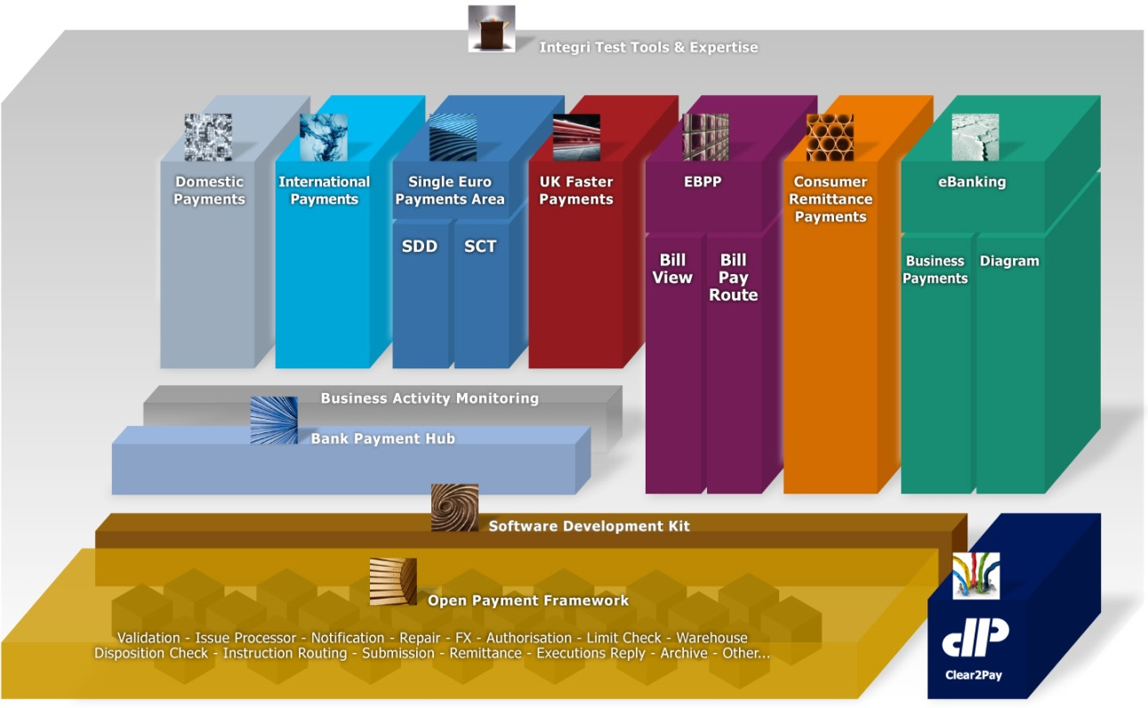
OPF – Open Payment Framework

Slide 63



What is the Open Payment Framework ?
Mission Statement
“OPF is a set of reusable and extensible components, frameworks and technical services for use by the Clear2Pay product development and project engagement teams who want to reuse, customize or extend Clear2Pay’s payments solutions.”
“Service-Oriented Payments”
Flexible and customisable to avoid reinventing the wheel
Delivered by:
“Customized Modules”
Customized
ORM
Customized
SDD
Custom
EBP
Custom
BAS
C2P Project Team
Admin
ORM
SDD
“Product Modules”
C2P Product Team
Open Payment Framework
C2P Core R&D Product Team

Slide 64
Why OPF ?
Maximize reusability of components, frameworks and services
Centralizing core code
Better product quality and improved company reputation for quality
Improve consistency across functional modules of the “standard” product and customization projects
Reduce effort to customize the OPF-based modules
Accelerating the overall time-to-market
Decrease overall support and maintenance overhead cost
SOA benefits

Slide 65


Decoupling
Process Manager from Technology Components
Open Payment Framework
Channels
Parsing
Service
Payment
Instruction
BPM
Orchestrated
Payment
Process Flow
Validation
Service
Enrichment
Service
OFAC / AML
Limit Check
Service
Payment
Repository
(Database)
Forex
Warehouse
Service
Liquidity
Service
Legend
Notification
Service
OFAC / AML
Third party component or service
Routing
Service
Validation
Service
C2P OPF
Business Service
Clearing &
Settlement
Systems
Submitter
Service
. . .

Slide 66
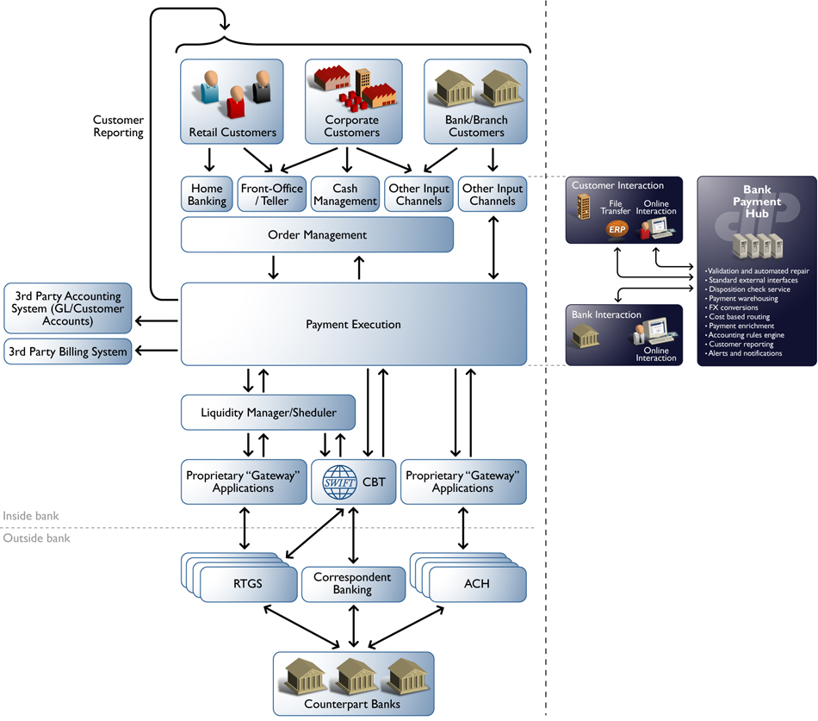
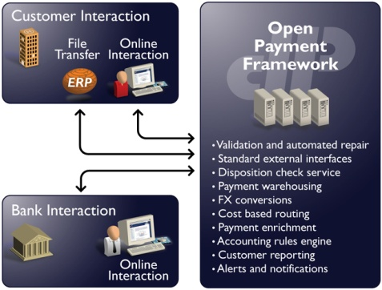
Example of OPF in a bank’s IT infrastructure

Slide 67





OPF -- Multi-Scheme
Multi-Product = Multi-scheme = Multi-PaymentType = Multi-team
SCT + SDD + XCT + UKFP + ... on a single OPF
Concept of “Scheme” : Instruction + Transaction
UKFP
ICT
Retail
EBK
Domestic
BP
OPF
SDD
Corporate
SCT
Rep.FI

Slide 68
Reference Implementation
An OPF reference implementation (RI) is built using the OPF stack of services.
Is an out-of-the-box application that can be deployed to a production site with minimal changes.
Makes use of BPEL orchestration using the Flow initiation service. BPEL helps an RI to choreograph various services to implement the desired business process.
Packed with UI rich features that bridges the gap between any back-end processing and front-end users.

Slide 69

OPF Reference Implementation
Re-use VisApp for customizing
visibility web application
- Re-use payment flows for
customizing flows
- Use SDK to extend
the product modules
.java
.xml
.bpel
Project Implementation
”Reference Implementation”
Reference Implementation:
- Working / Configurable product
- Example Code
- “OPF Project Workspace”
- Build & Deployment Scripts
VisApp
Payment
Flows
SDK
- Source code for
Struts Actions, Forms
- HTML, JSP, CSS
- Source .bpel for
default BPEL flow
- Sample source code
for customization
- Documentation
Pre-defined extension points
Public components
Extension
Points
Module Features & Functionality
Core product functionality
Technical Frameworks
Business Components /Services
Technical Services
EJB/POJO Interfaces, WSDL Interfaces, XML Config files, Property files
ORM (OPF-dependent Module)
Open Payment Framework

Slide 70
OPF Training - Functional Track
OPF – Business domain model

Slide 71

OPF – Business domain model
OPF data model based on ISO20022
OPF data model extended for xCT, in line with ISO20022
What is ISO20022?
Also known as UNIFI (UNIversal Financial Industry message scheme)
Is not a format of a single message, but it’s a messaging standard.
Registered with the ISO organization and Swift is assigned by ISO as the body that maintains the standard.
The standard consists of messages and a library of (standard) data components that are used in these messages

Slide 72
OPF – Business domain model
Why to use ISO20022 as a basis for the data model?
A global standard for payment transactions
Be able to retain information of almost any existing message format in a unified way
Eases conversion from one message format to another
Enables seamless SWIFT-MT, SWIFT-MX (ISO20022) co-existence

Slide 73
OPF – Business domain model
Extension strategy
Challenge is to support the different payments data requirements of different implementations without requiring different database schemas in each implementation
The payments details are generally written to the database and rarely updated. E.g. remittance information
Approach taken is to store payments details in XML format:
XML details: in general, information parsed from an incoming message or information used to format into an outgoing message
XML processing details: captures information during processing, required for later reference

Slide 74
OPF – Business domain model
Documentation:
Business domain model Document which provides models and descriptions of all entities
Data dictionary
All attributes in OPF-xCT-SEPA are identified by their specific attribute name, both for payment entities and so-called static data entities
Documented in the VSDK as distributions:
OPF data dictionary
xCT data dictionary
(containing the xCT extensions to OPF)
SEPA data dictionary
(containing the SEPA extensions to OPF)

Slide 75

Important OPF data model entities
Payment
Participant
Account
Exchange Condition
Exchange schedule and business calendars
Routing
Service, Product, Agreement
Accounting events and exchange reconciliation
Audit&History
Bank group, Bank, Department
Person, User, Role
Reference data

Slide 76
Important OPF data model entities
Payment
Participant
Account
Exchange Condition
Exchange schedule and business calendars
Routing
Service, Product, Agreement
Accounting events and exchange reconciliation
Audit&History
Bank group, Bank, Department
Person, User, Role
Reference data

Slide 77
Interchanges, Instructions, Transactions
Payments in general are stored and structured in OPF’s Payment Registry typically as Instructions and Transactions
When those payments are exchanged between parties via various channels other than online payment entry, the messages are formatted in Interchanges
The atomic entity is the Transaction, grouped in incoming or outgoing Instructions, which on their turn are grouped in an Interchange
Payment

Slide 78
Interchanges, Instructions, Transactions
Payment

Slide 79
Incoming & Outgoing Instructions / Interchanges
Payment

Slide 80
Instruction and Transaction groups
Instruction Groups and Transaction Groups exist in the data model but are only used by implementation teams when appropriate
Their sole purpose is to match closer with the format of the exchange files when this is of interest for the user
“Business” information that is stored at the level of those groups in the file format should be replicated in the Instruction and Transaction.
For instance, if the “Settlement Day” exists in the Instruction Group, it should be copied to all Instructions, because this is where OPF expects to find that information
Payment

Slide 81
Instruction and Transaction groups
Payment

Slide 82
Payment reconciliation
A Payment Reconciliation is a link between two payments entities that are related by business logic. For instance, upon successful reconciliation between an announcement (MT103) and a cover (MT202COV), a Payment Reconciliation is created to store the link between those entities.
Payment Reconciliation is required in two circumstances:
When a Payment Entity is received from an external party, and must be reconciled to an existing Payment Entity in the system.
When a Payment Entity is created by the system, and linked to another Payment Entity already existing in the system.
Payment

Slide 83
Payment reconciliation
Payment

Slide 84
Payment – classification, instruction type
Classification Indicates the nature of the transfer the Instruction or Transaction represents. Most important classifications:
Credit Transfer Initiation (CCTI): classification used for payments that are received from an initiating party. The classification is used to request movement of funds from the debit party account to a credit party. The classification is used for, for example, SWIFT MT101 and PAIN.001 messages.
(FI2FI Customer) Credit Transfer: classification used for payments exchanged between the debit party agent and credit party agent, directly or through other agents and/or a payment clearing and settlement system. It is used to move funds from a debit party account to a credit party. The classification is used for, for example, SWIFT MT103, MT102 and PACS.008 messages.
Financial Institution Credit Transfer: classification used for payments exchanged between a debit party financial institution to a credit party financial institution, directly or through other agents and/or a payment clearing and settlement system. It is used to move funds from a debit party account to a credit party, where both debit party and credit party are financial institutions. system. It is used to move funds from a debit party account to a credit party. The classification is used for, for example, SWIFT MT202 and PACS.009 messages.
Payment

Slide 85
Payment – parties and agents
OPF Bank Bank at which the Clear2Pay OPF system is running
Debit party (Trn) / Originating party (Instr; Customer Initiated Credit Transfer) Party that owes an amount of money to the credit party (50a)
Credit party (Trn) Party to which an amount of money is due (59a)
Ultimate debit party (Trn) Ultimate party that owes an amount of money to the (ultimate) credit party
Ultimate credit party (Trn) Ultimate party to which an amount of money is due
Initiating party (Instr) Party that initiates the payment
Debit party agent (Trn) / Originating party agent (Instr; Customer Initiated Credit Transfer) Financial institution servicing an account for the debit party (sender/52a)
Credit party agent (Trn) Financial institution servicing an account for the credit party (receiver/57a)
Payment

Slide 86
Payment – parties and agents
Intermediary agent (Trn) Financial institution between the debit party agent and credit party agent (56a)
Instructing Agent (Instr) / Sending party (Intchg) Agent that instructs the next party in the chain to carry out the payment (sender)
Instructed Agent (Instr) / Receiving party (Intchg) Agent that is instructed by the previous party in the chain to carry out the payment (receiver)
Forwarding Agent (Instr) Financial institution that receives the instruction from the initiating party and forwards it to the next agent in the payment chain for execution.
Payment
Notes:
Instructing Reimbursement Agent (Instr) Agent through which the instructing agent will reimburse the instructed agent (53a)
Instructed Reimbursement Agent (Instr) Agent at which the instructed agent will be reimbursed (54a)
Third Reimbursement Agent (Instr) Agent at which the instructed agent will be reimbursed (55a)
Previous Instructing Agent (Instr) Agent immediately prior to the instructing agent (:72:/INS)

Slide 87
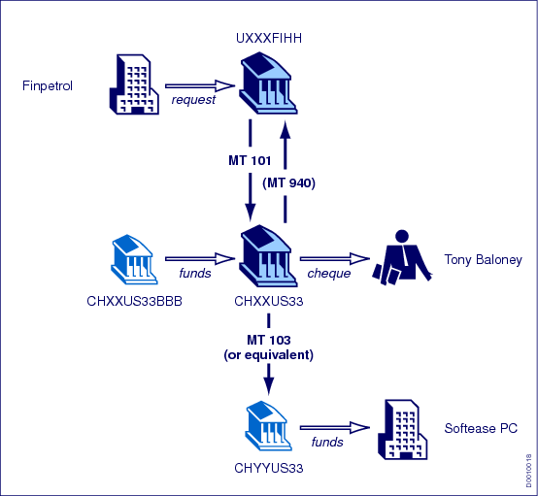
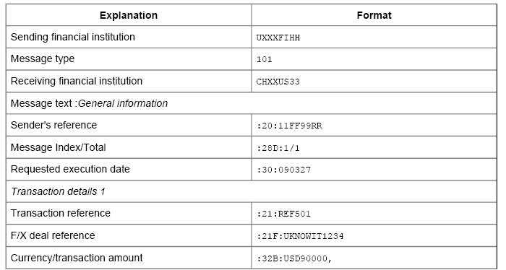
Payment – parties and agents (map MT101)
Originating Party
Sending party
Debit party
Instructing agent
OPF Bank
Receiving party
Instructed agent
Originating Party Agent
Debit party agent
Credit party agent
Credit party
Interchange
Instruction
Transaction
Payment

Slide 88
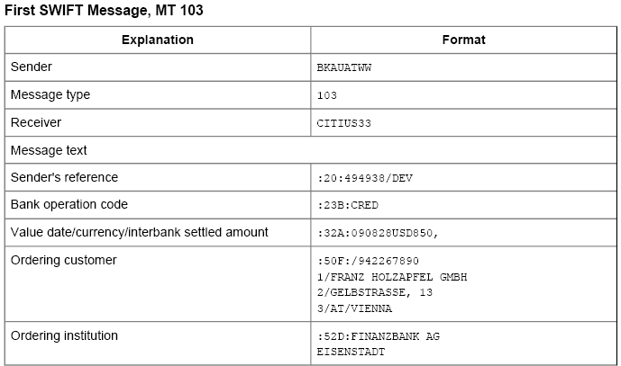
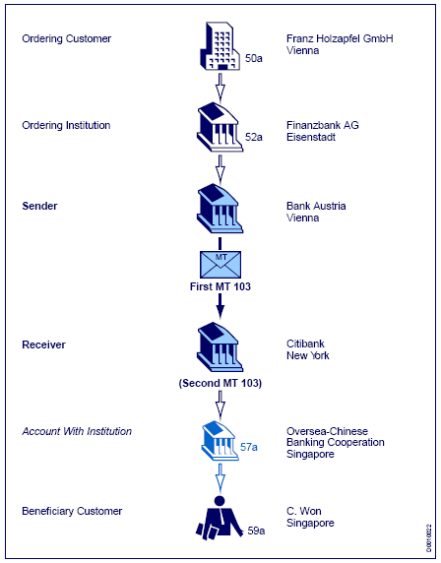
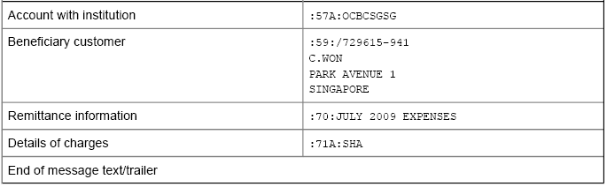
Payment – parties and agents (map MT103)
Debit party
Debit party agent
Sending party
Instructing agent
OPF Bank
Receiving party
Instructed agent
Interchange
Credit party agent
Instruction
Transaction
Credit party
Payment

Slide 89
Payment – parties and agents
Party details (1/3)
Type, Id, Id Type, Id Issuer A party can be identified by an “Id” (e.g. “123-456-7890”) of a certain “Id Type” (e.g. BICorBEI) of a certain “Type” (e.g. Private), issued by an “Id Issuer” (e.g. Belgium):
Examples “Id Type”: SEPA, BICorBEI etc.
Possible values “Type”: Private, Organisation
Name & Adress
Structured:
name, street name, building number, postal code, city, state, country
Semi structured:
name, address line 1-2, City, Postal Code, Country
Unstructured:
name, address line 1-3
Payment

Slide 90
Payment – parties and agents
Party details (2/3)
Account, Account Id Type A party can have an “Account” (e.g. BE28001390079920) of a certain “Account Id Type” (e.g. “IBAN”):
Possible values “Account Id Type”: “BBAN”, “IBAN”, “UPIC”, “Proprietary”
Payment

Slide 91
Payment – on-us, outbound, from-us
Outbound vs. Inbound
Outbound and inbound indicate the “direction” of received payments (Instructions) from the OPF Bank point’s of view.
Outbound means that the payment originates from the OPF Bank (from a bank’s customer or bank’s internal department and other such examples).
Inbound means that the payment originates from another party than the OPF Bank (from a correspondent bank or clearing system and other such examples).
On-us vs. Not on-us
On-us and not on-us indicate the “direction” of a routed payment (transaction) from the OPF Bank point’s of view.
On-us means that the payment is routed to the OPF Bank (intended for a bank’s customer or bank’s internal department and other such examples). The destination account is in the bank’s books.
Not on-us means that the payment is routed to another party than the OPF Bank (to a correspondent bank or clearing system and other such examples). The destination account is not in the bank’s books.
Payment

Slide 92

Payment – on-us, outbound, from-us
Outbound
Inbound
Customer
channel
Small Company
Debit Party
Clarity Bank Belgium
Debit Party Agent
(OPF Bank)
Clearing system
World Company
Credit Party
On-us
Not on-us
Payment

Slide 93


Payment – on-us, outbound, from-us
From-us vs. Not from-us
Indicates for a customer credit transfer initiation (MT101), whether the OPF Bank is the debit party agent of the payment (from-us) or not (not from-us)
From-us payments are “processed” by the OPF Bank
Not from-us payments are forwarded to the debit party agent (relay scenario)
World Company,
Spain
Debit Party
SWIFT
Gateway
World Company,
Belgium
Initiating Party
Clarity Bank Belgium
Forwarding Agent
(OPF Bank)
Big Bank Spain
Debit Party Agent
Credit Party Agent
Fashion Inc
Credit Party
MT101
MT101
Not from-us
Payment

Slide 94
Payment – instructed vs. settlement day
Instructed day Day at which the party initiating a credit transfer initiation requests the OPF Bank to process the payment (equivalent of the SWIFT-MT101’s field 30)
Settlement day Day on which the amount of money ceases to be available to the party that owes it and when the amount of money becomes available to the party to which it is due:
Incoming settlement day: settlement day applicable at the incoming side (debit side for credit transfers) (*)
Outgoing settlement day: settlement day applicable at the outgoing side (credit side for credit transfers) (**)
(*) PaymentInstruction.settlementDay, PaymentTransaction.incomingSettlementDay
(**) PaymentTransaction.settlementday
Payment

Slide 95
Payment – amounts
Instructed amount Amount of money to be moved between the debit party and credit party, before deduction of charges, expressed in the currency as ordered by the initiating party (equivalent of the SWIFT-MT101’s field 32B, if no equivalent amount used)
Equivalent amount Amount of money to be moved between the debit party and credit party, expressed in the currency of the debit party's account (*), and the currency in which the amount is to be moved (**)
(*) PaymentTransaction.equivalentAmount
(**) PaymentTransaction.equivalentAmountCurrencyOfTransfer
Settlement amount Total amount of money settled between a party and the OPF Bank:
Incoming settlement amount: settlement amount settled at the incoming side (*)
Outgoing settlement amount: settlement amount settled at the outgoing side (**)
(*) PaymentInstruction.settlementDay, PaymentTransaction.incomingSettlementDay
(**) PaymentTransaction.settlementday
Payment

Slide 96
Payment – references
Display ids The system assigns a so-called “display id” to each payment entity (Interchange, Instruction, Transaction) it creates. A display id is a unique identifier generated by the system in a human-readable format, and that can be used on the UI and in the content of the submitted payment.
Interchange reference Point to point reference assigned by the sending party and sent to the next party in the chain to unambiguously identify the interchange.
Interchange MIR/MOR (xCT) SWIFT’s Message Input Reference (MIR) and Message Output Reference (MOR) as received in an incoming SWIFT MT message.
Interchange Message user reference (xCT) SWIFT’s Message User Reference (MUR) as received from an incoming SWIFT MT message or provided in a submitted SWIFT MT message. For outgoing messages the reference is taken from the Interchange’s display id.
Payment

Slide 97
Payment – references
Instruction reference Point to point reference assigned by the instructing party and sent to the next party in the chain to unambiguously identify the instruction.
Transaction’s instructing agent transaction id Point to point reference of the Transaction passed by the instructing agent/party, and that should be unique per instructing agent/party. The Transaction has both an incoming and outgoing instructing agent transaction id.
Transaction’s first instructing agent transaction id Unique identification assigned by the first instructing agent to unambiguously identify the transaction and passed on, unchanged, throughout the entire interbank chain.
Transaction’s end to end id Unique identification assigned by the initiating party to unambiguously identify the transaction. This identification is passed on, unchanged, throughout the entire end-to-end chain.
Payment

Slide 98
Payment – other information
Scheme Indicates the scheme under which the Transaction is processed. A scheme has a specific set of rules linked to it, which results in a different behavior in the various OPF services. Possible values of scheme are: ICT, SDDCORE, SDDB2B, SCT and other such schemes.
Settlement method Method used to settle the payment. Possible values are:
Clearing (CLRG): Settlement is done through a payment clearing system.
Cover Method (COVE): Settlement is done through a cover payment.
Instructed Agent (INDA): Settlement is done by the agent instructed to execute a payment instruction (serial method).
Instructing Agent (INGA): Settlement is done by the agent instructing and forwarding the payment to the next party in the payment chain (serial method).
Debit – credit indicator Indicates if a Transaction is a debit ("D") or credit ("C"). E.g. a credit transfer is a credit (the destination account will be credited), a direct debit is a debit.
Exchange rates, Code words, Cheque information, Remittance information...
Payment

Slide 99
Important OPF data model entities
Payment
Participant
Account
Exchange Condition
Exchange schedule and business calendars
Routing
Service, Product, Agreement
Accounting events and exchange reconciliation
Audit&History
Bank group, Bank, Department
Person, User, Role
Reference data

Slide 100
Participant
Participant
A participant is a party who the OPF Bank has an agreement (*) with to process payments.
The Participant can be:
An external Financial Institution: correspondent banks, represented banks, or an agent receiving or sending payments on behalf of one of those
A clearing system
An external non Financial Institution that acts on behalf of a Financial Institution: a Data Processor, a Cheque Printer, …
An Accounting Management System
An “Order Management-type” System
A customer of the OPF Bank
(*) The agreement that exists is not necessarily modeled as an entity in the Business Data Model,
but it exists it the real world.
Participant

Slide 101
Participant
Participant
Notes:
Show Participant BVA

Slide 102
Clearing, Business, Settlement participant
OPF can make the distinction between Clearing, Business and Settlement Participant.
In simple schemes, this distinction is not necessary. Clearing Participant = Business Participant = Settlement Participant
In more complex schemes, it is required.
For instance, Bank A could designate a Payment Processor to which the payments should be sent for Clearing. The Payment Processor will be called the Clearing Participant.
The same Bank A could designate a Central Institution with which Settlement could occur. The Central Institution will be called the Settlement Participant.
Bank A will be called the Business Participant.
To cope with that, OPF supports “Delegation”:
Clearing Delegation
Settlement Delegation
Participant

Slide 103
Clearing, Business, Settlement participant
An Exchange Condition can “delegate” the submission or reception of files to another Participant
This is the case when the Participant that owns the Exchange Condition wants to use another Participant as intermediary between him and the system.
This intermediary Participant also has one or several Exchange Conditions, and one of these Exchange Conditions could specify that a third Participant must be used as intermediary.
Up to 4 delegations are supported, but customization teams may add more if needed.
Participant

Slide 104
Clearing, Business, Settlement participant
A Participant can “delegate” the settlement to another Participant
For instance, to a Central Institution
Or to another subsidiary with a Bank Group
The delegation can be repeated.
Participant

Slide 105
Clearing, Business, Settlement participant
A payment can potentially be linked to six Participants
Incoming Business Participant The previous Agent in the payment processing chain that sent the Transaction to the Financial Institution running the system, either directly (in which case it is the same as the Clearing Participant) or indirectly (in which case the Clearing Participant is the intermediary)
Incoming Settlement Participant The Participant with which the exchange of funds is settled on the incoming side
Incoming Clearing Participant (via a Clearing Condition) The Participant that delivered the Payment Interchange to the system
Outgoing Business Participant The Participant that represents the next Agent in the payment processing chain (in the routing algorithm, this typically the first Participant found, before following any “delegation” link)
Outgoing Settlement Participant The Participant with which the exchange of funds is settled on the outgoing side
Outgoing Clearing Participant (via a Clearing Condition) The Participant to which the system delivers the Payment Interchange
Participant

Slide 106
Clearing, Business, Settlement participant
Incoming Side
The Payment Interchange is linked to the Exchange Condition that was used to receive the file -> “incoming Clearing Condition”
The (incoming) Payment Instruction is linked to the (Incoming) Business Participant and an (Incoming) Settlement Participant. Dedicated services will determine the Business and Settlement Participants
Participant

Slide 107
Clearing, Business, Settlement participant
Outgoing Side
After the Routing Service, a Transaction is linked to
The “Outgoing Clearing Condition” that will be used to submit it
A “Business Participant” that represents the Participant with which the Bank has an agreement to process this transaction
A “Settlement Participant” that represents the party with which this transaction must be settled.
Participant

Slide 108


Clearing, Business, Settlement participant
Example clearing delegation
Bank cheque
print
Bank cheque printer
Outgoing Clearing
Participant
World Company,
Belgium
Debit Party
Clarity Bank Belgium
(BANKBEBB)
Debit /Credit Party Agent
(OPF Bank)
JPMC, UK (CHASGB2L)
Outgoing Business Participant
Outgoing Settlement Participant
MT101
(23:CHQB)
MT110

Slide 109
Clearing, Business, Settlement participant
Example settlement delegation
VOSTRO
HSBC
D
C
X
AMS
Outgoing Clearing Participant
Outgoing Settlement Participant
Banco Santander, Spain
(BSCHESMM)
Debit Party (Agent)
Clarity Bank Belgium
(BANKBEBB)
Credit Party Agent
(OPF Bank)
HSBC Hong Kong
(HSBCHKHHHKH)
Credit Party
Outgoing Business Participant
MT202
MT910

Slide 110
Break 1

Slide 111
Important OPF data model entities
Payment
Participant
Account
Exchange Condition
Exchange schedule and business calendars
Routing
Service, Product, Agreement
Accounting events and exchange reconciliation
Audit&History
Bank group, Bank, Department
Person, User, Role
Reference data

Slide 112
Account
Account In banking, an Account is typically defined as “the formal record of transactions of a particular type expressed in money and maintained in a ledger”. Following kinds of accounts are kept in the OPF system:
Account (Processing Account) An Account can be specified in a Participant’s (Processing)Agreement so that payments “using” the account are processed within the terms of that Agreement.
AMS Account “Mirror” of the AMS accounts. Used specifically for disposition check purposes.
Settlement Account (xCT) A settlement account is a specific purpose account used to post debit and credit entries as a result of the payment. A Participant can have mutliple settlement accounts defined. E.g. Mirror-NOSTRO account of the OPF Bank’s USD Correspondent Bank.
Internal Account (xCT) OPF Bank’s internal account (G/L accounts)
Account

Slide 113
Important OPF data model entities
Payment
Participant
Account
Exchange Condition
Exchange schedule and business calendars
Routing
Service, Product, Agreement
Accounting events and exchange reconciliation
Audit&History
Bank group, Bank, Department
Person, User, Role
Reference data

Slide 114
Exchange Condition
Exchange Condition
An Exchange Condition is a set of attributes that describe how files are sent/received files to/from a Participant.
Typical attributes: format, grouping rules, destination code, submission queues, …
An Exchange Condition can apply to incoming or outgoing files (or both):
An incoming Exchange Condition will typically be used to validate a received file.
An outgoing Exchange Condition will typically be used to route and submit the file.
Exchange Conditions are linked to Exchange Schedules to determine when submission occurs.
Exchange Condition
Notes:
Show Exchange Condition BVA

Slide 115
Exchange Condition
Exchange Condition
A Participant is linked to 0, 1 or more Exchange Conditions.
An Exchange Condition is always linked to one Participant
Exchange Condition
Notes:
Stop Point: Show on BVA

Slide 116
Important OPF data model entities
Payment
Participant
Account
Exchange Condition
Exchange schedule and business calendars
Routing
Service, Product, Agreement
Accounting events and exchange reconciliation
Audit&History
Bank group, Bank, Department
Person, User, Role
Reference data

Slide 117
Exchange schedule & Business Calendars
Exchange schedule An Exchange Schedule is used to determine when transactions resorting to an Exchange Condition must be exchanged between the system and the Participant.
Exchange schedule and business calendars

Slide 118
Exchange schedule & Business Calendars
Business Calendar A Business Calendar defines business and non-business days for the entities it is “linked” to:
An Exchange Condition may be linked to a “Submission” Calendar
A Participant may be linked to a “Settlement” Calendar
A Bank maybe linked to the “Bank’s” Calendar
A Currency maybe linked to the “Currency” Calendar (attribute on Calendar)
Exchange schedule and business calendars
Notes:
Stop Point: Show on BVA

Slide 119
Important OPF data model entities
Payment
Participant
Account
Exchange Condition
Exchange schedule and business calendars
Routing
Service, Product, Agreement
Accounting events and exchange reconciliation
Audit&History
Bank group, Bank, Department
Person, User, Role
Reference data

Slide 120
Routing
Routing
Routing is the process by which the destination of a received payment is found
Routing must assign each Transaction an Outgoing Clearing Condition
Routing will also assign an Outgoing Business Participant and an Outgoing Settlement Participant
Routing determines whether a Transaction is on-us or not on-us
Routing relies on an ordered list of “Routing Rules”, which can be of two types
“Criteria Based”: certain attributes of the Transaction are compared with attributes of the Exchange Condition. If all criteria matched, the Transaction is routed to the Exchange Condition. For instance: Currency, Maximum Amount, Destination Bank Code, …
“Algorithm Based”: the Routing Rule consists of code developed by customization team, which, for a Transaction received as parameter, will return the Outgoing Clearing Condition.
Each Routing Rule is evaluated up until a Clearing Condition is found
Routing

Slide 121
Routing
Participation Directory
A Participation Directory is a list of agent codes that the attached entity (EC) represents in the system.
If the Participant is a clearing house, the Participation Directory lists all the bank codes of the banks that can be reached (= are participants) via this clearing house.
If the Participant is a bank, the Participation Directory lists all the banks that are represented by this bank
Participation Directory is to be used as a Criteria of a Routing Rule.
The Criteria would say something like: Destination BIC must be listed in Participation Directory linked to the Exchange Condition
Routing
Notes:
Stop Point: Show on BVA

Slide 122
Important OPF data model entities
Payment
Participant
Account
Exchange Condition
Exchange schedule and business calendars
Routing
Service, Product, Agreement
Accounting events and exchange reconciliation
Audit&History
Bank group, Bank, Department
Person, User, Role
Reference data

Slide 123
Service – Product – Agreement
Service An OPF Bank, can offer various services to their Participants. These Services are defined per Bank Group. From a high level, those services can be categorized as:
Processing Service: service related to the ‘processing’ of payments. E.g. “currency conversion” and other such processing services.
Visibility Service: service related to ‘visibility’ access. E.g. “manual entry” (order management)
Product A product is a collection of Services offered as a Product by an OPF Bank to its Participants. Products are defined per Bank. Products can be categorized as:
Processing Product: product related to the ‘processing’ of payments. E.g. “International Credit Transfer - Customer Initiation – CorpDirect” which is a product offered by the OPF Bank to corporates (identified via processing accounts) to send in SWIFT MT101 messages.
Visibility Product: product related to ‘visibility’ access.
Service, Product, Agreement

Slide 124
Service – Product – Agreement
Agreement An Agreement details a Participant’s use of a Product. Agreements are defined per Participant. Agreements can be categorized as:
Processing Agreement: Agreement related to the ‘processing’ of payments. E.g. “International Credit Transfer - Customer Initiation – CorpDirect - Gold”. The Participant which has the agreement has better conditions in terms of currency conversion and charges than the related product.
Visibility Agreement: Agreement related to ‘visibility’ access.
Service, Product, Agreement

Slide 125
Service – Product – Agreement
Service Attributes Attributes that define settings and constraints in relation to a Service supported by the OPF:
Processing Service Attributes
Visibility Service Attributes
Product Service Attributes Service Attributes can be overridden on Product level. These are referred to as Product Service Attributes. These attributes define how a Service will be utilized / applied for a given Product:
Processing Product Service Attributes
Visibility Product Service Attributes
Agreement Service Attributes Service Attributes can be overridden on Agreement level. These are referred to as Agreement Service Attributes. These attributes define how a Service will be utilized / applied for a given Agreement:
Processing Agreement Service Attributes
Visibility Agreement Service Attributes
Service, Product, Agreement

Slide 126
Service – Product – Agreement
Service, Product, Agreement
Notes:
Stop Point: Show on BVA

Slide 127
Important OPF data model entities
Payment
Participant
Account
Exchange Condition
Exchange schedule and business calendars
Routing
Service, Product, Agreement
Accounting events and exchange reconciliation
Audit&History
Bank group, Bank, Department
Person, User, Role
Reference data

Slide 128
Accounting events & exchange reconciliation
Accounting event
Representation of the fact that one or more accounting entries must be created as a result of a step in the processing of a Payment Transaction or Instruction.
Contains contextual information about the event that requires an Accounting Entry to be created, such as an Event Code, a Payment Transaction Id, etc.
Does not contain the details of the Accounting Entry itself.
Accounting events and exchange reconciliation

Slide 129
Accounting events & exchange reconciliation
Exchange Event An Exchange Event records the exchange of a payment or group of payments with a Clearing Participant, or with an internal partner (for instance, the BVA).
Accounting events and exchange reconciliation

Slide 130
Accounting events & exchange reconciliation
Exchange Reconciliation
Replaces the concept of “Position keeping”.
Is based on Exchange Events:
When Payments are received, an “incoming” Exchange Event is created
When Payments are sent, an “outgoing” Exchange Event is created
By comparing “Incoming” Exchange Events and “Outgoing” Exchange Events for a specific day, one can make sure no payment was “lost” (so called “water-tightness”)
By summing Exchange Events for a specific Participant, one can know how many payments were received or sent to that Participant. It can be used to facilitate the end-of-day reconciliation.
Accounting events and exchange reconciliation

Slide 131
Important OPF data model entities
Payment
Participant
Account
Exchange Condition
Exchange schedule and business calendars
Routing
Service, Product, Agreement
Accounting events and exchange reconciliation
Audit&History
Bank group, Bank, Department
Person, User, Role
Reference data

Slide 132
Audit & History
Audit
Audit event
A list of Functions (actions and events) that require a historical record to be captured for audit purposes in Audit Record.
The action or event may be executed by a Person or by an automated process or service.
Audit record
The specific record capturing the history for an Audit Event.
Capture the timestamp and User who initiated the action.
For CRUD functions, this will capture the changes to each field.
History A history (audit trail of all details) of state changes for a payment interchange, payment instruction or payment transaction.
Audit&History
Notes:
Stop Point: Show on BVA

Slide 133
Important OPF data model entities
Payment
Participant
Account
Exchange Condition
Exchange schedule and business calendars
Routing
Service, Product, Agreement
Accounting events and exchange reconciliation
Audit&History
Bank group, Bank, Department
Person, User, Role
Reference data

Slide 134
Bank group, Bank, Department
Bank group A Bank Group is a group of Banks or other Financial Institutions that are members of a common group or corporation. For example:
A Multinational Bank that has banking licences and operations in a number of different countries
A Financial Services Group that consists of a group of Financial Institutions that operate together on a local, national or multinational basis to provide a broad range of financial services
Bank A Bank is a type of Financial Institution that holds a license to provide banking services within a certain jurisdiction (e.g. within a country or state).
Department A Bank will have many Bank Departments which could represent Branches, Departments, Organizational Units, and so on.
Bank group, Bank, Department

Slide 135
Bank group, Bank, Department
Bank group, Bank, Department
Notes:
Stop Point: Show on BVA

Slide 136
Important OPF data model entities
Payment
Participant
Account
Exchange Condition
Exchange schedule and business calendars
Routing
Service, Product, Agreement
Accounting events and exchange reconciliation
Audit&History
Bank group, Bank, Department
Person, User, Role
Reference data

Slide 137
Person, User, User Role
Person
The OPF is accessible by human beings i.e. a Person on behalf of a Bank Department or Participant:
A Person representing a Bank will access the OPF via the BVA
A Person representing a Participant will access the OPF via the CVA
A Person will have a single physical login
A Person can have multiple Users assigned (i.e. Bank or Customer User)
User
Bank User A Bank User is a Person that uses the OPF on behalf of a Bank Department
Customer User A Customer User is a Person that uses the OPF on behalf of a Participant
Person, User, Role

Slide 138
Person, User, User Role
User Role
Bank User Role Defines the Data that users of the role may access, together with the Bank Functions they may perform on that data. These data and function permissions are defined using Bank Function Access Profile and Bank Data Access Profile.
Customer User Role Customer Roles are used to define the access permissions for CVA functions and data that Customer users may use for a particular Participant.
Person, User, Role

Slide 139
Person, User, User Role - Authorizations
Function Access Profile (FAP) : The functions and actions that a role is allowed to perform.
Data Access Profile (DAP) : the data on which the role can perform the actions defined by his FAPs.
Person, User, Role
Notes:
Stop Point: Show on BVA

Slide 140
Important OPF data model entities
Payment
Participant
Account
Exchange Condition
Exchange schedule and business calendars
Routing
Service, Product, Agreement
Accounting events and exchange reconciliation
Audit&History
Bank group, Bank, Department
Person, User, Role
Reference data

Slide 141
Reference data
Country – ISO 3166 , SWIFT_CT
Currency – ISO 4217 , SWIFT_CU
BIC / IBAN Directory – ISO 9362 / 13616 (SWIFT)
Calendar *
...
Reference data

Slide 142
OPF Training - Functional Track
OPF features

Slide 143

xCT / OPF product features
xCT – International and domestic collections and transfers
Updated
Updated
Parser/Formatters
(SWIFT MT, MX)
Foreign Exchange
Charges
Billing
PDE/PDM Duplicate
check
Updated
Updated
Auto-enrichment
Code word
processing
E&I
Cancellation
PSSM
(ACK/NAK Mgt.)
On-us FI Credit
Transfers
Updated
Updated
Updated
Serial - Cover
Manual entry
(Payments )
Bank cheque
requests
Y-copy
Settlement day
Determination
& Validation
New
Updated
Request for Transfer
PSD
determination
SSI Enrichment
Volume & value
thresholds
Accounting
(Accounting Entries)
OPF – Open Payment Framework
Updated
Routing
Disposition check
Intra bank group
transfer
Duplicate check
Accounting
(Accounting events)
Endorsement
Warehousing
Updated
Work List Items
Work Queues
Audit & History
framework
Exchange Events
Determine inc.
Bus./Settl. Part.
Submission
User/Bank
Administration
Interchange loader
Reject
Updated
New
New
New
New
Approval
Repair
4-Eye Verification
Risk filter
FATF 16
validation
Dashboard
Parameter
framework

Slide 144
OPF Training - Functional Track
OPF Features - Endorsement

Slide 145
Endorsement framework
Endorsement framework
Validation by a second user of an action taken on a “static data entity” (e.g. Bank) by a first user
Provides functionality to generate endorsement events when a User performs an action on an endorsable entity
Manages endorsement events while they await approval by a User
Examples of static data entities for which endorsement can be setup:
Bank
Bank User Role
Business Calendar
Participant
Exchange condition
Products
...

Slide 146
Endorsement framework
Endorsement framework
Endorsement activation depends on a configuration file setup:
Either all entities or no entities require endorsement
Setup is done on the level of Bank Group
Actions that trigger the creation of an endorsement event are:
Creation of an entity
Update to an entity
Activation of an entity
Suspension of an entity
Deletion of an entity

Slide 147
Endorsement framework
Endorsement framework
For each endorsement audit records, capturing the modifications made by the User, are created
The default behaviour for endorsement is to hide the modified details from the user until endorsement is done successfully
Each instance of an endorse-able entity has an endorsement status:
Pending endorsement for Modification
Pending endorsement for Deletion
Pending endorsement for Creation
Pending endorsement for Suspension
Pending endorsement for Activation
No Endorsement outstanding
Only a single active endorsement event can be pending against an entity

Slide 148
Endorsement framework
Endorsement framework
Can enforce endorsement in a hierarchical manner i.e. where a parent/child relationship exists. E.g. Agreements cannot be endorsed before the related Participant has been endorsed
Endorsement can be:
Approved:
Audit record created
Endorsement event removed
Endorsement status set to No Endorsement outstanding
Applies the modification
Declined:
Audit record created
Endorsement event removed
Endorsement status set to No Endorsement outstanding
Notes:
Stop Point: Show on BVA

Slide 149
OPF Training - Functional Track
OPF Features - Audit & history
Notes:
-

Slide 150
Audit framework
Audit framework
Allows recording of 'business' actions performed by a user with the visibility applications such as the BVA or CVA
Provides a way to provide a trace of user initiated actions:
Searches
Views
Creations
Updates
Deletions
Suspensions
Enablement
Endorsements
Authorizations
Approvals
Repairs
Declinations
Password changes
Logins / logouts
…

Slide 151
Audit framework
Audit framework
Properties captured for the audit records are:
The timestamp when the action was performed (e.g. view, search, create)
The entity the action was performed on (e.g. Instruction) – the ‘primary entity’
The entity that owns the primary entity – the ‘owning entity’ (Bank Group, Bank, Department, Participant)
The unique identifier of this entity within the system
Remote IP Address
User session id
User identifier
Person identifier
The values that were modified or used in a query
Allows any entity to be audited

Slide 152
Audit framework
Audit framework
Possible to define specific messages for each auditable action:
Allows each message to accept parameters so that variables can be part of the audit message e.g. changed values, identifiers for the entity
Allows each message to be localised
Allows the Visibility Applications to display an audit message for an audit event that is relevant for users of the Visibility Application
Summary and detail level message may be defined per event audited
For each entity that can be updated, detail audit messages are defined at the field level to capture the previous value and the value overwriting this previous value

Slide 153
Audit framework
Audit framework
The specific entities and actions to audit are defined as part of the configuration of the framework
The message text for each auditable event per entity is defined as part of configuration
For updates to existing entities, delta comparisons are done to determine which attributes have been modified; The entities and their attributes to perform this delta comparison on must be defined as part of configuration

Slide 154
History framework
History framework
Provides a means to capture changes that occur in the system to payment (Interchange, Instruction, Transaction) related information
Via history records which are captured in the database
Properties captured for the history records are:
The timestamp when the action was performed (e.g. view, search, create)
The unique identifier for the payment related entity within the system (e.g. Interchange key, Instruction key)
Remote IP Address
User session id (if initiated by a user)
The user identifier (if initiated by a user)
The person identifier (if initiated by a user)
The values that were modified or used in a query

Slide 155
History framework
History framework
Possible to define specific messages for each action performed on a payment entity:
Allows each message to accept parameters so that variables can be part of the history message e.g. changed values, identifiers for the entity
Allows each message to be localised
Allows the Visibility Applications to display a history message
The message text for each history event is defined as part of configuration
For updates to existing entities, delta comparisons are done to determine which attributes have been modified; The entities and their attributes to perform this delta comparison on must be defined as part of configuration
Notes:
Stop Point: Show on BVA via Payment

Slide 156
OPF Training - Functional Track
OPF Features - Accounting Events

Slide 157
Accounting
Accounting events
OPF
OPF generates accounting events.
E.g. in plain English: “One instruction executed on acc. nr. 01020304; amount is 12345 EUR; event code is XYZ”
The static rules held by OPF allow it to determine the account number to use in the Acc. Event as well as the event code to be used.
Accounting Service
Basic rules
Accounting Submitter
Accounting Event (XML)
‘Intelligent’ Core Accounting System
Interpretation (transforming events into entries)
Accounting scheme
The accounting event generated by OPF is interpreted by the Account Management System (AMS).
Based on the event code provided by OPF, and on its own rules (the accounting scheme), the AMS transforms the Accounting Event into actual balanced postings
Postings to accounts
100
80
20

Slide 158
Accounting
Functional flow
Parser
Incoming Interchange flow
EVENT 1
DR
Account = Txn.originatingPartyAccount
Amount = Ixn.InstructedAmount
Incoming CCTI Instruction flow
Incoming FI2FI CCT
Accounting event
Accounting event
CCT Not on-us flow
CCT On-us flow
Not on-us submission
On-us submission
EVENT 2
CR Account = Txn.originatingPartyAccount
Amount = Ixn.InstructedAmount
Accounting event
Accounting event
Notes:
Stop Point: Show on BVA via Accounting Tab

Slide 159
OPF Training - Functional Track
OPF Features - Work List Items & work queues

Slide 160
Work List Items & work queues
Work list items
Represent a task which needs to be performed by a user
To minimize the risk of two users working on the same item at the same time
Two types of Work list items:
Informational work list item: no “action” (e.g. Manual repair of a routing failure) relates to it. Required to inform the user (e.g. Time-out after which an announcement has not been reconciled reached)
Non-informational work list item: an “action” is related to it.
Work queues
Group Work list items in “buckets”
Users assigned to Work Queues
Candidates for future enhancements
Auto-assign Work List Items to Work Queues

Slide 161
Work list items
Actions that can be taken on a Work list item, depending on their status, are:
Claim
Action taken if a user wants to work on the (task related to the) Work list item
Assigned to the user who claimed it
For non-informational work list items, the user is redirected to the screen where the action has to be taken (e.g. to the instruction’s action tab for approval of a possible duplicate instruction failure)
Re-claim
Similar to the claim action
Used in case a user was assigned to the item and a user wants to claim it

Slide 162
Work list items
Release
Action taken if a user decides not to work further on a Work List Item.
The Work list item is no longer assigned to the user
Complete
Action taken if a user finished the task related to the Work List Item:
Automatically completed by the system
Manually completed by a user
Notes:
Stop Point: Show via IP

Slide 163
OPF Training - Functional Track
OPF Features - Interchange Loader

Slide 164
Interchange loader
Interchange Loader
Purpose is to provide a means to load raw payment related data from a channel:
Creates an Interchange
Stores “transport data”
Determines the: Bank Group, Bank and incoming Clearing Condition
Once raw data has been captured completely the Interchange Loader can notify, asynchronously, an implementation of the Parsing Service
If during Interchange loader process anything goes wrong:
The system cannot send a NAK message, since the content of the message is not even read
A ‘technical alert/error’ can be logged, which can be captured by alert systems like Tivoli.

Slide 165
Interchange loader
Interchange Loader
Two “flavours”:
Meta data (Bank group, Bank, Exchange condition) provided along with the message or file (i.e. Interchange loader used to load SWIFT MX messages in xCT)
Meta data derived from the message or file (i.e. Interchange loader used to load SWIFT MT messages in xCT)

Slide 166
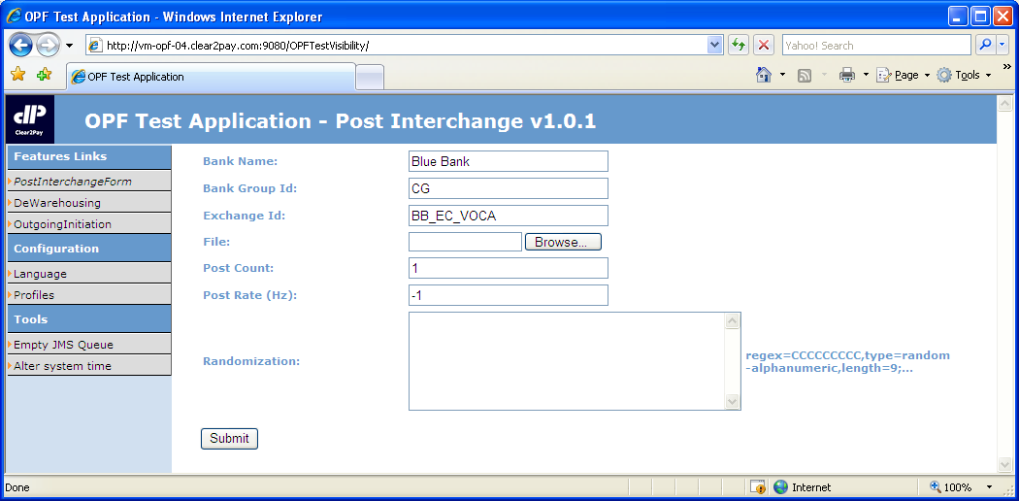
Interchange loader - demo
Interchange Loader – meta data provided
Bank Name
Bank Group Id
Exchange Id
Notes:
Open the Test Visibility Application: http://[server name]:9080/OPFTestVisibility
- Show the PostSwiftInterchangeForm
- Show the Bank’s Bank Name, Exchange Condition’s external id to point out the info the meta data is compared against

Slide 167
Interchange loader
Interchange Loader – meta data derived (i.e. SWIFT messages)
Bank group derived from the Bank, assuming the Bank is uniquely identified within the system
Bank determined by comparing:
Receiving party in block 1 or 2 of the SWIFT message (BIC11 or BIC8)
Bank’s external id

Slide 168
Interchange loader
Exchange Condition of the Bank by comparing:
If present, the Copy Service Code (tag 103) in block 3 of the SWIFT Message (BIC11 or BIC8)
Exchange Condition’s copy service code
Else, Sending party in block 1 or 2 of the SWIFT message
Exchange Condition’s external id
If still not found, Exchange Condition with external id “SWIFTGATEWAY” (e.g. for announcement messages)

Slide 169
OPF Training - Functional Track
OPF Features - Parser and Formatter

Slide 170
Parser/formatter
Parser
Component which reads a message’s raw data, transforms it and retains it in the OPF internal data model
Upon failure of the parser, the complete interchange will be rejected:
Since the interpretation of the message failed, the already read data is not trustworthy.
Makes it difficult to reply in an automated way.
A ‘technical alert/error’ can be logged, which can be captured by alert systems like Tivoli.
Formatter
Component which reads the relevant data from the OPF internal data model, transforms it and creates a message
Part of the submission framework:
The submission service will create an outgoing Instruction (optionally) and Interchange and will enrich these entities
The formatter creates an outgoing message based on the Transaction, outgoing Instruction and outgoing Interchange

Slide 171
OPF Training - Functional Track
OPF Features - Exchange Events – exchange reconciliation

Slide 172
Exchange Events & Exchange Reconciliation
Exchange Events & Exchange Reconciliation
Exchange Events & Exchange Reconciliation, data model recap
Exchange Event information retained:
Direction: indicates whether an Interchange/Instruction/Transaction is received or sent out by the system
Clearing participant: clearing participant related to the event
Settlement day: indicates the settlement day applicable for the exchange event
Transport date: indicates the day and time at which the Interchange for which the exchange event was created has been received or sent
Amount: indicates the amount the exchange event represents
Number of Credit/Debit Transactions: indicates the number of Credit/Debit Transactions related to the event
Sum of amounts of Credit/Debit Transactions: indicates the sum of the amounts of all Credit/Debit Transactions related to the event
Currency of Credit/Debit Transactions: indicates the currency of all Credit/Debit Transactions related to the event
Exchange Event information to be retained can be extended

Slide 173
Exchange Events & Exchange Reconciliation
Exchange Events & Exchange Reconciliation
A summary of the Exchange Events can be consulted from the BVA via the Exchange Reconiliation screen:
All Transactions in the system are taken into account by default
Possible to restrict the exchange recinciliation on:
Bank
Currency
Settlement day (to – from)
Transport date (to –from)
Exchange reconciliation shows:
Per Participant and currency the number of incoming/outgoing debit/credit transactions and total amounts
An aggregated total per currency of the number of incoming/outgoing debit/credit transactions and total amounts

Slide 174
OPF Training - Functional Track
OPF Features - Determine Processing Context

Slide 175
Determine processing context
Recap Services – Products – Agreements
Determination processing context (OPF)
The processing context determination determines the Processing Attributes (e.g. charges configuration, pre-paid charges required,…) that will impact the system’s behavior in processing a payment
The determined set of attributes can be passed on to the respective services that are called throughout the BPEL flow, as a ‘context’ of processing
The processing attribute context could be determined:
At very initial steps of the flow and passed on from one flow to another
Alternatively, at different points in the payment flow, the system may have to re-determine processing attributes, depending on the ‘phase’ the process is in

Slide 176
Determine processing context
Determination processing context (OPF)
The way the processing context is determined:
Can be varied based on the ‘phase’ the payment is in (by providing a context type to the determination of the processing context) E.g. Determine the “settlement processing context” by looking at the settlement Participant’s Agreement etc.
Is ‘implementation’ specific and can vary per Product (SEPA, ICT/DCT,...) and per specific implementation of the Product (project-level)
Will “typically” take the attributes defined on Service, Product or Agreement into account to determine the Processing Attributes

Slide 177


Determine processing context
Determination processing context (xCT) – example charges
Agreement
Agreement
Customer OPF Bank
OPF Bank
USD Correspondent
Instruction
flow
Not on-us
Transaction flow
MT103 (71G:$7)
Instruction flow - detail
Not on-us Transaction flow - detail
Determine processing context
Charges
Routing
Determine processing context
Charges
...
Charge amount = €5
Pre-paid charges = $7
Processing attribute | Value
Charge type config | “OPF Bank Retail standard”
Charge config | “OPF Bank Retail standard”
... | ....
Processing attribute | Value
Charge type config | “OPF Bank Wholesale standard”
Charge config | “USD Correspondent”
Pre-paid | True

Slide 178
Determine processing context
Determination processing context (xCT)
Attributes added as service attributes to determine the processing context:
Processing scheme The ‘scheme’ under which the payment is being processed. E.g. ‘ICT’, ‘SDDCore’, ‘SCT’
Product code A code which indicates the Product which is to be used for a particular payment. The product code is compared against a code provided in the payment.

Slide 179
Determine processing context
Determination processing context (xCT)
Rules to identify the payment’s account to compare the agreement’s processing account against
Instruction classification | Processing Account
FI2FICustomerCreditTransfer / FinancialInstitutionCreditTransfer | Instruction’s settlementAccount
CreditTransferInitiation | Instruction’s originatingPartyAccount
Transaction classification | On-us | Processing Account
CustomerCreditTransfer | True | Transaction’s creditPartyAccount
FinancialInstitutionCreditTransfer | True | Transaction’s creditPartyAccount, if not present use Transaction’s settlementAccount
CustomerCreditTransfer/ FinancialInstitutionCreditTransfer | False | Transaction’s settlementAccount

Slide 180
Determine processing context
Determination processing context (xCT)
Rules to identify processing scheme and product code in the payment
Instruction’s classification | Instruction’s Processing Scheme | Product code from Instruction
FI2FICustomerCreditTransfer / FinancialInstitutionCreditTransfer | Instruction’s processingScheme | Check in both Instruction’s serviceLevelProprietaryCode OR Instruction’s instructionForNextAgent[n]InstructionInformation
CreditTransferInitiation | Instruction’s processingScheme | Instruction’s serviceLevelProprietaryCode
Transaction classification | Scheme
CustomerCreditTransfer/ FinancialInstitutionCreditTransfer | Transaction’s scheme

Slide 181
OPF Training - Functional Track
OPF Features - Validations

Slide 182
Validation framework
Validation framework
Provides a means to validate any entity against flexible validation rules
Validation rules can be grouped, in order to re-use individual validation rules
Common types of validations available:
Mandatory field validation
Date field validation (incl. range validation)
Enumeration validation i.e. whether a field contains a value from a pre-defined set of values
Numeric range validation
Predicate validation i.e. whether an expression validates to true or false
Count validation
Sum validation
...
Notes:
Demo Included – Use file “MT103 Validation Failure”

Slide 183
Validation framework
Validation framework
Can be called from BPEL or the BVA:
Returns an issue to the BPEL if called by BPEL
The error is shown on the BVA if invoked from the BVA

Slide 184
Validation framework
Validations – parser
Some validations are already done in the parser
Validations are done on retained data, therefore the parser already has to detect exceptions to the format.
Examples of such validations:
Amount field:
SWIFT amount format: 125,12
Retained as: 125.12000
Date field:
SWIFT date format: 091108
Retained as: 2009-11-08
Exception handling self done by the validation service
It is possible to integrate customised xsd validations in the parser for SWIFT-MX messages (implementation choice)

Slide 185
Validation framework
Validations – web tier
As for the parser, some validations are done by the web tier instead of the validation service. E.g.:
Some validations of manual entry of payments.E.g. amount
Typically all validations for maintenance via the BVA of static entities.

Slide 186
OPF Training - Functional Track
OPF Features - Possible duplicate check

Slide 187
Possible duplicate check
Possible duplicate check
Validation on certain attributes revealing Instructions that are possibly duplicates of Instructions that are already existing in the system:
Having the same incoming Clearing Condition
Within a configurable time range
The attributes are configurable
An issue is raised upon detection of a possible duplicate Instruction
Outcome can be Instruction approval, other outcomes are possible too (e.g. Reject)

Slide 188
Possible duplicate check

Slide 189
OPF Training - Functional Track
OPF Features - Disposition check

Slide 190
Disposition check
Disposition check
The Disposition Check Service centralizes the validations that can be performed on accounts (debit and/or credit):
Account existence
Checks whether the account exists or not
An Issue is raised if the account does not exist
Outcome of the Reference Implementation can be to send the Payment to manual repair
Account status
Checks the status of the account (open, closed, blocked)
An Issue is raised if the account does not exist
Outcome of the Reference Implementation can be to:
Reject the Payment if the account is closed
Send the Payment to approval if the account is blocked The payment can next be sent to manual repair by the user
A substitute account can be returned. The original account is next replaced with the substitute account
Notes:
Demo Included – Use file “MT101_Disposition Check” – this will check for account existence

Slide 191
Disposition check
Disposition check
Account currency
If the account’s currency is present in the payment (Instruction/Transaction), checks whether an account exists with this currency
An Issue is raised if the account’s currency does not exist
Outcome of the Reference Implementation can be to send the payment to approval The payment can next be sent to manual repair by the user
If the account’s currency is not present in the payment (Instruction/transaction), retrieves the account’s currency and enriches the payment with the account’s currency

Slide 192
Disposition check
Disposition check
Sufficient funds
Checks whether sufficient funds is available on the account
An Issue is raised if insufficient funds available
Outcome of the Reference Implementation can be to send the payment to approval The payment can next be sent to manual repair by the user
A reservation Id can be returned and is retained, so it can be provided whenever required (e.g. Accounting)
Release reserved funds This feature can be called by any service to release reserved funds

Slide 193
Disposition check
There are several possible ways for the Disposition Check to get the information from the Accounting Management System:
Via an OPF AMS Account table (sufficient funds check is not supported in this solution)
Via an external AMS: request – reply

Slide 194
Disposition check
Disposition check invoked from the flow:
Account existence and status check
Account currency check
Account Existence, Status and fund availability check
First step of each check is determining which account to check. The account is selected based on:
The payment entity the disposition check is done for (e.g. Payment Instruction)
The disposition check type, which is an input parameter of the service (e.g. Payment or Charges)
The payment’s classification (e.g. FI2FICustomerCreditTransfer)
Payment being On-us or not on-us

Slide 195

Disposition check - demo
Disposition check – account existence
A payment received from a customer has a non-existing account
Manual repair is invoked to correct the account. Existing debit party account is:
Account: BE61310126985517
Account Id Type: IBAN
Account Currency: EUR
4-eye verification is required next before the payment can be processed further
Account
does not
exist
Big Company,
Belgium
XCT BANK-1
(XCTABEBB)
Notes:
Stop Point: Include Demo

Slide 196
OPF Training - Functional Track
OPF Features - Approval

Slide 197
Approval
Approval
Refers to the functionality which is offered to a user to approve a payment prior to processing it further
Approval can be invoked from the Interchange/Instruction/Transaction flow:
The Issue Processor can be configured to trigger approval, after which the approval type for the issue at hand is invoked
Underlying entities are not processed further until the upper entity has been approved

Slide 198
Approval
Approval – invoked from an Interchange, Instruction or Transaction flow
An issue is raised by a certain service (e.g. Disposition check on account status failed – account blocked)
The Issue Processor determines the outcome as approval
The approval service is invoked with a certain approval type, related to the issue which occurred
A history record and Work List Item (optionally) is created, and the Payment waits until it is approved
Actions a user can take from the BVA for a certain approval type:
Approve and retry the service that caused the issue
Approve and Continue processing the Interchange/Instruction/Transaction
Decline the payment, after which the payment is rejected
Send the payment to repair

Slide 199
Approval
Approval – invoked from an Instruction or Transaction flow
Before continuing processing or retry executing the previous service, the payment might require 4-eye verificiation
The payment continues processing after the payment has been 4-eye verified
The Work List Item is completed

Slide 200
Approval
Issue | Possible user actions
Transaction routing failure | Retry routing: the user updates the routing rules and retries Send the Transaction to manual repair Reject Transaction
PDE/PDM Duplicate check failure | Continue processing: the user determines the Interchange is not a duplicate and decides to continue processing Reject Interchange
Disposition Check Failure | Retry disposition check: the problem is resolved and the user retries disposition check Send the Instruction/Transaction to manual repair Reject Instruction/Transaction
Possible duplicate Instruction | Continue processing: the user determines the Instruction is not a duplicate and decides to continue processing Reject Instruction
Code word detected | Continue processing: the user does the action required by the code word (e.g. Phone beneficiary) and decides to continue processing the Instruction/Transaction Reject Instruction/Transaction
Risk filter check | Continue processing: the user identified the risk filter hit as a false positive and decides to continue processing the payment Reject Instruction/Transaction: the user identified the payment cannot be executed due to the risk imposed with settling the payment and rejects the payment.
No charge configuration found | Retry: the user adds the required charge configuration to determine charges for the payment at hand and decides to retry charge calculation Reject Instruction/Transaction
No rate type found | Retry: a system admin adds the required rate type configuration to determine the forex rate type to use for the payment at hand. A user decides to retry currency conversion. Reject Instruction/Transaction
No/multiple Agreements found | Retry: the user adds the Agreement and decides to continue processing Reject Instruction/Transaction
Missing Business Calendar | Retry: a system adds the required business calendar. A user retries processing the payment Reject Instruction/Transaction

Slide 201
Approval - demo
Use file “MT101_Duplicate Check” – this will check for account existence
Duplicate check will result in ‘(Business) duplicate found for this Instruction’
This Instruction will be with status ‘Awaiting Approval’
Go to ‘Action’ tab and claim the Worklist Item
Complete the action ‘Approval - Possible Duplicate Instruction’
System will display ‘Instruction approved successfully’
Notes:
Stop Point : Demo Included – Use File “MT101_Duplicate Check
1.Upload file “MT101_Duplicate Check”
2.Again upload the same file and for the 2nd Instruction Duplicate Check will fail

Slide 202
Approval
Approval
Approval can be extended with new Approval Types
Implementing a new Approval Type involves:
The creation of the screen
The online “calling” of other services
The configuration of interchange/instruction/transaction processing after the approval

Slide 203
OPF Training - Functional Track
OPF Features - Manual Repair

Slide 204
Manual repair
Manual repair
Refers to the functionality which is offered to a user to change or add data to a payment (instruction/transaction) so it can be further processed
The user is not allowed to repair just any field of the Instruction/Transaction, a so-called manual repair type defines the fields that can be repaired
Manual repair can be invoked from the Instruction/Transaction flow:
The Issue Processor can be configured to trigger manual repair, after which the manual repair type for the issue at hand is invoked
Manual repair can be invoked for a payment which is in approval
If an Instruction is sent to repair, then the underlying Transactions are not processed further untill the Instruction is repaired

Slide 205
Manual Repair
A payment may not be processed as Straight Through Processing (STP) due to missing or incorrect information. The payment can then be manually corrected. The repair screen displays the information required for the user to repair the payment:
“Original value”- This column shows the Value of the field prior to any update as read only.
“Previous Value” – This column shows the previous value of the field after the last successful update as read only.
“Current Value” – This is an editable column which allows the user to enter the value of the field. If the last repaired values have been declined in 4EV, this column shows the declined 4EV values in an editable format.
Notes:
Manual repair
“Split screen” showing original, previous and current value
Next options to go to next WLI in order of priority (submit and next, submut, skip and next, release an next)
Examples of out-of-the-box manual repair types in the OPF-xCT product:
Transaction routing failure
PDE/PDM Duplicate
Possible duplicate Instruction
Disposition Check Failure
Code word detected
...

Slide 206
Manual repair
Manual repair – invoked from an Instruction or Transaction flow
An issue is raised by a certain service (e.g. Disposition check on account existence failed)
The Issue Processor determines the outcome as manual repair
The manual repair service is invoked with a certain repair type, related to the issue which occurred
A history record and Work List Item (optionally) is created, and the Payment waits until it is repaired
Actions a user can take from the BVA for a certain repair type:
Repair and Retry the service that caused the issue
Reject the payment

Slide 207
Manual repair
Manual repair – invoked from an Instruction or Transaction flow
Before continuing processing or retry executing the previous service, the payment
Is validated (e.g. format validations)
Might require 4-eye verificiation Repair is only effective as from 4-eye verification is successfull or if no 4-eye verification was required
The Work List Item is completed
Manual repair – invoked from approval
Manual repair can be invoked from the approval service. Manual repair follows the same “process” as if invoked from an Instruction or Transaction flow

Slide 208
Manual repair- Demo
Use file “MT101_Disposition Check” – this will check for account existence
Disposition check will result in ‘Account BE61310126985518X does not exist’ (value in tag :50G: of this file)
This Instruction will be with status ‘Awaiting Repair’
Go to ‘Action’ tab and claim the Worklist Item
Modify the value of ‘Originating Party Account’ from ‘BE61310126985518X’ to BE61310126985518’
System will ask for ‘4-Eye Verification is required’ (Instruction status will be ‘Awaiting 4-Eye Verification’
Login with another user (e.g. bva20) and again go to ‘Action’ of this Instruction tab and approve ‘'4EV - Manually repair on originating party or charges account‘
System will display ‘The Instruction has been approved’
Notes:
Stop Point : Demo Included – Use file “MT101_Disposition Check” – this will check for account existence

Slide 209
Manual Repair
Issue | Possible user actions
Transaction Routing returned no result | Add/change (information about)/delete agents from the Transaction and retry routing Reject Transaction
Instruction Routing returned no result | Change payment information related to the originating party agent Reject Instruction
Disposition Check Failure | Change payment information related to the account, currency and account’s agent and Retry the Disposition Check Reject Instruction/Transaction
Too many parties check | A user should be able to remove an agent from the intermediaries and add it to the narrative information (Instruction for Next Agent) and retry Reject Transaction
SWIFT Counterpart Relationship Check Failure | Change payment information related to the originating party agent Reject Instruction
Manually register rate | Manually enter a rate in case it was not possible to determine a rate or a rate type was selected for which the source was user defined Reject the Instruction/Transaction
FATF Recommendation 16 repair | The user fills-in the required ordering (debit) and beneficiary (credit) party information and indicates to retry processing the payment The user is unable to obtain the required ordering (debit) and beneficiary (credit) party information and rejects the payment

Slide 210
Break 2

Slide 211
OPF Training - Functional Track
OPF Features - 4-eye verification

Slide 212
4-eye verification
4-eye verification
Validation by a second user of an action taken on a payment by a first user
4-eye verification can be invoked from another service (e.g. manual repair, manual entry)
4-eye verification can be done for an action taken on an Interchange, Instruction or Transaction
Actions a user can take:
Approve: the action which required 4-eye verification is executed
Decline: the action which required 4-eye verification is not executed and needs to be performed again
Types of 4-eye verification can be extended
4-eye verification with rekey for manually entered payments
Notes:
Demo Included - Use file “MT101_Disposition Check”
Also refer to the slide “Manual repair- Demo” where 4 eye verification is included

Slide 213
OPF Training - Functional Track
OPF Features - Warehousing

Slide 214
Warehousing
Warehousing
The purpose of the Warehousing Service is to keep Instructions or Transactions in the system until they are to be released (the payment hotel)
Available both on Instruction and Transaction level
Typically after warehousing, the system executes a ‘Post-Warehouse flow’ to redo time dependent validations

Slide 215
Warehousing
Warehousing
Whether to warehouse a payment or not depends on the Expected Dewarehouse Time (EDWART):
The date/time on which the Instruction or Transaction is expected to be de-warehoused in order to be submitted “in time”.
Calculation can be done from various points in the Instruction’s or Transaction’s processing. E.g. BVA upon validation of a payment, by the warehousing service
Standard determination Input date - configurable offset number of business days = Release Date
Determination of EDWART can be extended by implemenation teams

Slide 216
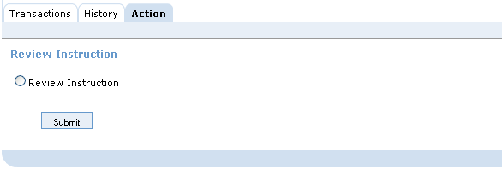
Warehousing - demo
Review a Warehoused Instruction or Transaction
While an Instruction or Transaction is in the warehoused state, it must be possible for a BVA user to take it out of the warehouse manually to review it, and then put it back into the warehouse – with or without changes made to it
In this way the Instruction can be put ‘on hold’ manually
Additionally it can be repaired
Builds on OPF repair and approval service
Notes:
Stop Point : Demo Included – Use File “MT101_Warehousing”
Change the value of Date (tag :30:) to any future date and Instruction will go in status ‘Warehoused’
Show the Instruction on BVA also

Slide 217
OPF Training - Functional Track
OPF Features - Routing

Slide 218
Routing
Routing
Recap routing data model concepts
Aim of routing is to identify the “destination” of the Payment:
Determine the outgoing Exchange Condition (Clearing Condition) and related outgoing Clearing Participant
Determine the outgoing Business and Settlement Participant (business, clearing, settlement)
Routing determines whether a Transaction is On-us or not:
By looking at the on-us flag on the outgoing clearing Participant

Slide 219
Routing – Algorithm
Routing determines the “Routing Agent” first, in order to find the “path” to reach this agent:
The routing agent is the agent the OPF Bank tries to reach
For credit transfers, routing determines the agent as:
Intermediary Agent if present
Otherwise Credit Party Agent
The routing agent’s account is also determined by routing
Routing next loops through the OPF Bank’s routing rules, in increasing order of usage until a match is found:
The Exchange Condition of the first matching routing rule is the one of the outgoing Business Participant
If clearing delegation is defined from this Exchange condition, delegation is followed (max. 4 delegates). The exchange condition found, is the outgoing Clearing condition.
If settlement delegation is defined from the Business Participant, delegation is followed (max. 4 delegates). The Participant found, is the outgoing Settlement Participant

Slide 220
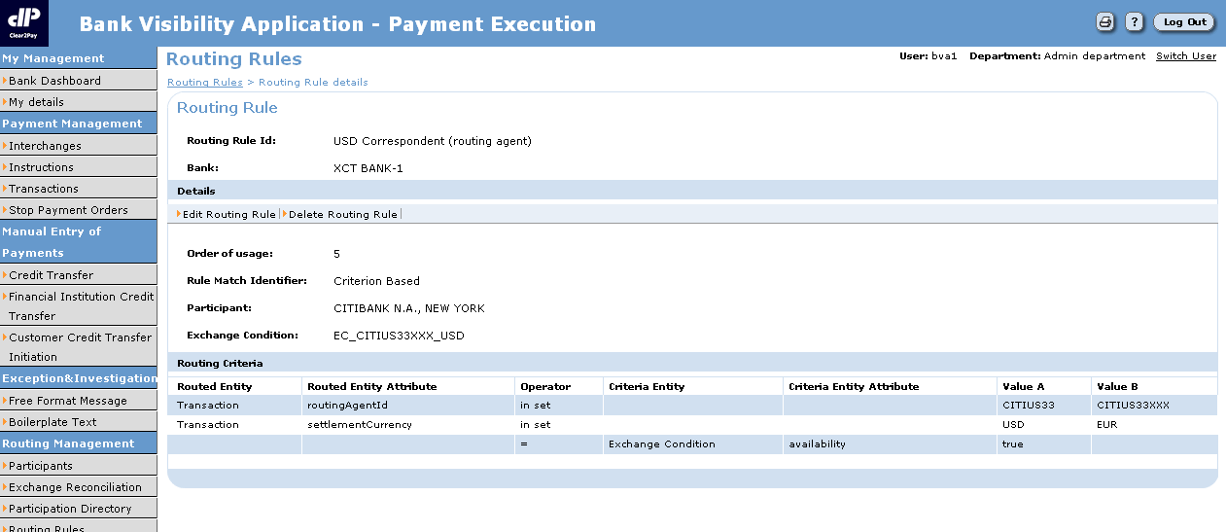
Routing: rule definition
Possible Operators | Description
=, <, >, <> | The basic ones
IsNull | Returns true when the value being compared is NULL or empty
IsNotNull | Returns true when the value being compared is not empty or NULL
InSet | Returns true when the value being compared is equal to one of the literal values specified in the Routing Criterion
Defines the order of preference in which the routing rule must be evaluated.
Can be:
“Criteria Based”: certain attributes of the Transaction are compared with attributes of the Exchange Condition. If all criteria matched, the Transaction is routed to the Exchange Condition. For instance: Currency, Maximum Amount, Destination Bank Code…
“Algorithm Based”: the Routing Rule consists of code developed by customization team, which, for a Transaction received as parameter, will return the Outgoing Clearing Condition.
Exchange condition related to the routing rule.
Participant related to the routing rule
Transaction attribute which is compared.
Entity and attributes to compare against. Attributes of Participant and Exchange Condition can be defined.
Operator used to do the comparison
Fixed values to compare against.

Slide 221
Routing – Criteria-based rules
Examples routing rules
# | Routing Entity | Routing Attribute | Operator | Criteria Entity | Criteria Attribute | Fixed Value(s)
1 | Transaction | Settlement Currency | = | NULL | NULL | ‘USD’
2 | Transaction | Settlement Currency | InSet | NULL | NULL | 1: ‘USD’ 2: ‘EUR’ 3: ‘GBP’
3 | Transaction | Classification | = | NULL | NULL | ‘CustomerCreditTransfer’
4 | Transaction | Priority | = | Exchange Condition | Priority | ‘NORM’
5 | Transaction | Settlement Amount | > | NULL | NULL | 50000
6 | Transaction | Routing Agent Id | IsInPartDir | Exchange Condition | NULL | 50000

Slide 222
OPF Training - Functional Track
OPF Features - Submission

Slide 223
Submission
Submission
At the end of the Transaction Flow, the Transactions are marked as “ready to be submitted”
Two ways of initiating submission:
Thanks to the Exchange Timing, a scheduler can start the submission at the appropriate time.
Immediate submission (configurable on Exchange Condition)

Slide 224
Submission
Outgoing Enrichment & Grouping
Map the OPF data model to the supported message types (formatting)
delivery handling

Slide 225
Submission
Submission
For Not-On-Us Transactions, the submitter will:
Group Transactions destined to the same Participant
Further group the Transactions in Instructions, and Instructions in Interchanges according to Grouping Rules
Submit the Interchanges:
Possibly format the Interchange into the required format
Deliver the formatted data based on the “delivery handler” specified on Exchange Condition (e.g. File, queue...)
For On-Us Transactions, the submitter will generate accounting information that can be used by the AMS of the bank.

Slide 226
Submission
Submission and the Exchange Condition
Field | Field description
Exchange Format | The format defines the structure and grouping rules of the interchange that is received or submitted using this Exchange Condition.
Transport Data Generator | Refers to the formatter used to format the output into the exchange condition's exchange format.
Max. Number of Transactions per Interchange | Maximum number of transactions to include in one interchange. When this number is reached, a new interchange is created.
Immediate Submission | When checked it means that transactions routed to this Exchange Condition must be submitted immediately.
Delivery Handler | Refers to the interchange handler, which is used to write the output to the required queue or file system.
Delivery Handler Configuration | Refers to the parameters required for the interchange handler.

Slide 227

Submission – demo (format)
Big Company,
Belgium
XCT BANK-1,
Belgium
MT101
1
2
MT103
PACS.008
Barclays, UK (BARCGB22)
Toblerone UK
Notes:
Stop Point : Include Demo Immediate Submission

Slide 228
OPF Training - Functional Track
OPF Features - Intra Bankgroup Transfer

Slide 229
IntraBankgroup transfers
Intra Bankgroup transfers In a multibank environment, OPF offers the ability to have Intra Bankgroup Transfers:
In case multiple OPF Banks exist in the system
Payment messages need to be sent from one OPF bank to another OPF bank
The system will create Interchange/Instruction and Transaction records (outgoing and incoming), simulating that a message was sent out from the first OPF bank and received by the second OPF bank
No physical exchange of messages happens

Slide 230




IntraBankgroup transfers
Toblerone Germany
Credit Party
Clarity Group
Customer
channel
IntraBankgroup transfer
Small Company
Debit Party
Clarity Bank Belgium
Debit Party Agent
Clarity Bank Germany
Credit Party Agent
City Trends Inc.
Credit Party
PAIN.001
MT103
JPMC, Japan
Credit Party Agent
Fitness Inc.
Credit Party

Slide 231
IntraBankgroup transfers
Intra Bankgroup transfer
Logical submission and parsing is one process
Done by the Submission service
Submission decides whether the payment is submitted using the Intra Bankgroup Transfer or a physical file or message is to be sent
Based on the “delivery handler”, configured on the exchange condition
An incoming Interchange, incoming Instruction and Transactions are created for the receiving Bank

Slide 232
IBGT - demo
XCT BANK-2,
Belgium
XCT BANK-1,
Belgium
Intra bank group transfer
Notes:
Stop Point : Demo Included- Use File “MT101 –IBGT”

Slide 233
OPF Training - Functional Track
OPF Features - Dashboard

Slide 234
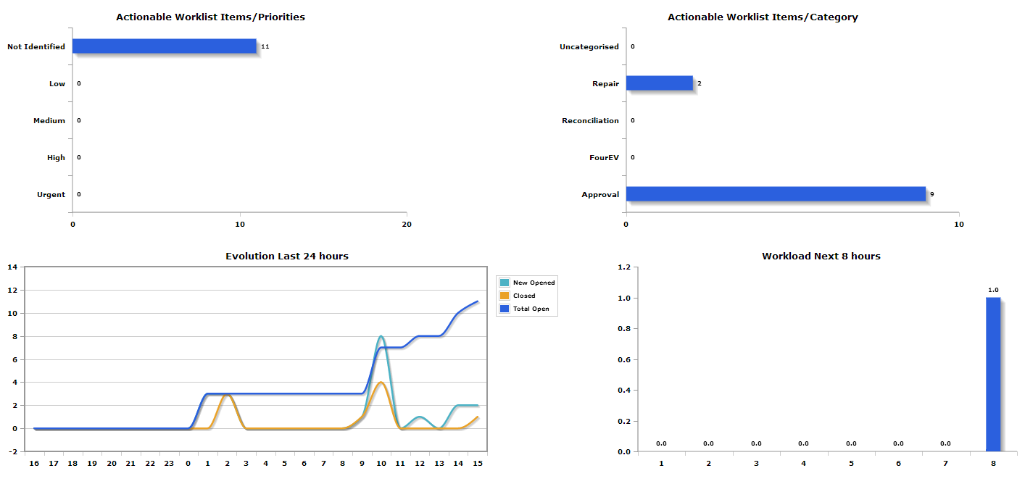
Dashboard
Management dashboard
WLI categories per WLI priority
Number of WLIs per category
WLI evolution per hour
Workload next (configurable number of) hours
Workload per work queue

Slide 235
Dashboard
Currency dashboard:
Number of payments awaiting approval/repair and time remaining to cut-off per currency in tabular view
Ability to click through to WLIs

Slide 236
OPF Training - Functional Track
OPF Features – Parameter Framework

Slide 237
Parameter framework
Goal is to manage different types of reference data that require dynamic online updates
User for example for:
Business code validation
Look up values from lists or populate e-list
Currently linked to Bank Group
New Parameter definitions setup in database
Examples:
Russian VO Codes
EEA Countries and Currencies
Notes:
Stop Point: Show on BVA

Slide 238
OPF Training - Functional Track
OPF Features – FATF 16 validation

Slide 239
FATF Recommendation 16
The FATF Recommendation 16 sets out specifications for the inclusion of ordering and beneficiary customer information in payments to guarantee sufficient information is available for doing legal/regulatory checks
Applicable for both international and domestic payments that reference customers (e.g. MT101, MT103, MT202-COV)
For Domestic payments only ordering customer information is required
For International payments above a threshold (country specific), both ordering customer and beneficiary information is required

Slide 240
FATF Recommendation 16
FATF Recommendation 16 has been implemented in local regulations and can vary per country (e.g. Info to provide, threshold, domestic exempted...)
OPF scope excludes the specific implementation of all local variants, but facilitates these:
Basis is the PMPG – Payments Market Practice Group – guidelines
Threshold configurable per country
Default outcome is repair

Slide 241
OPF Training - Functional Track
OPF Features – Risk Filter

Slide 242
Risk Filter check
Stop payments when facing external risk (e.g. Lehman Brothers bankrupt)
Allows a user to setup filters that detect and hold payments by matching the risk filter criteria with the payment properties
Any payment attribute can be used
Operators: 'equals', 'starts with', 'contains' and ‘contains Country’.
User can indicate what the outcome of a hit should be (approval/reject)
Real time and batch

Slide 243
OPF-xCT Training - Functional Track
Domestic and International Credit Transfers (xCT)

Slide 244
OPF Training - Functional Track
Domestic and International Credit Transfers (xCT)
xCT Terminology

Slide 245
OPF Training - Functional Track
Domestic and International Credit Transfers (xCT)
xCT – Scope

Slide 246
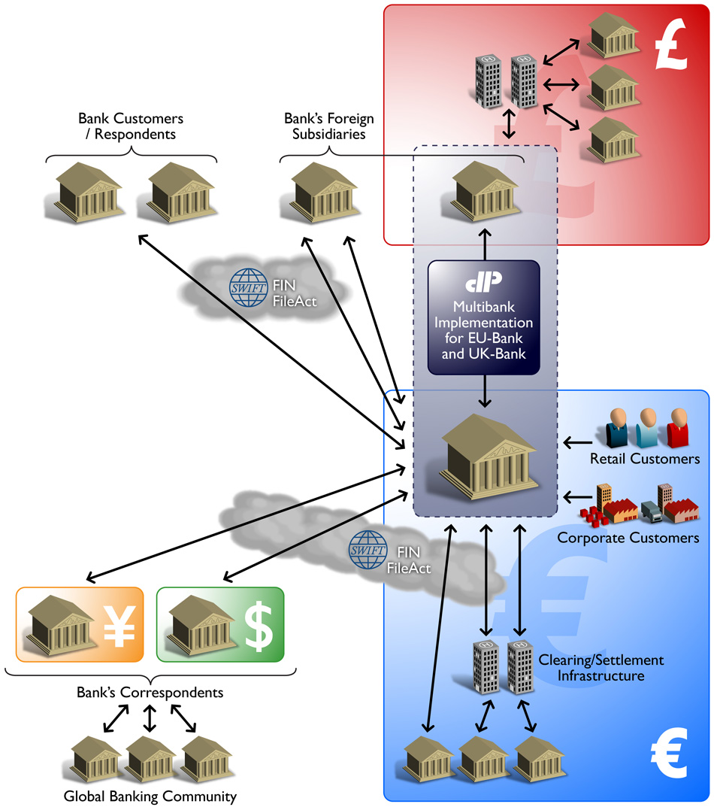
xCT – scope
xCT = International and Domestic Credit Transfers
Features that are applicable “globally”
Local specificities not in scope
Notes:
xCT = International and Domestic Credit Transfers
International credit transfers:
Foreign currency payments
Domestic currency payments sent to, or received from, outside the Bank’s currency zone
Domestic credit transfers:
Domestic currency payments settled inside the Bank’s currency zone
Features that are applicable “globally”
Local specificities not in scope

Slide 247
xCT – scope
International payments and domestic payments are related. An international payment can have a “domestic leg”:
Notes:
In this example, ING is JPMC’s correspondent for euro. A customer of JPMC instructs the bank to transfer 100 euros to a beneficiary whose account is held at Crédit Agricole. When ING receives the payment instruction from JPMC, ING needs to send the payment to Crédit Agricole. This will typically be done via a local clearing and settlement mechanism. Thus although the payment is ‘international’ its processing by ING requires the use of facilities usually associated with domestic credit transfers. In this case there is a blurring of the line between ICT and DCT where both are inextricably linked.

Slide 248
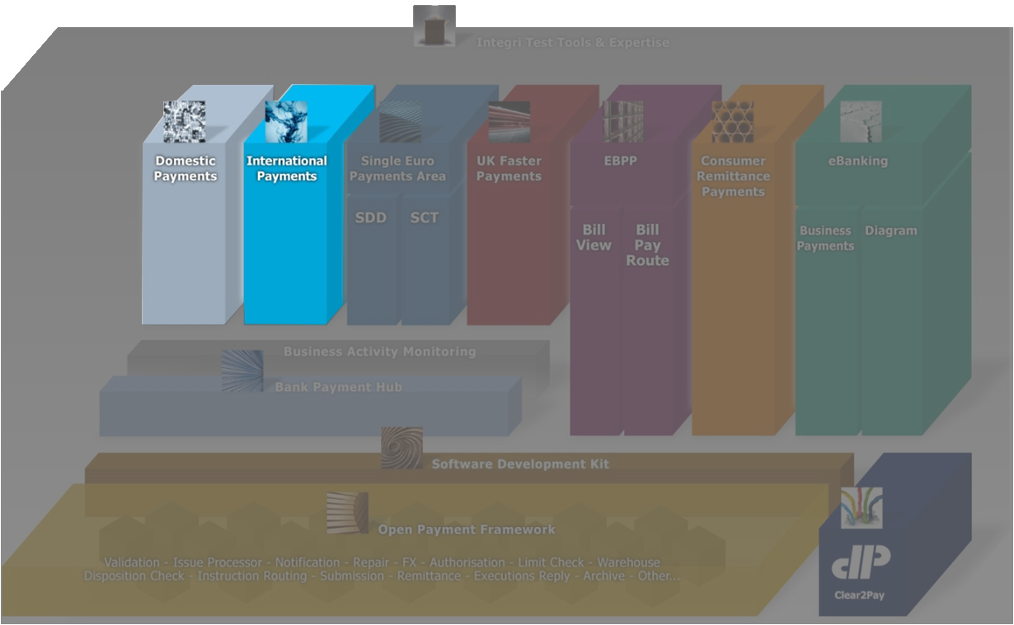
xCT – OPF product suite

Slide 249
xCT / OPF product features
xCT – International and domestic collections and transfers
Updated
Updated
Parser/Formatters
(SWIFT MT, MX)
Foreign Exchange
Charges
Billing
PDE/PDM Duplicate
check
Updated
Updated
Auto-enrichment
Code word
processing
E&I
Cancellation
PSSM
(ACK/NAK Mgt.)
On-us FI Credit
Transfers
Updated
Updated
Updated
Serial - Cover
Manual entry
(Payments )
Bank cheque
requests
Y-copy
Settlement day
Determination
& Validation
New
Updated
Request for Transfer
PSD
determination
SSI Enrichment
Volume & value
thresholds
Accounting
(Accounting Entries)
OPF – Open Payment Framework
Updated
Routing
Disposition check
Intra bank group
transfer
Duplicate check
Accounting
(Accounting events)
Endorsement
Warehousing
Updated
Work List Items
Work Queues
Audit & History
framework
Exchange Events
Determine inc.
Bus./Settl. Part.
Submission
User/Bank
Administration
Interchange loader
Reject
Updated
New
New
New
New
Approval
Repair
4-Eye Verification
Risk filter
FATF 16
validation
Dashboard
Parameter
framework

Slide 250
OPF Training - Functional Track
Domestic and International Credit Transfers (xCT)
Features

Slide 251

xCT / OPF product features
xCT – International and domestic collections and transfers
Updated
Updated
Parser/Formatters
(SWIFT MT, MX)
Foreign Exchange
Charges
Billing
PDE/PDM Duplicate
check
Updated
Updated
Auto-enrichment
Code word
processing
E&I
Cancellation
PSSM
(ACK/NAK Mgt.)
On-us FI Credit
Transfers
Updated
Updated
Updated
Serial - Cover
Manual entry
(Payments )
Bank cheque
requests
Y-copy
Settlement day
Determination
& Validation
New
Updated
Request for Transfer
PSD
determination
SSI Enrichment
Volume & value
thresholds
Accounting
(Accounting Entries)
Maximum adherence to SWIFT standards and guidelines
Future ready MT – MX coexistence

Slide 252
Parser/formatter
Supported message formats:
SWIFT MT F21, MT010, MT011, MT012, MT019, MT101, MT102, MT102+, MT103, MT103+, MT110, MT200, MT202, MT202, MT202-COV, MT203, MT204, MT205, MT210, MT400, MT671, MT900, MT910, MT950, MTn90 (MT190, MT290), MTn91 (MT191, MT291), MTn92 (MT192, MT292), MTn95 (MT195, MT295, MT995), MTn96 (MT196, MT296, MT996), MTn99 (MT199, MT299, MT999)
SWIFT MX pain.001.001.02, pacs.008.001.01, pacs.009.001.01
Adherence to SWIFT standards and guidelines

Slide 253
SWIFT MT – Header Block Information
Any SWIFT MT message is confined in 5 different Blocks.
SWIFT MT Headers
Application Header
User Header
Text /Body
Trailer
Basic Header

Slide 254
Sample SWIFT MT Message
{1:F01XCTABEBBAXXX1822765812}
{2:O1031235141209BARCGB22KTRD18850565201412091235N}
{3:{113:URGT}}
{4:
:20:UniqueRefa
:23B:CRED
:32A:141219EUR50,00
:33B:EUR50,00
:50F:/1234567
1/Mr Edward
2/RUE JOSEPH II, 19
3/CH/1044/Geneva
:57:XCTABEBB
:59:/321567
Mrs Elaine
555, S. FLOWER STREET
BE/Brussels/3006
:71A:SHA
-}
{5:{PDE:100510WDCMESESDXXX0987654321}{PDM:100510XCTABEBBAXXX1234567890}}
Basic Header Block
Application Header Block
User Header Block
Text Block or body
Trailer Block

Slide 255
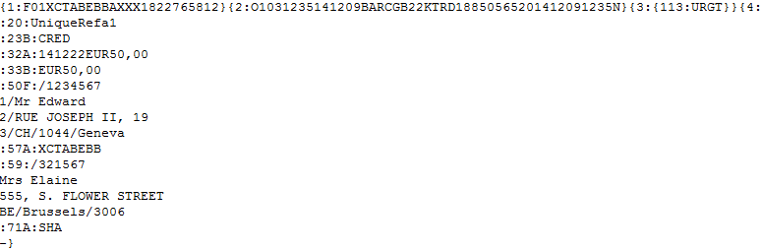
SWIFT MT Format
A Minimal MT Swift Format (MT103.txt)
Receiving Party
Sending Party
Unique Reference Id
Message Priority
Settlement Date, Settlement Currency & Amount
Debit Party Information
Credit Party Agent
Credit Party Information
Above is sample payment MT103.txt file (a Swift MT payment) that would enter into the bank application.

Slide 256
Parser/formatter
Basic payment messages
MT101 / PAIN.001 (Customer Credit Transfer Initiation)
MT103 / PACS.008 (FI2FI Customer Credit Transfer)
MT202 / PACS.009 (Financial Institution Credit Transfer)

Slide 257
Parser/formatter – SWIFT MT
SWIFT MT vs. Interchange, Instruction and Transaction
Format | Interchange | Instruction | Transaction
SWIFT-MT103 | 1 | 1 | 1
SWIFT-MT103+ | 1 | 1 | 1
SWIFT-MT202 | 1 | 1 | 1
SWIFT-MT210 | 1 | 1..n (One per repetitive sequence) | 0
SWIFT-MT101 | 1 | 1..n (The originating party and originating party agent should be the same per Instruction) | 1..n (One per B-sequence)
SWIFT-MT102 | 1 | 1 | 1..n (One per B-sequence)
SWIFT-MT110 | 1 | 1 | 0
SWIFT-MT200 | 1 | 1 | 1
SWIFT-MT202 | 1 | 1 | 1
SWIFT-MT202-COV | 1 | 1 | 1
SWIFT-MT203 | 1 | 1 | 1..n (One per repetitive sequence)
SWIFT-MT205 | 1 | 1 | 1
SWIFT-MT900 | 1 | 1 | 0
SWIFT-MT910 | 1 | 1 | 0
SWIFT-MT950 | 1 | 1..n | 0
SWIFT-MTn90 | 1 | 1 | 0
SWIFT-MTn91 | 1 | 1 | 0
SWIFT-MTn92 | 1 | 1 | 0
SWIFT-MTn95 | 1 | 1 | 0
SWIFT-MTn96 | 1 | 1 | 0
SWIFT-MTn99 | 1 | 1 | 0
SWIFT-MT012 | 1 | 1 | 0
SWIFT-MT019 | 1 | 1 | 0
F21 | Not parsed, handled by PSSM
SWIFT-MT010 | Not parsed, handled by PSSM
SWIFT-MT011 | Not parsed, handled by PSSM

Slide 258
Parser/formatter – SWIFT MT
Next to translating the source message, the parser sets values that are used “internally”. Examples are:
Interchange file format, instruction type. E.g. “SWIFT-MT103”
Classification. E.g. Instruction’s classification “CreditTransfer”
Status (“Created”)
Incoming (“True”)
Display Ids
Interbank E.g. “True” for a SWIFT-MT103
Debit-credit indicator E.g. “C” (Credit) for a SWIFT-MT103
Actual Debit or Credit Amount and Count of the Instruction

Slide 259
Parser/formatter – SWIFT MT
SWIFT MT parser/formatter documentation
Description source/target message For each Message Type (MT) a description of the source (for parsers) or target (for formatters) message structure is provided
Mapping sheet For each Message Type (MT) a mapping is provided on how to translate the source into the target. E.g. SWIFT MT103 (source) to the internal data model (target). Source and target are defined as paths:
SWIFT MT: E.g. MT103\B4\T50A, which means tag 50A of block 4 of the source path message, being a SWIFT MT103 message
Internal data model attribute: PaymentTransaction\settlementAmount, which means the settlement amount attribute of entity PaymentTransaction
Functions sheet Functions used to transform the source into the target are described in a seperate sheet, since used in multiple mapping sheets

Slide 260
xCT / OPF product features
xCT – International and domestic collections and transfers
Updated
Updated
Parser/Formatters
(SWIFT MT, MX)
Foreign Exchange
Charges
Billing
PDE/PDM Duplicate
check
Updated
Updated
Auto-enrichment
Code word
processing
E&I
Cancellation
PSSM
(ACK/NAK Mgt.)
On-us FI Credit
Transfers
Updated
Updated
Updated
Serial - Cover
Manual entry
(Payments )
Bank cheque
requests
Y-copy
Settlement day
Determination
& Validation
New
Updated
Request for Transfer
PSD
determination
SSI Enrichment
Volume & value
thresholds
Accounting
(Accounting Entries)
Maximum adherence to SWIFT standards and guidelines
Future ready MT – MX coexistence

Slide 261

PDE/PDM duplicate check
PDE/PDM duplicate check
MT
MT
MT
MT
PDE/
PDM ?
PDE
PDM
Notes:
PDE/PDM duplicate check (incoming messages)
A validation to check whether a PDE or PDM indication is present in the message
An issue is raised upon detection of a PDE/PDM indication
Outcome can be Interchange approval, other outcomes are possible too (e.g. Reject)
PDE duplicate indication manual entry (outgoing messages) A user can indicate, upon manual entry, that a Payment has already been initiated previously

Slide 262
Example PDE/PDM duplicate check
{1:F01XCTBBEBBAXXX0304503716}{2:O1030707100510BARCGB22ATRD50370120101005101001N}{3:{119:STP}}{4:
:20:HISTORY-DEMO
:23B:CRED
:23E:SDVA
:32A:101125EUR100000,
:33B:EUR100000,
:50K:TOBLERONE
:57A:XCTBBEBB
:59:/BE85999107547206
SMALL COMPANY
BE
:71A:OUR
-}{5:{PDE:100510WDCMESESDXXX0987654321}{PDM:100510XCTABEBBAXXX1234567890}}
Notes:
{PDE:[<time><mir>]}
{PDM:[<time><mor>]}
Open the Test Visibility Application: http://[server name]:9080/OPFTestVisibility
See to it that:
Field 32A’s Date (Value Date) in “PDE-PDM demo.txt” is updated to the today’s date or the system time is altered via “Alter system time” in the menu to 13/12/2010, approximately 9 am
When re-loaded, field 20 (Sender's Reference) is updated in order to avoid running into the possible duplicate check. Note that the reference cannot be longer than 16 characters. Characters allowed are: “a b c d e f g h i j k l m n o p q r s t u v w x y z A B C D E F G H I J K L M N O P Q R S T U V W X Y Z 0 1 2 3 4 5 6 7 8 9 / - ? : ( ) . , ' + Space”.
Click on PostSwiftInterchangeForm at the left hand side of the screen
Origin: should be selected as From SWIFT
Select the following file by clicking Browse…: PDE-PDM demo.txt
Click Submit
Go to the Bank Visibility Application: http://[server name]:9080/BankVisibility/login
Login:
User: bva1 – bva20
Password: password
The uploaded MT103 Interchange will go to approval due to the MT containing an Possible Duplicate Message/Emission indication.
Go to the Interchange’s Action tab (directly or via the WLI)
Approve the Interchange
If 4EV is required:
- Login as another user
- 4EV the approval action

Slide 263
Possible duplicate check
Possible duplicate check
Validation on certain attributes revealing Instructions that are possibly duplicates of Instructions that are already existing in the system:
Having the same incoming Clearing Condition
Within a configurable time range
The attributes are configurable
An issue is raised upon detection of a possible duplicate Instruction
Outcome can be Instruction approval, other outcomes are possible too (e.g. Reject)

Slide 264
Possible duplicate check

Slide 265
Possible duplicate check
Possible duplicate check criteria xCT
 | Instructing Agent Id | Instruction Reference | Interchange Reference | Settlement Currency | Settlement Amount | Settlement Day | Instructed Day | Control Sum (Sum of Amount) | Instruction Type | Originating Party Account | Originating Party [n] Id | Originating Party [n] Id Issuer | Originating Party Agent [n] Id | Message Sequence
MT101 | X |  | X |  |  |  | X |  | X | X | X | X | X | X
MT102 | X | X |  | X | X | X |  |  | X
MT103 | X | X |  | X | X | X |  |  | X
MT200 | X | X |  | X | X | X |  |  | X
MT202 | X | X |  | X | X | X |  |  | X
MT202 COV | X | X |  | X | X | X |  |  | X
MT203 | X |  |  |  |  | X |  | X | X
MT205 | X | X |  | X | X | X |  |  | X
MT910 | X | X |  | X | X | X |  |  | X
pacs.008 | X | X |  |  |  |  |  |  | X
pacs.009 | X | X |  |  |  |  |  |  | X

Slide 266
Example Possible duplicate check
{1:F01XCTABEBBAXXX3333654181}{2:O1031808100308BARCGB22ATRD12341234561003081811N}{3:{113:HIGH}}{4:
:20:POSDUP103
:23B:CRED
:23E:SDVA
:32A:100324EUR9999999999,
:50K:ABC INC
:57A:KREDBEBB
:59:DEF INC
:71A:OUR
-}
Notes:
{PDE:[<time><mir>]}
{PDM:[<time><mor>]}

Slide 267
Possible duplicate check - demo
MT (Instruction type): 101
Sender: (Instructing Agent Id): WDCMESESXXX
Field 20 (Interchange reference): DUPLICATE
Field 30 (Instructed day): 101126
Field 50 (Originating Party Account/id): BE61310126985517
Field 52 (Originating Party Agent Id): XCTABEBB
MT101
=
Big Company,
Belgium
Initiating Party
XCT BANK-1
(XCTABEBB)
MT101
MT (Instruction type): 101
Sender: (Instructing Agent Id): WDCMESESXXX
Field 20 (Interchange reference): DUPLICATE
Field 30 (Instructed day): 101126
Field 50 (Originating Party Account/id): BE61310126985517
Field 52 (Originating Party Agent Id): XCTABEBB
Notes:
Open the Test Visibility Application: http://[server name]:9080/OPFTestVisibility
See to it that:
Field 30’s Date (Instructed day) in “Possible duplicate check - demo 1.txt” and “Possible duplicate check - demo 2.txt” is updated to the today’s date or the system time is altered via “Alter system time” in the menu to 13/12/2010, approximately 9 am
When re-loaded, field 20 (Sender's Reference) is updated in order to avoid running into the possible duplicate check. Note that the reference cannot be longer than 16 characters. Characters allowed are: “a b c d e f g h i j k l m n o p q r s t u v w x y z A B C D E F G H I J K L M N O P Q R S T U V W X Y Z 0 1 2 3 4 5 6 7 8 9 / - ? : ( ) . , ' + Space”.
Click on PostSwiftInterchangeForm at the left hand side of the screen
Origin: should be selected as From SWIFT
Select the following file by clicking Browse…: Possible duplicate check - demo 1.txt
Click Submit
Select the following file by clicking Browse…: Possible duplicate check - demo 2.txt
Click Submit
Go to the Bank Visibility Application: http://[server name]:9080/BankVisibility/login
Login:
User: bva1 – bva20
Password: password
Go to the WLI via the Bank dashboard
Select the WLI with Event “Approval - Possible Duplicate Instruction”
Click “Claim”
Click “Continue”
The Action tab allow a user to approve the payment (not a duplicate) or to Decline it (duplicate). The History tab shows which Instruction is detected as the possible duplicate

Slide 268
xCT / OPF product features
xCT – International and domestic collections and transfers
Updated
Updated
Parser/Formatters
(SWIFT MT, MX)
Foreign Exchange
Charges
Billing
PDE/PDM Duplicate
check
Updated
Updated
Auto-enrichment
Code word
processing
E&I
Cancellation
PSSM
(ACK/NAK Mgt.)
On-us FI Credit
Transfers
Updated
Updated
Updated
Serial - Cover
Manual entry
(Payments )
Bank cheque
requests
Y-copy
Settlement day
Determination
& Validation
New
Updated
Request for Transfer
PSD
determination
SSI Enrichment
Volume & value
thresholds
Accounting
(Accounting Entries)
Maximum adherence to SWIFT standards and guidelines
Future ready MT – MX coexistence

Slide 269


Routing - Volume / Value thresholds
Volume / Value thresholds
Max volume: 40000
Usage: 40000
$500
OPF Bank
Max value: $ 9999999,99
Usage: $ 0
Notes:
Volume / Value thresholds
To reflect correspondent reciprocity agreements in the case where OPF bank has several correspondents for the same currency
In terms of volume (number of Transactions)
In terms of value (value of the Transactions)
New routing operators have been added:
VolumeThresholdNotReached Actual number of Transactions ^{(*)} + 1 compared against the defined threshold
ValueThresholdNotReached Total settlement amount of Transactions ^{(*)} + settlement amount of the routed Transaction compared against the defined threshold
The thresholds can be maintained online (Participant BVA)
The actual usage can be consulted online (Participant BVA)
(*) Restricted by the following criteria: - Transactions have the same outgoing Business Participant as the Transaction routed - Transactions have the same settlement currency as the threshold’s currency - Transactions have the same settlement day as the Transaction routed - Transations are not cancelled or rejected

Slide 270
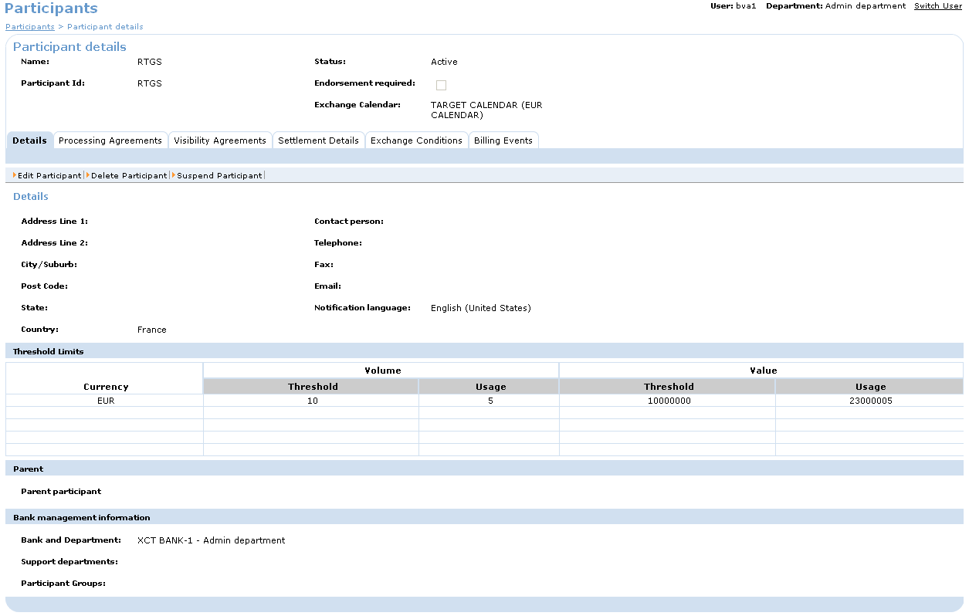
Volume / Value thresholds

Slide 271
Volume / Value thresholds
Volume / Value thresholds
To reflect correspondent reciprocity agreements in the case where OPF bank has several correspondents for the same currency.
Configured at (Business) Participant level
Works in conjunction with Routing Service (specific Operators): VolumeThresholdNotReached, ValueThresholdNotReached
Routing rule must be specifically set up with these operators for the thresholds to be taken into account
During routing, comparison of Actual value + transaction.settlementAmount versus Threshold Value
During routing, comparison of Actual volume + 1 versus Threshold Value

Slide 272
Volume / Value thresholds
Volume / Value thresholds
If thresholds are reached, then there is no match with the routing rule
N.B. Thresholds are absolute (not percentages)
It is possible to define up to 5 volume & value thresholds for different currencies
N.B. If no thresholds are defined, they are considered to be infinite
The Actual usage takes into account transactions: in same currency, with same settlement day, that have been routed, that are not rejected or cancelled
UI to view Actual usage (for current settlement day) vs. Threshold

Slide 273
xCT / OPF product features
xCT – International and domestic collections and transfers
Updated
Updated
Parser/Formatters
(SWIFT MT, MX)
Foreign Exchange
Charges
Billing
PDE/PDM Duplicate
check
Updated
Updated
Auto-enrichment
Code word
processing
E&I
Cancellation
PSSM
(ACK/NAK Mgt.)
On-us FI Credit
Transfers
Updated
Updated
Updated
Serial - Cover
Manual entry
(Payments )
Bank cheque
requests
Y-copy
Settlement day
Determination
& Validation
New
Updated
Request for Transfer
PSD
determination
SSI Enrichment
Volume & value
thresholds
Accounting
(Accounting Entries)
Maximum adherence to SWIFT standards and guidelines
Future ready MT – MX coexistence

Slide 274
Standard Settlement Instructions (SSIs)
SSI = Standard Settlement Instruction
SSIs indicate the preferences of banks via which correspondent bank(s) they want to receive payments by
Preferences are published for each currency in which the bank can receive payments in.
When a bank tries to reach another bank, it will:
First consult the other bank’s SSI to search for its preferred correspondent bank(s).
Enrich the payment with the agent(s) found

Slide 275


Example SSI enrichment
USD
Big Company,
Belgium
XCT BANK-1,
Belgium
(XCTABEBB)
MT103
(USD equivalent EUR)
Credit Lyonnais, France
(CRLYFRPP)
City Trends Inc.
MT101
MT202COV
(USD equivalent EUR)
Citibank, New York (CITIUS33)
Notes:
SSI = Standard Settlement Instruction

Slide 276
Automated enrichment (SSI maintenance)
Notes:
SSIs are maintained on Bank level. An SSI can be applicable multilaterally (between an agent publishing SSIs and all Banks), bilaterally (between an agent publishing SSIs and one or more Banks, but not all). Therefore a m-n relationship is present between SSI and Bank.

Slide 277
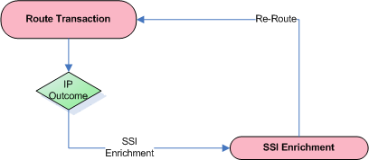
Automated enrichment (SSI enrichment and routing)
SSI enrichment process
If routing fails, then SSI enrichment is called
Lookup SSI for routing agent + transaction currency. If no match and BIC is a branch, then lookup done on BIC8
If routing fails once more, the enrichment is rolled back, and payment goes to manual repair (different Issue code than the first routing failure).
Specific attribute for use in default currency routing rule: PaymentTransaction.enrichedUsingSSI (this attribute = FALSE as routing criterion). Thus default currency routing rule is not applied on the ‘first pass’.

Slide 278
Automated enrichment – SSI
SSI
Data enriched:
Publishing Agent’s account
Preferred Agent’s BIC & account
Via Agent’s BIC & account (if available)
Example of “Via Agent”:
PublishingSSIAgentBIC: BANVDEHB (KBC Deutschland) (for CYP)
PreferredAgentBIC: BCYPCY2N (Bank of Cyprus)
ViaAgentBIC: KREDBEBB (KBC Belgium)

Slide 279
Automated enrichment (SSI & intermediaries)
Via Agent Not Present
Agents in the Transaction | Action to be performed | Role of Preferred Agent
Creditor Agent |  | IntermediaryAgent1
Creditor Agent, Intermediary Agent1 | Copy IntermediaryAgent1 details to IntermediaryAgent2 | IntermediaryAgent1
Creditor Agent, Intermediary Agent1, Intermediary Agent2 | Copy IntermediaryAgent2 details to IntermediaryAgent3 and IntermediaryAgent1 details to IntermediaryAgent2 | IntermediaryAgent1
Creditor Agent, Intermediary Agent1, Intermediary Agent2, Intermediary Agent3 | Raise an Issue
Via Agent Present
Agents in the Transaction | Action to be performed | Role of Preferred Via Agent | Role of Preferred Agent
Creditor Agent |  | IntermediaryAgent1 | IntermediaryAgent2
Creditor Agent, Intermediary Agent1 | Copy IntermediaryAgent1 details to IntermediaryAgent3 | IntermediaryAgent1 | IntermediaryAgent2
Creditor Agent, Intermediary Agent1, Intermediary Agent2 | Raise an Issue
Creditor Agent, Intermediary Agent1, Intermediary Agent2, Intermediary Agent3 | Raise an Issue

Slide 280
SSI enrichment - demo
USD
Big Company,
Belgium
XCT BANK-1,
Belgium
(XCTABEBB)
MT103
(USD equivalent EUR)
Credit Lyonnais, France
(CRLYFRPP)
City Trends Inc.
MT101
MT202COV
(USD equivalent EUR)
Citibank, New York (CITIUS33)
Notes:
Open the Test Visibility Application: http://[server name]:9080/OPFTestVisibility
See to it that:
Field 30’s Date in “SSI enrichment demo.txt” is updated to the today’s date or the system time is altered via “Alter system time” in the menu to 13/12/2010, approximately 9 am
When re-loaded, field 20 (Sender's Reference) is updated in order to avoid running into the possible duplicate check. Note that the reference cannot be longer than 16 characters. Characters allowed are: “a b c d e f g h i j k l m n o p q r s t u v w x y z A B C D E F G H I J K L M N O P Q R S T U V W X Y Z 0 1 2 3 4 5 6 7 8 9 / - ? : ( ) . , ' + Space”.
Click on PostSwiftInterchangeForm at the left hand side of the screen
Origin: should be selected as From SWIFT
Select the following file by clicking Browse…: SSI enrichment demo.txt
Click Submit
Go to the Bank Visibility Application: http://[server name]:9080/BankVisibility/login
Login:
User: bva1 – bva20
Password: password
CITIBANK (CITIUS33XXX) has been enriched from the USD SSI setup for Crédit Lyonnais (CRLYFRPPXX).
An MT202-COV is sent to Citibank to cover the payment. An MT103 announcement is sent to Crédit Lyonnais.

Slide 281
xCT / OPF product features
xCT – International and domestic collections and transfers
Updated
Updated
Parser/Formatters
(SWIFT MT, MX)
Foreign Exchange
Charges
Billing
PDE/PDM Duplicate
check
Updated
Updated
Auto-enrichment
Code word
processing
E&I
Cancellation
PSSM
(ACK/NAK Mgt.)
On-us FI Credit
Transfers
Updated
Updated
Updated
Serial - Cover
Manual entry
(Payments )
Bank cheque
requests
Y-copy
Settlement day
Determination
& Validation
New
Updated
Request for Transfer
PSD
determination
SSI Enrichment
Volume & value
thresholds
Accounting
(Accounting Entries)
Maximum adherence to SWIFT standards and guidelines
Future ready MT – MX coexistence

Slide 282
Bank cheque requests - definition
Instruction to issue (print and deliver) a bank cheque
Notes:
Bank cheque requests: definition
Customer initiates a bank cheque request.
Bank A then:
Issues the bank cheque if:
The bank cheque request currency equals the OPF bank local currency
The bank cheque request does not equal the OPF bank local currency. The OPF bank has no agreement with a bank in the currency and for the destination country of the request to issue bank cheques (SWIFT-to-cheque).
Forwards the request if:
The bank cheque request does not equal the OPF bank local currency. The OPF bank has an agreement with a bank in the currency and for the destination country of the request to issue bank cheques.

Slide 283
Bank cheque requests - definition
OPF bank issues the cheque:
Notes:
Bank cheque requests: definition illustration

Slide 284
Bank cheque requests - definition
OPF bank forwards the cheque request, another bank issues the cheque (SWIFT-to-cheque):
Notes:
Bank cheque requests: definition illustration

Slide 285
Bank cheque requests
Bank cheque requests
Able to detect bank cheque requests (based on code word CHQB or CHK)
Able to determine whether to issue a bank cheque or forward the request (based on routing)
Able to trigger submission of:
A bank cheque in print layout (XML proprietary file)
An Advice of cheque (SWIFT MT110)
A SWIFT-to-cheque (SWIFT MT103, containing code word CHQB)
Notes:
Bank cheque requests: requirements

Slide 286
Bank cheque requests
Processing bank cheque requests
Payments containing bank cheque request code words (CHQB, CHK) are processed through the Interchange and Instruction Flows in the same manner as any other payment
Routing determines what happens next:
The OPF bank is forwarding the request
Example routing rule:
The Transaction is treated as normal not on-us transaction and essentially the codeword is also ignored (apart from including it in the outgoing message)
Transaction information | Operator | Criteria | Participant | Exchange condition
instruction for credit party agent code | = | “CHQB” | Bank Z (printing the cheque) | No clearing delegation
Settlement amount | < | 10000
Settlement currency | = | “USD”
Credit party country | = | “USA”

Slide 287
Bank cheque requests
Processing bank cheque requests
The OPF bank is printing the bank cheque
Example routing rule:
The transaction is routed to a clearing partner representing the printer, which is defined as “on-us”
A bank cheque “on-us” flow is triggered based on the transaction being “on-us” and the presence of a bank cheque code word
Bank cheque “on-us” flow:
Transaction information | Operator | Criteria | Participant | Exchange condition
Payment method | = | “CHK” | Bank Z (correspondent on which the bank cheque is drawn) | Delegation to Participant: printer
Settlement currency | = | “USD”

Slide 288
Bank cheque requests
Fields enriched if not already present
Name | Value
Cheque Type | BCHQ (Bank Cheque)
Cheque Number | <<PaymentInstruction.displayInstructionId>> (Transaction ID)
Delivery Method Code | CRCD (Courier to Creditor)
Cheque Priority | NORM (Normal)
Cheque Print Location | NULL
If the outgoing Business Participant’s Exchange Condition (determined during routing) indicates an Advice of Cheque is to be sent out, then an Advice of Cheque Instruction is created and submitted (as an MT110)
The Transaction is submitted as a proprietary XML print cheque file

Slide 289



On-us foreign bank cheque request - demo
Super Market Deluxe
XCT BANK-1,
Belgium
(XCTABEBB)
Barclays, UK (BARCGB22)
Town Ware
Inc.
PAIN.001
MT110
Notes:
Go to the Bank Visibility Application: http://[server name]:9080/BankVisibility/login
Login:
User: bva1 – bva20
Password: password
- Edit Exchange Condition “EC_BARCGB22TRD_CHK” of Participant “BARCLAYS BANK PLC, UK”: set “Generate Advice of Cheque” to true
Open the Test Visibility Application: http://[server name]:9080/OPFTestVisibility
See to it that:
/Document/pain.001.001.02/PmtInf/ReqdExctnDt in Bank Cheque Request.xml is updated to today’s date or the system time is altered via “Alter system time” in the menu to 30/6/2010, approximately 9 am
Exchange Condition “EC_BARCGB22TRD_CHK” of Participant “BARCLAYS BANK PLC, UK” should have the “Generate Advice of Cheque” flag set to TRUE
Click on PostInterchangeForm at the left hand side of the screen
Fill-out the details:
Bank Name: “XCT BANK-1”
Bank Group Id: “OPFBankgroup”
Exchange Id: “ECCHANNEL”
Select the following file by clicking Browse…: Bank Cheque Request.xml
Click Submit
The Transaction will be submitted as a proprietary print bank cheque request in XML. A linked Instruction (to the Transaction) is created and submitted as an MT110.

Slide 290
xCT / OPF product features
xCT – International and domestic collections and transfers
Updated
Updated
Parser/Formatters
(SWIFT MT, MX)
Foreign Exchange
Charges
Billing
PDE/PDM Duplicate
check
Updated
Updated
Auto-enrichment
Code word
processing
E&I
Cancellation
PSSM
(ACK/NAK Mgt.)
On-us FI Credit
Transfers
Updated
Updated
Updated
Serial - Cover
Manual entry
(Payments )
Bank cheque
requests
Y-copy
Settlement day
Determination
& Validation
New
Updated
Request for Transfer
PSD
determination
SSI Enrichment
Volume & value
thresholds
Accounting
(Accounting Entries)
Maximum adherence to SWIFT standards and guidelines
Future ready MT – MX coexistence

Slide 291
Code words
Code words Instruct a party in the payment chain to execute a certain action
Notes:
Code words
Code words instruct a party in the payment chain to execute a certain action.
Code word can be:
Defined by SWIFT
Imposed by industry practice
Bilateral agreed code words (between two banks)
Example: CHQB (Pay beneficiary customer only by cheque). The code word instructs the instructed agent (Credit party's agent) to create a bank cheque to pay the beneficiary instead of crediting his account.
PEX should detect code words that require manual action.
It can do this based on:
List of code words (for a certain field) that require manual action. A code word in this list would send the payment to manual intervention. Such a list would be used for fields for which most code words do not require manual action. E.g. Field 23E (Instruction code): \PHOB\+3216212343
List of code words (for a certain field) that do not require manual action. A code word NOT in this list would send the payment to manual intervention. E.g Field 72 (Sender to receiver information): \INS\KREDBEBB: The instructing institution which instructed the Sender to execute the transaction
Once a code word is detected which needs manual intervention:
Create issue
Create WLI
User claims WLI and executes action; he then:
Approves the instruction/transaction => processing continues
Dissaprove the instruction/transaction => sent to manual repair

Slide 292
Code word processing
Code word processing
Service can be invoked on Instruction and Transaction level
Acts on code words contained in field 23, 23E & 72. These are mapped to a number of attributes
System behavior defined in configuration file (applicable system-wide)

Slide 293
Code word processing (Reference Implementation)
At Instruction Level
REC = Instructions following are for the Receiver of the message.
REJT = A reject (message and/or transaction has not yet been booked) and is followed by the identification of the field causing the reject or
RETN = A return (message and/or transaction has already been booked) and is followed by the identification of the field causing the return.
Code word | Condition to be checked | Possible Action
REC | PaymentInstruction.instructionForNextAgent[n]Code IsNull AND PaymentInstruction.instructionForNextAgent[n]ProprietaryCode IsNull AND PaymentInstruction.instructionForNextAgent[n]InstructionInformation IsNotNull, where “[n]” contains values NULL, “2”, “3”, “4” or “5” | Send Instruction for Approval
RJCT | PaymentInstruction.instructionForNextAgentProprietaryCode EqualsString “RJCT” | Send Instruction for Approval
RETN | PaymentInstruction.instructionForNextAgentProprietaryCode EqualsString “RETN” | Send Instruction for Approval

Slide 294
Code word processing (Reference Implementation)
Code words Detected for an “On-Us” Transaction
Code word | Condition to be checked | Possible Action
PHOB | PaymentTransaction.incominginstructionForCreditPartyAgent[n]Code EqualsString “PHOB” , where “[n]” contains values NULL, “2” or “3” | Send Transaction for Approval
TELB | PaymentTransaction.incominginstructionForCreditPartyAgent[n]Code EqualsString “TELB” , where “[n]” contains values NULL, “2” or “3” | Send Transaction for Approval
HOLD | PaymentTransaction.incominginstructionForCreditPartyAgen[n]tCode EqualsString “HOLD” , where “[n]” contains values NULL, “2” or “3” | Send Transaction for Approval
RECBEN | PaymentTransaction.incomingInstructionForNextAgent[n]ProprietaryCode EqualsString "RECBEN", where “[n]” contains values NULL, “2”, “3”, “4”, “5” or “6” | Create Informational Worklist Item.

Slide 295
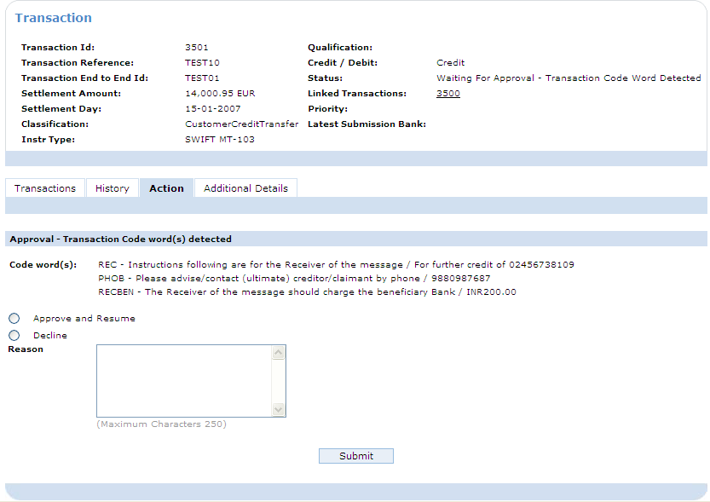
Code word processing – Approval demo
Notes:
Open the Test Visibility Application: http://[server name]:9080/OPFTestVisibility
See to it that:
Field 30 (Requested Execution Date) in Code word - approval demo.txt is updated to the today’s date or the system time is altered via “Alter system time” in the menu to 30/6/2010, approximately 9 am
When re-loaded, field 20 (Sender's Reference) is updated in order to avoid running into the possible duplicate check. Note that the reference cannot be longer than 16 characters. Characters allowed are: “a b c d e f g h i j k l m n o p q r s t u v w x y z A B C D E F G H I J K L M N O P Q R S T U V W X Y Z 0 1 2 3 4 5 6 7 8 9 / - ? : ( ) . , ' + Space”
Click on PostSwiftInterchangeForm at the left hand side of the screen
Origin: should be selected as From SWIFT
Select the following file by clicking Browse…: Code word - approval demo.txt
Click Submit
Go to the Bank Visibility Application: http://[server name]:9080/BankVisibility/login
Login:
User: bva1 – bva20
Password: password
Go to the Transaction’s action tab (directly or via WLI)
The approval screen is displayed

Slide 296
xCT / OPF product features
xCT – International and domestic collections and transfers
Updated
Updated
Parser/Formatters
(SWIFT MT, MX)
Foreign Exchange
Charges
Billing
PDE/PDM Duplicate
check
Updated
Updated
Auto-enrichment
Code word
processing
E&I
Cancellation
PSSM
(ACK/NAK Mgt.)
On-us FI Credit
Transfers
Updated
Updated
Updated
Serial - Cover
Manual entry
(Payments )
Bank cheque
requests
Y-copy
Settlement day
Determination
& Validation
New
Updated
Request for Transfer
PSD
determination
SSI Enrichment
Volume & value
thresholds
Accounting
(Accounting Entries)
Maximum adherence to SWIFT standards and guidelines
Future ready MT – MX coexistence

Slide 297
Auto-enrichment / Auto-repair
Auto-enrichment / Auto-repair
Improve STP rate by auto-enriching / auto-repairing payment agent information
Name, Address -> BIC
Enrichment
BIC <-> Local Bank Code
IBAN -> BIC
BIC – Local Bank Code coherence
Repair
Remove duplicate agent ids
Local Bank Code - Name, Address
Notes:
Auto-enrichment automatically enriches information of the Payment, to guarantee it can be processed STP:
Auto-repair automatically corrects data in the Payment, to guarantee it can be processed STP.

Slide 298
SWIFT’s BICPlusIBAN file
The BICPlusIBAN Directory contains:
Name and address of the financial institutions and their BICs
Institutions’ participation in national and international payment services reachable through FIN, and their SWIFT user category
Institutions’ national bank/branch codes (sort or clearing codes) cross-referenced with the BICs
Institutions’ national bank/branch codes in the format used in IBANs, cross-referenced with the BICs that the account holding institutions issue to their clients when opening and IBAN account
Financial institutions and corporates use the BICPlusIBAN Directory to:
Validate the BIC in a payment or in a customer information file
Look-up the BIC and its details for an institution’s name and address
Translate the beneficiary’s BIC into its national clearing/sort code
Look-up the BIC corresponding to an IBAN via the included bank/branch code
Look-up the connected (SWIFT) BIC for not-connected (non-SWIFT) BICs

Slide 299
Auto-enrichment / Auto-repair
Source for enrichment:
SWIFT SWIFTRef’s BankDirectoryPlus and IBANPlus (replace BICPLUSIBAN file)
BIC NAR Map

Slide 300
BIC-NAR map

Slide 301
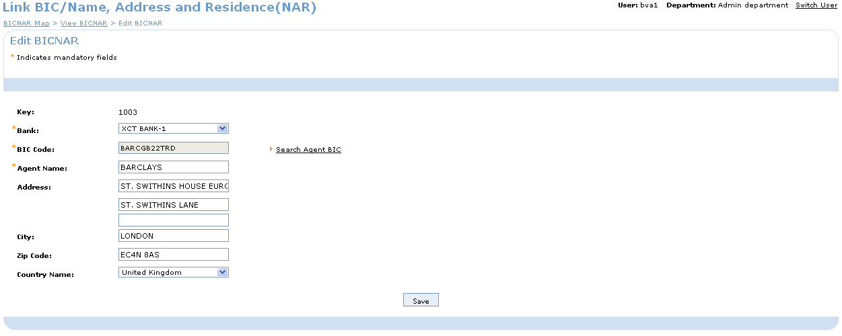
BIC-NAR map

Slide 302
Automated enrichment (Agent Id enrichment)
Applied to: intermediaryAgent[m] and creditParty(Agent)
Following Id Types:
Static data:
Id Type in Txn | Id auto enriched
BIC | Local Bank Code (LBC)
LBC (“CSM”) | BIC
NAR (Name, Address, Residence) | BIC

Slide 303
Automated enrichment - demo
Transaction 1 - Bank NAR -> BIC
Transaction 2 - IBAN -> BIC
Transaction 3 - BIC-> Local Bank Code
:57D:BARCLAYS
ST. SWITHINS HOUSE EUROPEAN
ST. SWITHINS LANE
UK/LONDON/EC4N 8AS
BARCGB22TRD
:59:/BE82270037559968
GEBABEBBXXX
:57A:CTBAAU2S
AU062000
Notes:
Open the Test Visibility Application: http://[server name]:9080/OPFTestVisibility
See to it that:
Field 30 (Requested Execution Date) in Automated enrichment demo 1.txt is updated to the today’s date or the system time is altered via “Alter system time” in the menu to 30/6/2010, approximately 9 am
When re-loaded, field 20 (Sender's Reference) is updated in order to avoid running into the possible duplicate check. Note that the reference cannot be longer than 16 characters. Characters allowed are: “a b c d e f g h i j k l m n o p q r s t u v w x y z A B C D E F G H I J K L M N O P Q R S T U V W X Y Z 0 1 2 3 4 5 6 7 8 9 / - ? : ( ) . , ' + Space”
Click on PostSwiftInterchangeForm at the left hand side of the screen
Origin: should be selected as From SWIFT
Select the following file by clicking Browse…: Automated enrichment demo 1.txt
Click Submit
Go to the Bank Visibility Application: http://[server name]:9080/BankVisibility/login
Login:
User: bva1 – bva20
Password: password
Transaction 1 - Bank NAR -> BIC
Go to the Transactions Details. The BIC will appear for Credit Party Agent
Also show the Transactions History tab
Transaction 2 - IBAN -> BIC
Go to the Transactions Details. The BIC will appear for Credit Party Agent
Also show the Transactions History tab
Transaction 3 - Local bank code -> BIC
Go to the Transactions Details. The BIC will appear for Credit Party Agent
Also show the Transactions History tab

Slide 304
Automated enrichment – demo (Agent enrichment)
Participation Directory enrichment
Occurs after routing
If routingAgent is an indirect participant (i.e. RepresentingAgentCodeValue is not Null)
Direct participant (representingAgent) is added to transaction:
Agents in the Transaction | Action to be performed | Role of Representing Agent
Creditor Agent |  | IntermediaryAgent1
Creditor Agent, Intermediary Agent1 | Copy IntermediaryAgent1 details to IntermediaryAgent2 | IntermediaryAgent1
Creditor Agent, Intermediary Agent1, Intermediary Agent2 | Copy IntermediaryAgent2 details to IntermediaryAgent3 and IntermediaryAgent1 details to IntermediaryAgent2 | IntermediaryAgent1
Creditor Agent, Intermediary Agent1, Intermediary Agent2, Intermediary Agent3 | Raise an Issue

Slide 305
Automated enrichment – demo (Agent enrichment)
RTGS
MT103
(1000001 EUR)
MT103
(1000001 EUR)
Nordea,
Denmark
BANCA TOSCANA S.P.A. (PASCITMM)
Super Store Inc
Banco Monex (MONXMXMM)
BANCA MONTE DEI
PASCHI DI SIENA S.P.A. (TOSCIT3F)
Web Lite Inc
Notes:
Open the Test Visibility Application: http://[server name]:9080/OPFTestVisibility
See to it that:
Field 32A’s Date (Value Date) in Automated enrichment demo 2.txt is updated to the today’s date or the system time is altered via “Alter system time” in the menu to 30/6/2010, approximately 9 am
When re-loaded, field 20 (Sender's Reference) is updated in order to avoid running into the possible duplicate check. Note that the reference cannot be longer than 16 characters. Characters allowed are: “a b c d e f g h i j k l m n o p q r s t u v w x y z A B C D E F G H I J K L M N O P Q R S T U V W X Y Z 0 1 2 3 4 5 6 7 8 9 / - ? : ( ) . , ' + Space”.
Click on PostSwiftInterchangeForm at the left hand side of the screen
Origin: should be selected as From SWIFT
Select the following file by clicking Browse…: Automated enrichment demo 2.txt
Click Submit
Go to the Bank Visibility Application: http://[server name]:9080/BankVisibility/login
Login:
User: bva1 – bva20
Password: password
The uploaded MT103 will be processed and an outgoing MT103 will be submitted

Slide 306
xCT / OPF product features
xCT – International and domestic collections and transfers
Updated
Updated
Parser/Formatters
(SWIFT MT, MX)
Foreign Exchange
Charges
Billing
PDE/PDM Duplicate
check
Updated
Updated
Auto-enrichment
Code word
processing
E&I
Cancellation
PSSM
(ACK/NAK Mgt.)
On-us FI Credit
Transfers
Updated
Updated
Updated
Serial - Cover
Manual entry
(Payments )
Bank cheque
requests
Y-copy
Settlement day
Determination
& Validation
New
Updated
Request for Transfer
PSD
determination
SSI Enrichment
Volume & value
thresholds
Accounting
(Accounting Entries)
Maximum adherence to SWIFT standards and guidelines
Future ready MT – MX coexistence

Slide 307
On-us FI Credit Transfer
On-us FI Credit Transfer
202
910
OPF Bank
D
C
Notes:
On-us FI Credit Transfer
Handling of on-us FI Credit Transfers (e.g. MT202)
FI Credit Transfers for which the credit party (Financial Institution) holds an account at the OPF Bank
Validation whether the credit party account is present
Generation of a Confirmation of Credit (MT910) if the credit party (outgoing Business Participant) has the preference to receive one

Slide 308
On-us FI Credit Transfer
On-us FI Credit Transfer
Handling of on-us FI Credit Transfers (e.g. MT202)
FI Credit Transfers for which the credit party (Financial Institution) holds an account at the OPF Bank
Validation whether the credit party account is present
Generation of a Confirmation of Credit (MT910) if the credit party (outgoing Business Participant) has the preference to receive one

Slide 309
FI Credit Transfers
MT 200 - Financial Institution Transfer for its Own Account
MT 202 General Financial Institution Transfer
MT 203 Multiple General Financial Institution Transfer
MT 205 Financial Institution Transfer Execution
PACS.009

Slide 310
On-us FI Transfers
Credit Party account validation
Credit party account should be present if:
FiCreditTransfer is for the OPF Bank (Credit Party Agent = Credit Party)
FICreditTransfer’s debit party equals the credit party
If the credit party account is not present in these cases, an issue is raised; standard outcome is manual repair
In other cases the credit party account is enriched if the credit party is setup as a Participant

Slide 311
On-Us FICreditTransfer - demo
MT202
(10000 EUR)
MT910
(10000 EUR)
MITSUBISHI UFJ TRUST AND
BANKING CORPORATION
(MTBCJPJT)
Debit Party
XCT BANK-1
(XCTABEBB)
Credit Party Agent
CBA, Sydney (CTBAAU2S) Credit Party
Notes:
Open the Test Visibility Application: http://[server name]:9080/OPFTestVisibility
Click on PostSwiftInterchangeForm at the left hand side of the screen
See to it that:
Field 32A’s Date (Value Date) in Scenario5.txt is updated to the today’s date or the system time is altered via “Alter system time” in the menu to 30/6/2010, approximately 9 am
When re-loaded, field 20 (Sender's Reference) is updated in order to avoid running into the possible duplicate check. Note that the reference cannot be longer than 16 characters. Characters allowed are: “a b c d e f g h i j k l m n o p q r s t u v w x y z A B C D E F G H I J K L M N O P Q R S T U V W X Y Z 0 1 2 3 4 5 6 7 8 9 / - ? : ( ) . , ' + Space”.
Origin: should be selected as From SWIFT
Select the following file by clicking Browse…: Scenario5.txt
Click Submit
Go to the Bank Visibility Application: http://[server name]:9080/BankVisibility/login
Login:
User: bva1 – bva20
Password: password
The uploaded MT202 will be processed on-us and an outgoing MT910 will be submitted

Slide 312
Break 3

Slide 313
xCT / OPF product features
xCT – International and domestic collections and transfers
Updated
Updated
Parser/Formatters
(SWIFT MT, MX)
Foreign Exchange
Charges
Billing
PDE/PDM Duplicate
check
Updated
Updated
Auto-enrichment
Code word
processing
E&I
Cancellation
PSSM
(ACK/NAK Mgt.)
On-us FI Credit
Transfers
Updated
Updated
Updated
Serial - Cover
Manual entry
(Payments )
Bank cheque
requests
Y-copy
Settlement day
Determination
& Validation
New
Updated
Request for Transfer
PSD
determination
SSI Enrichment
Volume & value
thresholds
Accounting
(Accounting Entries)
Maximum adherence to SWIFT standards and guidelines
Future ready MT – MX coexistence

Slide 314
Serial and cover settlement method (definition)
Cover settlement method
Serial settlement method
COV
103
103
Notes:
Serial and cover settlement method
“Outgoing”:
Determination whether to use settlement method ‘cover’ or not (by checking the SWIFTNet Counterpart information - RMA)
Formatting a SWIFT MT103 / MT202COV (or MX equivalents) accordingly
BVA RMA upload to populate the SWIFTNet Counterpart information
BVA maintenance of the SWIFTNet Counterpart information
“Incoming”:
Fully automated reconciliation of announcement and cover (both SWIFT MT and SWIFT MX messages)
Manual reconciliation in case of exceptions
User Notification (WLI) generated for unreconciled announcements, after configurable time-out
White list check to already process non-reconciled announcements

Slide 315
Serial and cover settlement method (definition)
Settlement method used when settling via correspondent banks
Cover settlement method
“Typical” European method
Announcement (typically MT103) sent as close as possible to the credit party agent, to inform the credit party agent that funds will arrive
Cover (typically MT202-COV/MT910) sent via OPF Bank’s correspondents towards the credit party agent to settle the payment
Serial settlement method (aka next)
“Typical” US method
Payment (typically MT103) sent via the OPF Bank’s correspondents towards the credit party agent and settled based on the message
No announcement

Slide 316
Serial and cover settlement method
Features
Auto-reconciliation cover (MT202-COV, MT910, MT950) and announcement (MT103)
Order agnostic
Manual reconciliation on failure
User notification (Work List Item) upon reconciliation time-out
Trusted agent list
Manually push through without waiting for cover
MT202 announcement

Slide 317
Outgoing serial/cover processing
Barclays, UK (BARCGB22)
Toblerone UK
1
MT103
(GBP)
Big Company,
Belgium
2
City Trends Inc.
XCT BANK-1,
Belgium
(XCTABEBB)
MT103
(USD equivalent EUR)
Credit Lyonnais, France
(CRLYFRPP)
MT101
MT202COV
(USD equivalent EUR)
Citibank, New York (CITIUS33)

Slide 318
Serial and cover method – outgoing
Outgoing:
Ability to setup, maintain and consult a list of SWIFTNet Counterpart Relationships (SCR, aka RMA-check).
Via the Bank Visibility Application (CRUD)
Via an online upload mechanism : RMA Distribution file
Determine whether to use the serial or cover settlement method based on:
The account relationship between the OPF bank and the credit party agent (is creditPartyAgent a Participant?)
The Credit party agent being able to receive announcement messages (i.e. MT103)
Determine the correct interchange(s) to use and to format it based on the settlement method determined

Slide 319
Serial and cover method – outgoing
Applies to Not-on-us transactions (therefore post routing)
Determination of settlement “scenario”. SCR check OK (see next slide)
If conditions not met, then Serial method is used
If conditions met, then Cover method is used
If Cover method :
Creation of new Cover transaction (isCover = true).
Announcement and Cover Txn re-routed (announcement to ‘SWIFT Gateway’ Participant/EC).
Announcement linked to Cover (via a ‘Payment Reconciliation’).
Enrichment of the Announcement Transaction
If Serial method: continue processing

Slide 320
Serial and cover method – outgoing
Determine Serial/Cover settlement method (Determine Outgoing Payment Settlement Scenario)
No direct (account) relationship with the Credit Party Agent:
Outgoing Business Participant’s agent Id <> Credit Party Agent Id
Credit Party Agent not in the outgoing Business Partner’s Participation Directory
Can the Credit Party Agent be reached? Criteria determining this:
Credit Party Agent identified by means of a BIC
Credit Party Agent is able to receive an MT103, by consulting the SWIFTNet Counterpart information (see next slides)

Slide 321
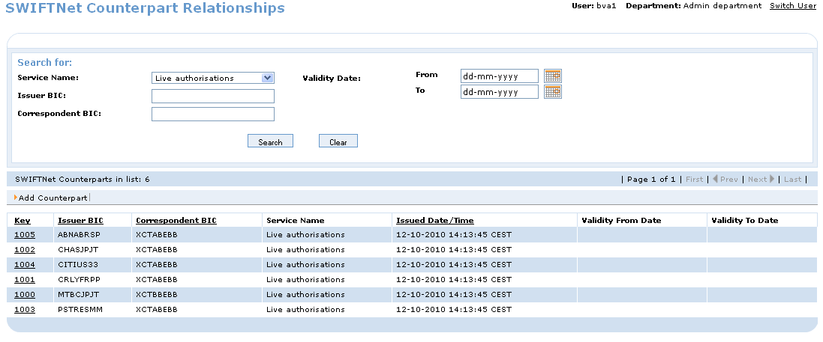
Serial and cover method – outgoing
SWIFTNet Counterpart Relationships (RMA)
Note: Service Name : swift.fin, etc .. Not ‘Live Authorisations’.

Slide 322
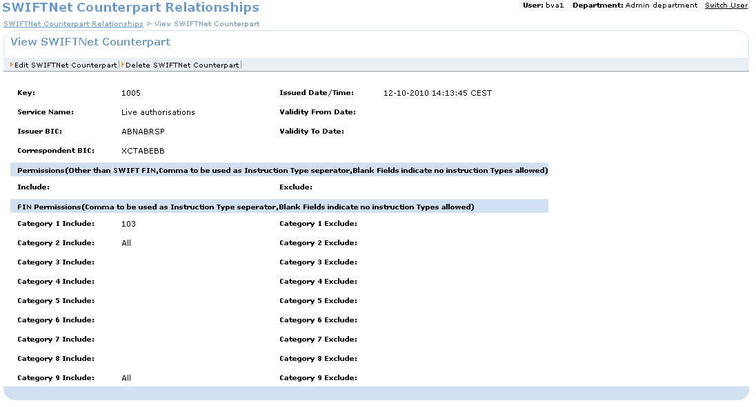
Serial and cover method – outgoing
SWIFTNet Counterpart Relationships (= RMA)
Note: Service Name : swift.fin, etc .. Not ‘Live Authorisations’.

Slide 323
Serial and cover method – outgoing example cover
Notes:
Serial & cover method (outgoing): Example cover method
In the example the PEX bank acts a Debit party's agent. The credit party is not a customer of the PEX bank. The PEX bank will therefore have to send payment(s) to the credit party's agent in order to settle the transaction. The transactions are thus classified as outgoing and not “on us”.
PEX will first determine whether the credit party's agent is an exchange partner of the PEX bank (which implies the PEX bank has an account relationship with the agent) to determine whether the cover or serial method is to be used. The credit party's agent seems no exchange partner of the PEX bank (1). Next the SWIFTNet Counterpart Relationships are consulted to see whether the credit party's agent can be reached via SWIFT. The credit party's agent is listed in the SWIFTNet Counterpart Relationships list (2). The cover method can therefore be used.
As a result an announcement (SWIFT MT103) (3) and a cover (SWIFT MT202) (4) are sent out.

Slide 324
Serial and cover method – outgoing example serial
Notes:
Serial & cover method (outgoing): Example serial method
To determine whether the cover or serial method is to be used, PEX will determine whether the credit party's agent is an exchange partner of the PEX bank (which implies that the PEX bank has an account relationship with the agent) or not. The credit party's agent seems no exchange partner of the PEX bank (1).
The SWIFTNet Counterpart Relationships are therefore consulted to check whether the credit party's agent can be reached via SWIFT. The credit party's agent is not listed in the SWIFTNet Counterpart Relationships list (2). The serial method will therefore be used.
As a result payment (SWIFT MT103) (3) is sent out to the routing agent (3).

Slide 325
Outgoing serial/cover processing – demo
Barclays, UK (BARCGB22)
Toblerone UK
1
MT103
(GBP)
Big Company,
Belgium
2
City Trends Inc.
XCT BANK-1,
Belgium
(XCTABEBB)
MT103
(USD equivalent EUR)
Credit Lyonnais, France
(CRLYFRPP)
MT101
MT202COV
(USD equivalent EUR)
Citibank, New York (CITIUS33)
Notes:
Open the Test Visibility Application: http://[server name]:9080/OPFTestVisibility
See to it that:
Field 30 (Requested Execution Date) in Serial - Cover - outgoing demo.txt is updated to the today’s date or the system time is altered via “Alter system time” in the menu to 30/6/2010, approximately 9 am
When re-loaded, field 20 (Sender's Reference) is updated in order to avoid running into the possible duplicate check. Note that the reference cannot be longer than 16 characters. Characters allowed are: “a b c d e f g h i j k l m n o p q r s t u v w x y z A B C D E F G H I J K L M N O P Q R S T U V W X Y Z 0 1 2 3 4 5 6 7 8 9 / - ? : ( ) . , ' + Space”
Click on PostSwiftInterchangeForm at the left hand side of the screen
Origin: should be selected as From SWIFT
Select the following file by clicking Browse…: Serial - Cover - outgoing demo.txt
Click Submit
Go to the Bank Visibility Application: http://[server name]:9080/BankVisibility/login
Login:
User: bva1 – bva20
Password: password
An incoming Interchange, Instruction and 2Transactions are created. The incoming Instruction will be in status “Awaiting Rate to be Published”. Two out of three Transactions require the rate to be published.
Publish the rate as follows:
Go to Currency Group in the left hand menu
Select the Currency Group having Currency Group Id 1004
Select Edit Currency Group
Flag the Available for Publishing flag and assure that the Fixing Cut Off Time has not passed yet
Click Save
Select Publish Rate Data
Two Transactions will get the status ‘Processing’ (not on-us Transactions requiring a receipt). Outgoing Instructions and Interchanges will be created for the Transactions that have status ‘Processing’.
The two submitted Interchanges of the 2 Transactions having status ‘Processing’ require a SWIFT ACK. The Interchanges will have status ‘Awaiting Transport Receipt’.

Slide 326


Incoming cover (MT202 COV)
MT202COV
(10000 EUR)
KBC, Belgium (KREDBEBB)
RTGS
MT202COV
(10000 EUR)
MT202-COV
(10000 EUR)
Oil Inc.
Al Rajhi Bank,
Riyadh (RJHISARI)
MT103
(10000 EUR)
XCT Bank-1,
Belgium
(XCTABEBB)
Big Company

Slide 327
Incoming cover (MT910)
Barclays, UK (BARCGB22) Instructing Reimbursement
Agent
MT202COV
(10000 GBP)
MT910
(10000 GBP)
Mini Store Inc Debit Party
Al Rajhi Bank, Riyadh (RJHISARI) Debit Party Agent
MT103
(10000 GBP)
XCT BANK-1
(XCTABEBB)
Credit Party Agent
Carrefour
Credit Party

Slide 328
Serial and cover method - incoming
Incoming
Be able to identify announcements:
Instructing/instructed reimbursement agent present in the transaction;
Instructing reimbursement agent <> sender or receiver.
Be able to identify potential covers:
Financial institution transfer or confirmation of credit;
Credit party is the OPF bank;
No account specified for the credit party.
Be able to reconcile cover/announcement:
Independent from the order in which they were received
Be able to process the announcement although the cover did not yet arrive (based on trusted agent list check)
Be able to setup, consult and maintain via UI a trusted agent list
Be able to manually reconcile cover and announcement in the BVA.
Notes:
Serial & cover method (incoming): Requirements

Slide 329
Potential Cover & Announcement
Determination of payment as ‘potential cover or announcement’
Criteria for potential announcement (determination done by Parser): Fields 53 or 54 not blank, Field 53 does not contain only an account number
Criteria for potential cover: instruction type, Receiver is OPF bank, related reference not blank.
Potential cover {202/910} → isCover set to TRUE + isCoverProcessing set to true
Potential announcement {103} → settlementMethod set to COVE
Boolean Operator | Attribute | Operator | Value/Attribute
 | PaymentInstruction.instructionType | Equals | SWIFT-MT202" OR “SWIFT-MT202-COV“ OR “pacs009.001.01” OR “SWIFT-MT910”
AND | PaymentInstruction.instructedAgentId | Equals | ExchangeCondition.InstructingAgentId, where the Exchange Condition key is PaymentInstruction.ClearingConditionKey
AND | PaymentInstruction.originalInstructionReference | NotEquals | "NONREF" AND NULL

Slide 330
Serial and cover method – incoming examples
Notes:
Serial & cover method (incoming): example announcement before cover
In the example the PEX bank acts a credit party's agent. The PEX bank receives a payment instruction. Both the instructing reimbursement agent (SWIFT field 53, sender’s correspondent: Bank X) and instructed reimbursement agent (SWIFT field 54, receiver’s correspondent: Bank Y) are present in the payment instruction (1). The instructing reimbursement agent (SWIFT field 53, sender’s correspondent) is moreover identified by means of a BIC and does not equal the sender or the receiver. The payment instruction is therefore identified as an announcement.
As a result PEX tries to reconcile the announcement with a cover. While the cover has not been received yet, no matching transactions are found.
An “on us” announcement can be further processed if the instructing agent is on the white list. The instructing agent is the Debit party's agent and is on the white list (2). The credit leg processing of the announcement is therefore executed, after which the credit party is being credited (3).
Next another payment instruction arrives. The payment instruction is a Confirmation of Credit (MT910) which confirms that the PEX bank’s account has been credited (4). The related reference (field 21) of this payment instruction is not empty and the receiver of the message is the PEX bank self. The instruction is therefore identified as a potential cover.
As a result reconciliation is executed. The cover matches with the previously received announcement. The settlement agent’s account of the cover is next copied to the announcement. The status of the cover is also set to “Finalized after reconciliation”.
Next the debit leg processing of the announcement is executed. This will result in the debit of the mirror account of the PEX bank’s account at Bank Y (6).

Slide 331
Serial and cover method – incoming examples
Notes:
Serial & cover method (incoming): example cover before announcement
In the example the PEX bank acts a credit party's agent. The PEX bank receives a payment instruction (2). The payment instruction is a financial institution transfer (SWIFT MT202) (1). The related reference (SWIFT field 21) of this payment instruction is not empty and the credit party of the transaction (SWIFT field 58) is the PEX bank itself. No account is moreover specified for the credit party (SWIFT field 58). The instruction is therefore identified as potential cover.
As a result PEX tries to reconcile the cover with the announcement. While the announcement has not been received yet, no matching payment instructions will be found. The status of the cover is therefore set to “to be reconciled / to be repaired”.
Next the PEX bank receives another payment instruction (2). Both the instructing reimbursement agent (SWIFT field 53, sender’s correspondent: Bank X) and instructed reimbursement agent (SWIFT field 54, receiver’s correspondent: Bank Y) are present in the payment instruction (3). The instructing reimbursement agent (SWIFT field 53, sender’s correspondent) is moreover identified by means of a BIC and does not equal the sender or the receiver. The payment instruction is therefore identified as an announcement.
The incoming settlement partner information of the cover is next copied to the announcement. The status of the reconciled cover is moreover set to “Finalized after reconciliation”. The announcement is then further processed, which will finally result in a debit of the mirror account of the PEX bank’s account at Bank Y and a credit of the credit party’s account (4). The credit party in a financial institution transfer (SWIFT field 58) equals the credit party's agent in a customer transfer.

Slide 332
Incoming Serial-Cover - demo
HSBC, London (MIDLGB22) Instructing Reimbursement
Agent
Barclays, London (CHASGB2L) Instructed Reimbursement
Agent
MT202COV
(10000 GBP)
MT910
(10000 GBP)
Mini Store Inc Debit Party
Al Rajhi Bank, Riyadh (RJHISARI) Debit Party Agent
MT103
(10000 GBP)
XCTBANK-1
(XCTABEBB)
Credit Party Agent
Super Market
Standard Credit Party
Notes:
Open the Test Visibility Application: http://[server name]:9080/OPFTestVisibility
See to it that:
Field 32A’s Date (Value Date) in Serial - Cover - incoming 103 demo.txt and Serial - Cover - incoming 910 demo.txt is updated to the today’s date or the system time is altered via “Alter system time” in the menu to 30/6/2010, approximately 9 am
When re-loaded, field 20 (Sender's Reference) is updated in order to avoid running into the possible duplicate check. Note that the reference cannot be longer than 16 characters. Characters allowed are: “a b c d e f g h i j k l m n o p q r s t u v w x y z A B C D E F G H I J K L M N O P Q R S T U V W X Y Z 0 1 2 3 4 5 6 7 8 9 / - ? : ( ) . , ' + Space”. Also note that field 21 in Scenario3-910.txt should be equal to field 20 in Scenario3-103.txt
Click on PostSwiftInterchangeForm at the left hand side of the screen
Origin: should be selected as From SWIFT
Select the following file by clicking Browse…: Serial - Cover - incoming 103 demo.txt
Click Submit
Go to the Bank Visibility Application: http://[server name]:9080/BankVisibility/login
Login:
User: bva1 – bva20
Password: password
The uploaded MT103’s Instruction will have status ‘Awaiting Reconciliation’
Next the related MT910 is to be loaded.
Open the Test Visibility Application: http://[server name]:9080/OPFTestVisibility
Click on PostSwiftInterchangeForm at the left hand side of the screen
Origin: should be selected as From SWIFT
Select the following file by clicking Browse…: Serial - Cover - incoming 910 demo.txt
Click Submit
Go to the Bank Visibility Application: http://[server name]:9080/BankVisibility/login
Login:
User: bva1 – bva20
Password: password
The uploaded MT910’s Instruction will have status ‘Reconciled’
The previously loaded MT103’s Instruction will also have the status ‘Reconciled’. The Transaction is processed on-us.

Slide 333
xCT / OPF product features
xCT – International and domestic collections and transfers
Updated
Updated
Parser/Formatters
(SWIFT MT, MX)
Foreign Exchange
Charges
Billing
PDE/PDM Duplicate
check
Updated
Updated
Auto-enrichment
Code word
processing
E&I
Cancellation
PSSM
(ACK/NAK Mgt.)
On-us FI Credit
Transfers
Updated
Updated
Updated
Serial - Cover
Manual entry
(Payments )
Bank cheque
requests
Y-copy
Settlement day
Determination
& Validation
New
Updated
Request for Transfer
PSD
determination
SSI Enrichment
Volume & value
thresholds
Accounting
(Accounting Entries)
Maximum adherence to SWIFT standards and guidelines
Future ready MT – MX coexistence

Slide 334
Request for Transfer - definition
Allow a corporate to send all its payments to a single bank, irrespective of the bank at which its account is held
Notes:
Request for transfer: definition

Slide 335
Request for Transfer - definition
Message typically used : MT101
This message is sent by a financial institution on behalf of a non-financial institution account owner, that is, the ordering customer/instructing party, and is subsequently received by the receiving financial institution and processed by the receiving financial institution or the account servicing financial institution.
It is used to move funds from the ordering customer's account(s) serviced at the receiving financial institution or at the account servicing institution, or from an account(s) owned by the ordering customer which the instructing customer has explicit authority to debit, for example, a subsidiary account.
The MT 101 can be used to order the movement of funds:
• Between ordering customer accounts, or
• In favor of a third party, either domestically or internationally.

Slide 336
Request for transfer
Request for Transfer For a received Request for Transfer (MT101), OPF:
Forwards the Instructions:
If the originating party agent is not the OPF bank (handled by Instruction routing)
If the originating party agent is allowed to receive SWIFT MT101 messages (SWIFTNet Counterparty check)
Or otherwise processes the Instruction
Notes:
Request for transfer: requirements

Slide 337
Request for Transfer
Instruction routing:
From-us indication checked for on the determined Participant:
From-us = true:
OPF Bank = Originating Party Agent
Instruction is processed by the OPF Bank
CCTI Instruction flow triggered
From-us = false:
OPF Bank = Forwarding Agent
New Instruction is created to forward the Request for Transfer
Request for Transfer Instruction flow triggered

Slide 338
Request for Transfer
RMA check:
If the Clearing Exchange Condition linked to the Instruction has the flag “SWIFT Counterpart Relationship Authorization Check Required” flagged as “TRUE”
Checks whether the Originating Party Agent mentioned in the Instruction can be reached, by checking the SWIFTNet Counterpart information (see next slide)
An issue is raised if the agent cannot be reached. Outcome = repair

Slide 339

Request for Transfer - demo
Bank of Phillipines
(BOPIPHMM)
Credit Party Agent
Henry Olagna
Credit Party
Big Company,
Spain
Debit Party
SWIFT
Gateway
Big Company,
Belgium
Initiating Party
XCT BANK-1
(XCTABEBB)
Forwarding Agent
Banco Pastor, Spain
(PSTRESMMBAR)
Debit Party Agent
Credit Party Agent
Fashion Inc
Credit Party
MT101
(10000 EUR | Fashion Inc
(10000 EUR | José Rodrigues)
(10000 EUR | Henry Olanga)
MT101
Banco Popular Español, S.A.
(POPUESMMXXX)
Credit Party Agent
José Rodrigues
Credit Party

Slide 340
xCT / OPF product features
xCT – International and domestic collections and transfers
Updated
Updated
Parser/Formatters
(SWIFT MT, MX)
Foreign Exchange
Charges
Billing
PDE/PDM Duplicate
check
Updated
Updated
Auto-enrichment
Code word
processing
E&I
Cancellation
PSSM
(ACK/NAK Mgt.)
On-us FI Credit
Transfers
Updated
Updated
Updated
Serial - Cover
Manual entry
(Payments )
Bank cheque
requests
Y-copy
Settlement day
Determination
& Validation
New
Updated
Request for Transfer
PSD
determination
SSI Enrichment
Volume & value
thresholds
Accounting
(Accounting Entries)
Maximum adherence to SWIFT standards and guidelines
Future ready MT – MX coexistence

Slide 341
Exceptions and Investigations
Exceptions and Investigations : CRAQ & Free-Text
Request for Cancellations (MTn92)
Queries (MTn95), Answers (MTn96)
Free text messages (MTn99)

Slide 342
Exceptions and Investigations
Cancellations (MTn92):
Auto-reconcile with original message
Try to stop original message if still in system
If original message is already processed:
Original message on-us: approval prior to “honouring” the cancel
Original message not on-us: MTn92 is forwarded
Auto generate Answer (MTn96) once stopped or unable to apply
Initiated from BVA or received as incoming message
In case of cover method, follows announcement

Slide 343
Exceptions and Investigations - E&I
Requirements E&I:
Parse & Submit SWIFT formats (SWIFT MT n92, MT n95, MT n96, MTn99)
Process incoming E&I messages:
Automatically reconcile E&I messages with transactions they relate to
Create info-WLI if reconciliation successful
Create action-WLI if reconciliation fails + allow manual reconciliation
Initiate and process outgoing E&I messages:
BVA:
Be able to initiate E&I messages:
Enter destination BIC
Select standard texts (queries/answers) and fill-out variable text
Submit E&I messages (SWIFT message gets submitted; link made to transaction or instruction)
Maintain standard/boilerplate text
Display link between E&I messages and transactions
Be able to manually reconcile E&I messages with transactions
Notes:
CRAQ: requirements

Slide 344
E&I – auto-reconciliation
Payment Reconciliation Table Attribute | Original InstructionKey | Reconciling InstructionKey | Original TransactionKey | Reconciling TransactionKey | ReconciliationType
Match for an Answer is detected | Matching Query/Request for Cancellation Instruction Key | Answer Instruction Key | n/a | n/a | RfC - Ans (Request for Cancellation_To_Answer, if reconciled against an RfC), Query - Ans (Query_To_Answer, if reconciled against a Query)
Answer is reconciled to the payment, in case the match is already reconciled | (Matching Instruction key, if the payment is an Instruction) | Answer Instruction Key | (Matching Transaction key, if the payment is a Transaction) | n/a | Instr - Ans (Instruction_To_Answer, if the payment is an Instruction), Trn - Ans (Transaction_To_Answer, if the payment is Transaction)
Match for a Request for Cancellation is detected | Matching Instruction key | Request for Cancellation Instruction Key | n/a | n/a | Instr - RfC (Instruction_To_ Request for Cancellation)
Match for an Query is detected | Matching Instruction key | Query Instruction Key | n/a | n/a | Instr - Query (Instruction_To_Query)
Match for a Free Text Message is detected | Matching Instruction key | Free Text Message Instruction Key | n/a | n/a | Instr - FFM (Instruction_To_Free Format Message)

Slide 345
E&I – initiate Query
Example initiate Query

Slide 346
E&I – initiate Query

Slide 347
xCT / OPF product features
xCT – International and domestic collections and transfers
Updated
Updated
Parser/Formatters
(SWIFT MT, MX)
Foreign Exchange
Charges
Billing
PDE/PDM Duplicate
check
Updated
Updated
Auto-enrichment
Code word
processing
E&I
Cancellation
PSSM
(ACK/NAK Mgt.)
On-us FI Credit
Transfers
Updated
Updated
Updated
Serial - Cover
Manual entry
(Payments )
Bank cheque
requests
Y-copy
Settlement day
Determination
& Validation
New
Updated
Request for Transfer
PSD
determination
SSI Enrichment
Volume & value
thresholds
Accounting
(Accounting Entries)
Maximum adherence to SWIFT standards and guidelines
Future ready MT – MX coexistence

Slide 348
Manual entry - requirements
Requirements:
Be able to register a payment (instruction and related transaction(s)):
From scratch
Based on a template
Be able to validate, store and further process the registered payment
Configure the user authority to manually register a payment
Be able to save registered payments as a template
Notes:
Manual entry: requirements

Slide 349
Manual entry
Manual entry of a Payment
Allows a user to manually enter a Payment:
Financial Institution to Financial Institution Customer Credit Transfer (e.g. PACS.008, MT103, MT102 equivalent)
Financial Institution Credit Transfer (e.g. PACS.009, MT202, MT202-COV, MT200, MT203, MT205 equivalent)
Customer Credit Transfer initiation (e.g. PAIN.001, MT101 equivalent)
Screens have been defined based on the ISO terminology:
Manual entry screens use the same terminology irrespective of the payment to be entered (e.g. PACS.008, MT103 and a proprietary domestic credit transfer can be entered by using the same screen)
Learning curve decreases by using descriptive terminology instead of format specific terminology (credit party agent vs. field 57)

Slide 350
Manual entry
Manual entry of a Payment
Manually entered payments are retained as Instructions and Transactions, no Interchange created
“Advanced” payment entry, extensive amount of payment info can be entered (ISO-based and MT based entry)
Store/update/retrieve templates
4-eye verification by re-entering key information (date, amount, ccy)

Slide 351
Manual entry - Template
Manual entry of a Payment - Template
When creating a payment the user can save the details of that payment into a template, which can be used later on to create a new payment
The system stores the input as a new Payment Template. The system records the following details for the template:
Payment type (FI2FI Customer Credit Transfer/Financial Institution Credit Transfer/Customer Credit Transfer Initiation)
Template name
Description (optionally)
The system stores all information entered (including dates)
Both Instruction & Transaction(s) are saved in the template
While creating a new payment using a template, all fields that are automatically determined, are re-determined

Slide 352
xCT / OPF product features
xCT – International and domestic collections and transfers
Updated
Updated
Parser/Formatters
(SWIFT MT, MX)
Foreign Exchange
Charges
Billing
PDE/PDM Duplicate
check
Updated
Updated
Auto-enrichment
Code word
processing
E&I
Cancellation
PSSM
(ACK/NAK Mgt.)
On-us FI Credit
Transfers
Updated
Updated
Updated
Serial - Cover
Manual entry
(Payments )
Bank cheque
requests
Y-copy
Settlement day
Determination
& Validation
New
Updated
Request for Transfer
PSD
determination
SSI Enrichment
Volume & value
thresholds
Accounting
(Accounting Entries)
Maximum adherence to SWIFT standards and guidelines
Future ready MT – MX coexistence

Slide 353
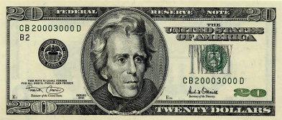

Currency conversion (Forex)
Currency conversion
Forex rate 1 EUR = 1,4 USD
Forex rate quotation EUR/USD or USD/EUR
Base currency 1 EUR = 1,4 USD - EUR is the base currency
D
EUR
C
20 USD
?
Notes:
Currency conversion Applying a foreign-exchange rate to convert an amount from one currency into another
Forex rate A foreign-exchange rate (forex rate) is the rate at which one currency can be exchanged (or traded) for another (e.g. 1 EUR = 1,4 USD)
Forex rate quotation A forex rate quotation (e.g. EUR/USD or USD/EUR) expresses the amount of money that can be bought of a certain currency in terms of another currency.
Base currency The base currency is the “first” currency in a quotation. A forex rate is quoted per unit of a base currency (e.g. 1 EUR = 1,4 USD; EUR is the base currency)

Slide 354
Currency conversion (Forex)
Price currency 1 EUR = 1,4 USD - USD is the price currency
Direct vs. Indirect quotation
Indirect quotation
Typical European method of expressing forex rates
OPF bank’s local currency is EUR
The indirect quotation is 1 EUR = 1,4768 USD
Notes:
Price currency The price currency (aka quote currency, counter currency, terms currency) is the second currency in a quotation. It represent the price which is to be paid for one unit of the base currency (e.g. 1 EUR = 1,4 USD; USD is the price currency)
Direct vs. Indirect quotation The currency which is to be taken as the base or as the price currency depends on the OPF bank’s local currency and whether a so-called direct or indirect quotation is used:
Indirect quotation
The OPF Bank’s local currency is taken as the base currency (e.g. OPF bank’s local currency is EUR; the indirect quotation is 1 EUR = 1,4768 USD )
This rate quotation is a typical European method of expressing forex rates

Slide 355
Currency conversion (Forex)
Direct vs. Indirect quotation
Direct quotation
Typical American method of expressing rates
OPF bank’s local currency is USD
The direct quotation is 1 EUR= 1,4768 USD
Indirect
1 EUR = 1,2 USD
Direct
0,8 EUR = 1 USD
Notes:
Direct vs. Indirect quotation
Direct quotation
The OPF bank’s local currency is taken as the price currency (E.g. A US OPF bank’s local currency is USD; the direct quotation is 1 EUR= 1,4768 USD)
This rate quotation is a typical American method of expressing rates

Slide 356

Currency conversion (Forex)
Forex rate types
Defines how a certain forex rate is to be fetched (i.e. from the OPF database, from an external source, entered by a user)
Defines whether payments have to wait until rates are fixed, to apply currency conversion
Could express what “kind” of rate will be applied, which can be used by the external system to know which rate to return
xCT
External
system

Slide 357
Currency conversion (Forex)
Buy/Sell/Mid rate
Buy rate A Buy rate is the rate at which a bank buys (“We buy”) a certain currency
Sell rate A Sell rate is the rate at which a bank sells (“We sell”) a certain currency
Mid rate The mid or average rate is the arithmetic mean between the Buy and Sell rate

Slide 358
Currency conversion (Forex)
Cross-rate A rate applied if none of the currencies in the currency conversion equal the OPF Bank’s base currency. E.g. The OPF Bank’s base currency is EUR. A currency conversion is required from USD to JPY.
Example cross-currency
OPF Bank local currency | EUR
Originating Party account currency | USD
Settlement currency | JPY

Slide 359



Currency conversion (Forex)
Cases in which currency conversion is required
100
100
D
C
D
C
80
80
Originating party’s account currency <> settlement currency
Credit party’s account currency <> settlement currency
100
100
D
C
D
C
80
80
Incoming Settlement Participant’s account currency
<> settlement currency
Outgoing Settlement participant’s account currency
<> settlement currrency

Slide 360
Currency conversion (Forex)
Cases in which currency conversion is required
100
100
2
D
C
D
C
80
120
3
Equivalent amount’s currency <> settlement currency
Charges amount currency
<> charges account or debit party’s account
98
71F = 2
100
F/X rate type ?
0 > 100000 = Day rate 100000 > ... = Manual rate
3
Receiver’s charges (SWIFT field 71F) to be deducted from
settlement amount and to be converted to the settlement currency
F/x rate type’s selection criteria include amounts (minimum amount, maximum amount) expressed in bank’s base currency. Settlement amount currency to be converted to bank’s base currency

Slide 361
Currency conversion (Forex)
Functionality supported by the Forex feature
Support currency conversion for a payment (instruction/transaction) / currency conversion required by another service
Support configurable determination of rate types:
By applying rules applicable on Product (Bank level)
By applying rules applicable for a certain Agreement (Participant level)

Slide 362
Currency conversion pre-conditions
Processing attributes determined
Account and account currency should have been determined:
Settlement account:
Account present in the input message, no account currency
Account present in the input message, account currency present
No account present in the input message
Originating party account, charges account, credit party account:
Account present in the input message, no account currency
Account present in the input message, account currency present

Slide 363
Determine processing context
Determination processing context (xCT)
Forex (currency conversion)
Service attribute | Usage by the forex service
Rate type configuration name | Reference to the configuration, based on which the rate type is determined and which specifies the rate type characteristics. E.g. “Simple rate type” configuration: the rate type config determines that: If the settlement amount is between €0 and €49999,99 then the rate type is a “current market rate”. The “current market rate” is fetched from an external source. It does not require fixing. If the settlement amount is equal or higher than €50000 then the rate type is a “user defined rate” . The “current market rate” is to be entered by a user.
Currency group name | Reference to the rates that are to be applied (if the source of the rate type to apply is “Currency Group”) E.g. The “EUR” currency group, listing all rates against EUR

Slide 364
Currency conversion (Forex)
Currency Convert an Amount
Main use case of the Forex Service
Responsible for invoking the following individual functionalities of Forex:
Determine Conversion Required
Determine whether currency conversion is required or not
If currency conversion is required, then the use case determines all information required to do the currency conversion (e.g. the source amount, source currency, target currency)
If no currency conversion is required, the use case ends
Determine Rate Type
Determines the rate type to be used for the payment at hand

Slide 365
Currency conversion (Forex)
Currency Convert an Amount
Responsible for invoking the following individual functionalities of Forex:
Determine Rate
Determines a Forex rate, required for converting the “Source Amount”, expressed in a certain “Source Currency”, to the “Target Currency”
Apply Rate
Converts the “Source Amount”, expressed in the “Source Currency” to the “Target Currency”
Calculates the Margin Amount
The Margin Amount and Target Amount (converted amount) are updated in the Payment Transaction or Payment Instruction

Slide 366
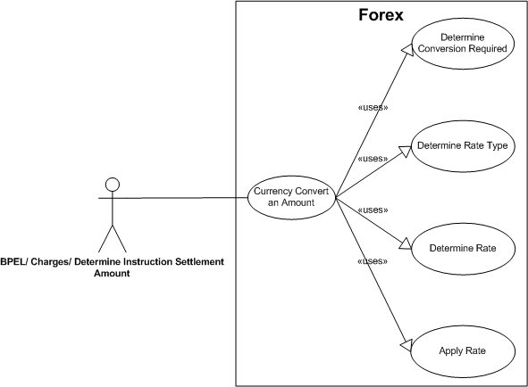
Currency conversion (Forex)
Currency Convert an Amount

Slide 367
xCT / OPF product features
xCT – International and domestic collections and transfers
Updated
Updated
Parser/Formatters
(SWIFT MT, MX)
Foreign Exchange
Charges
Billing
PDE/PDM Duplicate
check
Updated
Updated
Auto-enrichment
Code word
processing
E&I
Cancellation
PSSM
(ACK/NAK Mgt.)
On-us FI Credit
Transfers
Updated
Updated
Updated
Serial - Cover
Manual entry
(Payments )
Bank cheque
requests
Y-copy
Settlement day
Determination
& Validation
New
Updated
Request for Transfer
PSD
determination
SSI Enrichment
Volume & value
thresholds
Accounting
(Accounting Entries)
Maximum adherence to SWIFT standards and guidelines
Future ready MT – MX coexistence

Slide 368
Determine and validate settlement days
Determine incoming/outgoing settlement day
Customer Initiated Payments
Incoming validations performed:
Requested Execution Day is not in the past
Requested Execution Day is an open business day (debit party account currency, instructed currencycy calendar)
Timelines (cut-offs) in the agreement contracted between the Bank and the party/agent instructing the payment are respected
Settlement day determined as:
Requested Execution Day if not past cut-off
Next Business Day if past cut-off

Slide 369
Determine and validate settlement days
Determine outgoing settlement day
Part of calculation of the outgoing Transaction days, determined after routing
First step is to calculate the outoing settlement day (see next slides)
Next, the earliest and latest submission date time and earliest dewarehousing date time are determined

Slide 370
Determine and validate settlement days
Determine outgoing settlement day
Determined for on-us and not on-us Transactions
A float is determined based on a number of configurable parameters:
Classification
Priority
Settlement Currency
Credit Party Agent Country
Processing Scheme
On-us
Outbound
The parameters can be extended.
The float can be defined as:
Calendar Days
Business Days

Slide 371
Determine and validate settlement days
Determine outgoing settlement day
The incoming settlement day, increased with the determined float should be a valid business day according to:
The settlement currency (Business Calendar)
The credit party account or settlement account currency (Business Calendar)
The first open day is determined and becomes the settlement day

Slide 372
Determine and validate settlement days
Validate incoming settlement day
Not for Customer Credit Transfer Initiation Payments.
Inbound payments
Range check
Open business day (settlement account ccy and settlement ccy calendars)
Cut-off not past (VOSTRO)
Outcome if issue
Closed business day, Range check: repair
Cut-off past : (e.g. for charging) outgoing side date is rolled-over

Slide 373
xCT / OPF product features
xCT – International and domestic collections and transfers
Updated
Updated
Parser/Formatters
(SWIFT MT, MX)
Foreign Exchange
Charges
Billing
PDE/PDM Duplicate
check
Updated
Updated
Auto-enrichment
Code word
processing
E&I
Cancellation
PSSM
(ACK/NAK Mgt.)
On-us FI Credit
Transfers
Updated
Updated
Updated
Serial - Cover
Manual entry
(Payments )
Bank cheque
requests
Y-copy
Settlement day
Determination
& Validation
New
Updated
Request for Transfer
PSD
determination
SSI Enrichment
Volume & value
thresholds
Accounting
(Accounting Entries)
Maximum adherence to SWIFT standards and guidelines
Future ready MT – MX coexistence

Slide 374
Y-copy – outgoing
SWIFT message content (Y-copy)
Sender: Bank A
Receiver: Bank B
103: Y-copy code
57: absent
59: Beneficiary
SWIFT message content (No Y-copy)
Sender: Bank A
Receiver: RTGS
103: absent
57: Bank B
59: Beneficiary
Notes:
Y-copy: definition
Service offered by SWIFT, whereby SWIFT manages communication with the clearing system (e.g. RTGS).
The sender includes a service code in the message he sends to SWIFT.
This code indicates to which clearing system the information is to be copied (e.g. TGT = Target2).
SWIFT copies part of a received message and sends it to the clearing system.
The clearing system then does the settlement and:
Sends an ACK to SWIFT if settlement succeeded:
SWIFT then sends the message it received from the sender on to the receiver
Sends an ACK (if required) to the sender
Sends an NAK to SWIFT if settlement failed
SWIFT then sends a NAK to the sender.

Slide 375
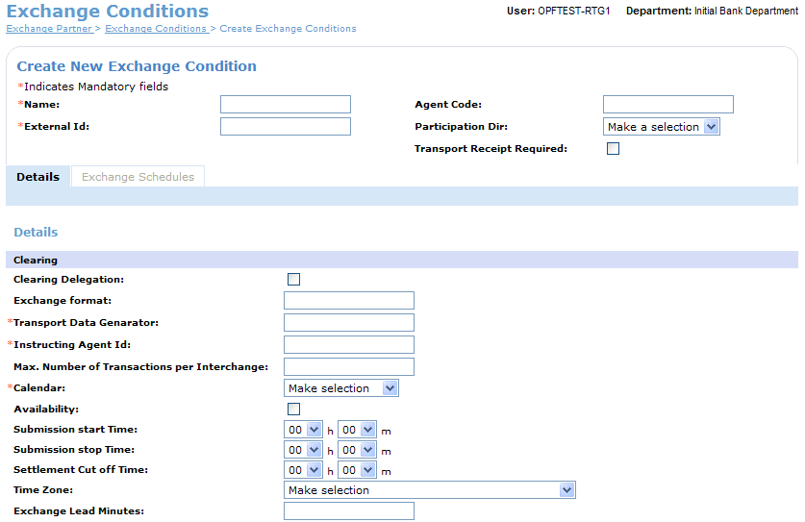
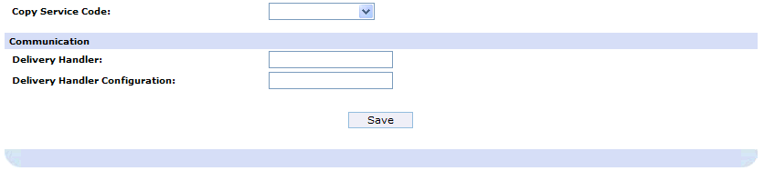
Y-copy - outgoing

Slide 376
Y-Copy - outgoing
 | Source | Enriched to | SWIFT Message
Y-copy | Exchange Condition’s Copy Service Code | Interchange’s clearing system | Tag 103
 | Transaction’s Intermediary agent | Interchange’s receiving party | Receiver
 | Transaction’s Credit party agent | Interchange’s receiving party (if intermediary agent not present) | Receiver
No y-copy | Exchange Condition’s agent id | Interchange’s receiving party | Receiver

Slide 377
Y-copy - demo
MT103
(1000001 EUR)
RTGS
MT012
MT103
(1000001 EUR)
XCT BANK-1
(XCTABEBB)
BANCA TOSCANA S.P.A. (TOSCIT3F) Intermediary
Agent
Super Store Inc Debit Party
Banco Monex (MONXMXMM) Debit Party Agent
BANCA MONTE DEI PASCHI
DI SIENA S.P.A. (TOSCIT3F) Credit Party Agent
Web Lite Inc Credit Party

Slide 378
xCT / OPF product features
xCT – International and domestic collections and transfers
Updated
Updated
Parser/Formatters
(SWIFT MT, MX)
Foreign Exchange
Charges
Billing
PDE/PDM Duplicate
check
Updated
Updated
Auto-enrichment
Code word
processing
E&I
Cancellation
PSSM
(ACK/NAK Mgt.)
On-us FI Credit
Transfers
Updated
Updated
Updated
Serial - Cover
Manual entry
(Payments )
Bank cheque
requests
Y-copy
Settlement day
Determination
& Validation
New
Updated
Request for Transfer
PSD
determination
SSI Enrichment
Volume & value
thresholds
Accounting
(Accounting Entries)
Maximum adherence to SWIFT standards and guidelines
Future ready MT – MX coexistence

Slide 379
Post Submission Status Management
Different Participant behaviour, gateways, networks, protocols => need to be able configure for each Exchange Condition what level of ‘ACK / NAK’ is expected
OPF Concepts:
Transport receipts:
Report on delivery status of an Interchange.
Not modelled themselves as Interchange/Instruction. Data stored in History of corresponding Interchange.
3 ‘levels’: Gateway receipt, Network receipt, Delivery receipt
Examples: SWIFT ACK/NAK (F21), MT010, MT011
Instruction receipts:
Report on status of an Instruction
Modeled as Interchange/Instruction (“R-Instructions”). Visible in specific tab on UI.
2 ‘levels’: Validations receipt, Settlement receipts
Examples: STEP2 CVF, MT012, MT019
Can contain R-transaction (e.g. STEP2 CVF)
Optional time-outs (for Transport receipt & Instruction receipt)
Standard supported receipts: F21, MT010, MT011, MT012, M019
Examples of topology

Slide 380
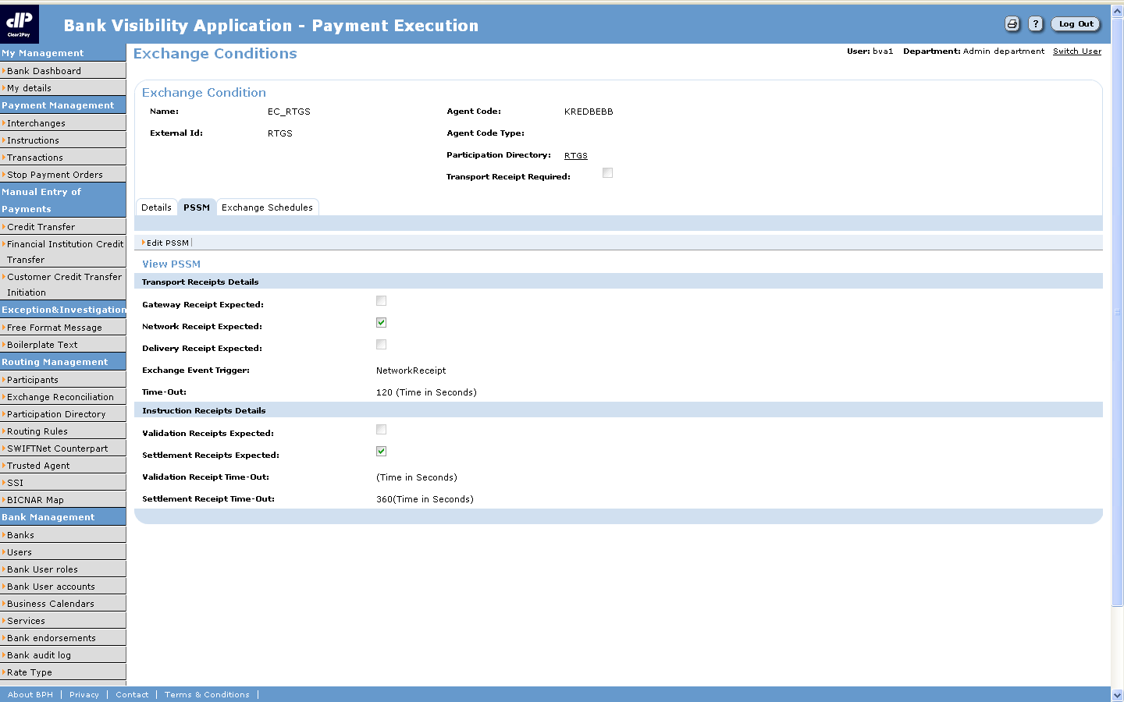
PSSM – configurable online
Define the time-out after which the user is to be notified of a non-receipt (informational Work List Item)
Define which transport receipts are expected for a particular exchange condition
Define which instruction receipts are expected for a particular exchange condition

Slide 381
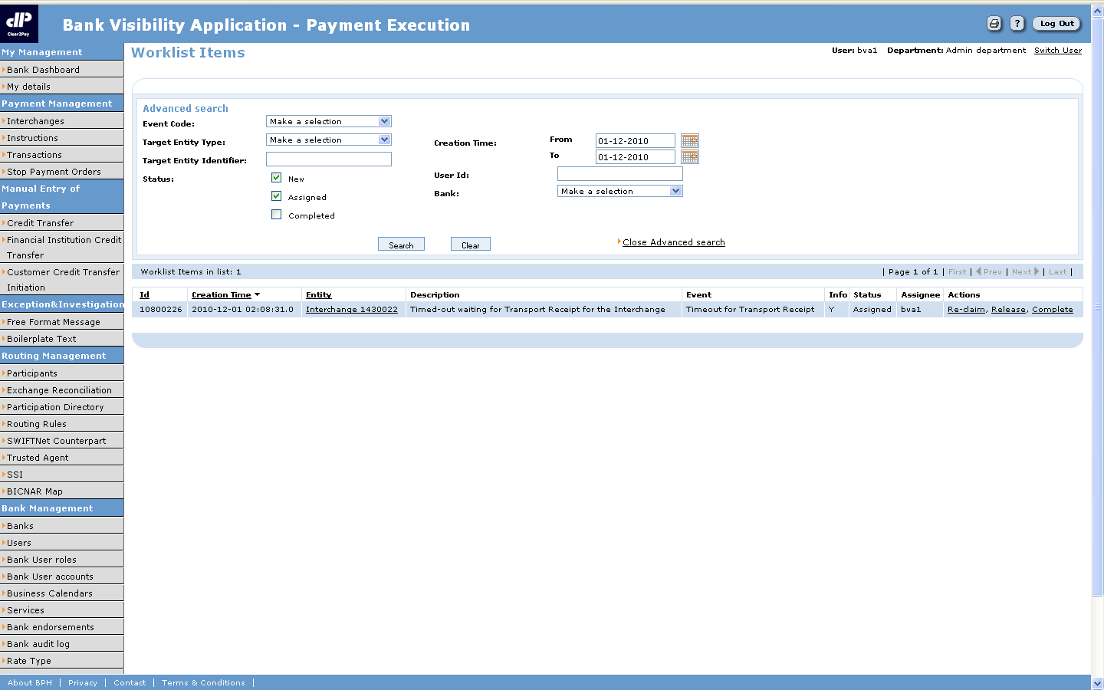
PSSM – time-out exceeded
The user can browse to the Interchange for which no receipt was received
Informational WLI created to warn the user about a non-receipt of a transport receipt

Slide 382
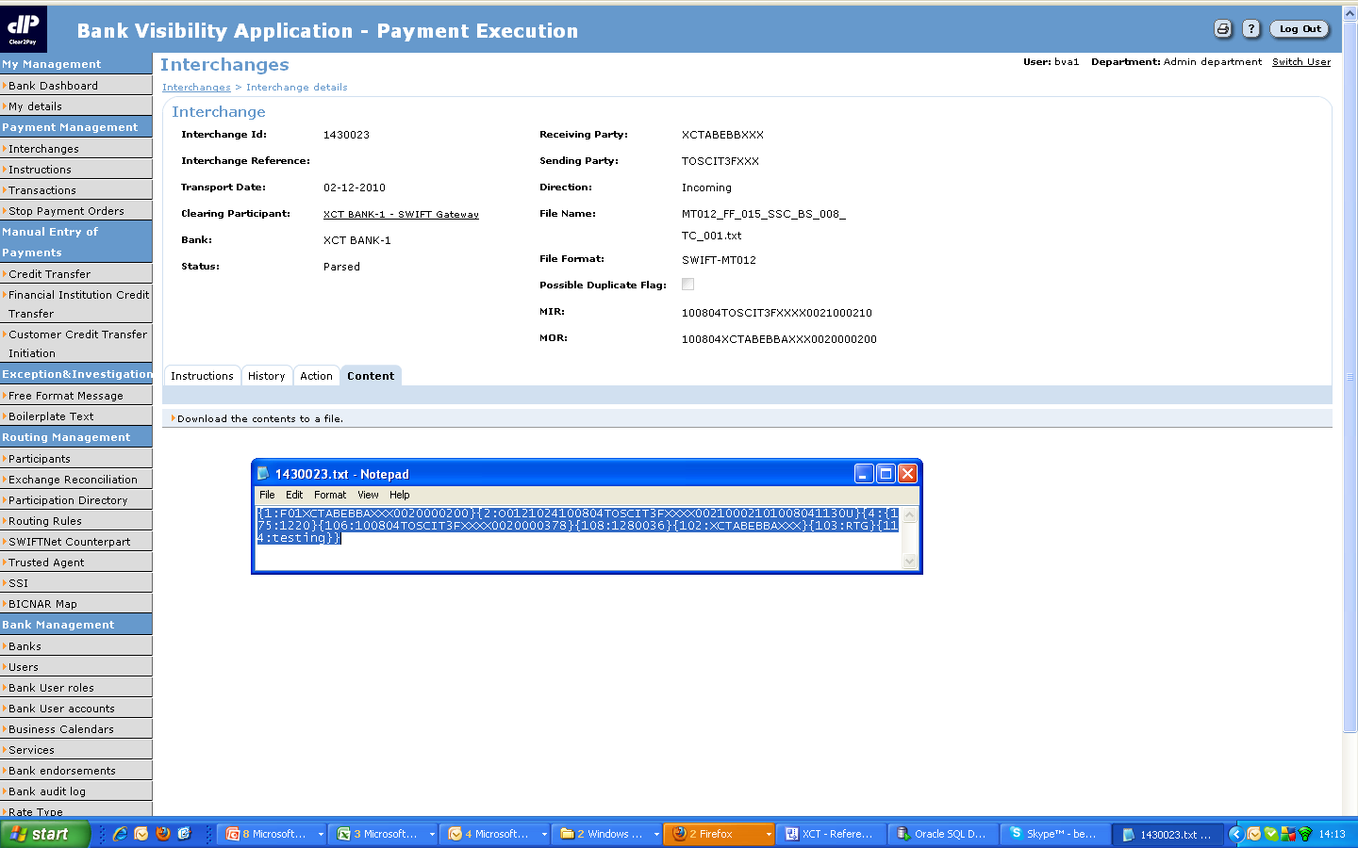
PSSM - Receipts can be viewed online
The receipts “raw data” can be viewed online

Slide 383
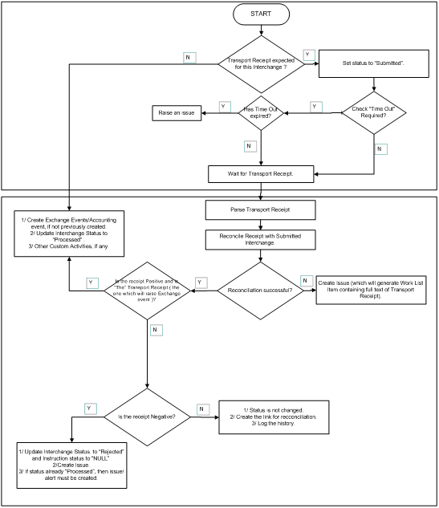
PSSM – Transport Receipt Processing
Interchange status only updated for ‘The’ Transport Receipt (the one expected that triggers Exchange Event). No status updates for intermediary receipts.
Status updated to Processed or Rejected.
Conflicting Receipt do not lead to status update: e.g. If status is Processed it remains Processed. (but WLI is created).
On submission, Transaction status set to NULL (inherits Instruction status)
When Interchange status is updated:
If Rejected, then Instruction status set to NULL (it ‘inherits’ Interchange status on UI).
Transaction status remains NULL (inherits Instruction status).
Reconciliation can be unsuccesful if:
No match
Multiple matches
If time out → WLI; no status update

Slide 384
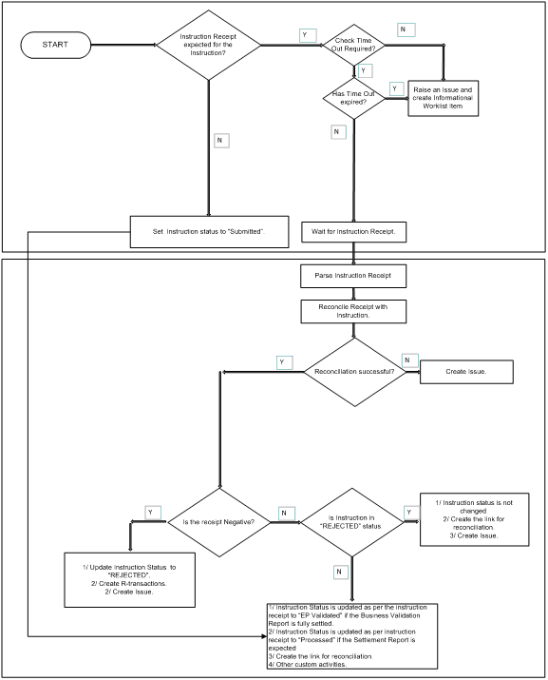
PSSM – Instruction Receipt Processing
On submission, Instruction status set to ‘Submitted’
If no Instruction Receipt expected, then Instruction status set to NULL (it ‘inherits’ Interchange status on UI)
On receipt of positive ‘validation’ Instruction Receipt:
Status updated to ‘EP validated’, if ‘settlement’ Instruction Receipt expected
Status updated to ‘Processed’, if no ‘settlement’ Instruction Receipt expected.
On receipt of positive ‘settlement’ Receipt: status updated to ‘Processed’
Transactions inherit Instruction status (on UI)

Slide 385
PSSM – examples status update
Transport receipts (network receipt F21)
Notes:
Network receipt expected (F21)
Configuration of the receiver’s exchange condition: network receipt expected (+ identified as the one to generate the Exchange Event)
Processing:
Upon submission: a transport receipt is expected. The status of the Interchange is therefore set to “Submitted”. The Instructions’ and transactions’ statuses are set to NULL.
Upon receipt F21:
Positive receipt: the receipt is the “final” transport receipt (no more expected after this transport receipt type). The status of the Interchange is therefore set to “Processed”. No Instruction receipt is expected. The related Instructions’ and Transactions’ statuses are therefore not updated.
Negative receipt: the status of the Interchange is updated to “Rejected”.

Slide 386
PSSM – examples status update
All possible transport receipts and Instruction receipts expected, Y-copy

Slide 387
PSSM - demo
MT103
(1000001 EUR)
RTGS
MT012
MT103
(1000001 EUR)
XCT BANK-1
(XCTABEBB)
BANCA TOSCANA S.P.A. (TOSCIT3F) Intermediary
Agent
Super Store Inc Debit Party
Banco Monex (MONXMXMM) Debit Party Agent
BANCA MONTE DEI PASCHI
DI SIENA S.P.A. (TOSCIT3F) Credit Party Agent
Web Lite Inc Credit Party

Slide 388
xCT / OPF product features
xCT – International and domestic collections and transfers
Updated
Updated
Parser/Formatters
(SWIFT MT, MX)
Foreign Exchange
Charges
Billing
PDE/PDM Duplicate
check
Updated
Updated
Auto-enrichment
Code word
processing
E&I
Cancellation
PSSM
(ACK/NAK Mgt.)
On-us FI Credit
Transfers
Updated
Updated
Updated
Serial - Cover
Manual entry
(Payments )
Bank cheque
requests
Y-copy
Settlement day
Determination
& Validation
New
Updated
Request for Transfer
PSD
determination
SSI Enrichment
Volume & value
thresholds
Accounting
(Accounting Entries)
Maximum adherence to SWIFT standards and guidelines
Future ready MT – MX coexistence

Slide 389
Charges & Billing
Charges
On a payment per payment basis
OUR, BEN and SHA charge options
Customer and interbank charges
Features
Charges defined/calculated in various ways
Various methods to claim charges (accounting, SWIFT MT190, SWIFT MT191, pre-paid charges)
Charges can be defined per the agreement on Bank group, Bank, Participant or Account level
No charges for PSD eligible payments
Fixed
€20
Percentage
0,1 %
Min. €5
Max. €100
Tiers
€0-€10000: €5
€10000-€100000: €10
Notes:
Charges
OUR, BEN & SHA charging-options
Customer and interbank charges
Charges defined as:
Fixed charges
Percentages, optionally constrained by minima and maxima
Tiers
Supported “charge mechanisms”:
OUR (prepaid)
Credit Fee Deduct
Charge VOSTRO and advice via MT190
Charge on request via MT191
Accounting

Slide 390
Charges - terminology
Charges Amount charged for providing payment services to, amongst others, customers and other financial institutions
Charge bearer OUR, BEN, SHA vs. DEBT, CRED and SHAR Indicates which party/parties will bear the charges
OUR Charges are to be borne by the debit party. The value used internally/by ISO20022 is ‘DEBT’
BEN Charges are to be borne by the credit party. The value used internally/by ISO20022 is ‘CRED’
SHA Charges on the sender side are to be borne by the debit party, charges on the receiver side are to be borne by the credit party. The value used internally/by ISO20022 is ‘SHAR’

Slide 391
Charges - terminology
Charge type Kind of charges that are to be claimed to process a Payment. E.g. Payment processing fee, Fee to call the beneficiary, SWIFT-to-cheque fee

Slide 392
Charges - terminology
Charge calculation methods
Fixed amount expressed in a certain currency. E.g. 1 EUR
Percentages of the payment’s amount, optionally constrained by minima and maxima amounts. E.g. 0,01% min. 5 EUR, max 100 EUR
Tiers – fixed amount Fixed charges amounts can be defined per “tier slab” of the Payment’s amount (e.g. Tier 1 slab – Up to Amount 10000 – Charge EUR 100, Tier 2 slab – Greater than 10000 – Charge EUR 200)
Tiers – percentages Percentages of the payment’s amount to charge, can be defined per “tier slab” of the Payment’s amount, optionally constrained by minima and maximum amounts (e.g. Tier 1 slab – Up to Amount 10000 – Charge 1%, Tier 2 slab – Greater than 10000 – Charge 0.75%)

Slide 393
Charges & Billing
Charges
Various supported “charge mechanisms”
Accounting
Benededuct
Notes:
Charges & billing
A number of “mechanisms” to reimburse charges can be distinguished:
OUR (prepaid): the debit party’s agent calculates charges for himself and for the next agent in the chain. He charges the customer for the total amount of charges. The charges due to the next agent are included in the settlement amount.
Benededuct: Each agent in the chain deducts charges from the settlement amount.
Charge VOSTRO and advice via MT190: Applicable if the agent from which charges are to be reimbursed holds an account at the agent who claims the charges. The latter then debits the former agent’s VOSTRO account for the charges amount. An Advice of Charges (SWIFT MT190) is next sent, to inform the VOSTRO agent about the event.
Charge on request via MT191: reimbursement occurs by sending a Request for Payment of Charges (SWIFT MT191) to the agent which owes the charges. The latter then pays the charges by means of a financial institution transfer (SWIFT MT202)

Slide 394
Charges & Billing
Charges
Various supported “charge mechanisms”
Charge VOSTRO and advice via MT190
Charge on request via MT191
OUR Pre-paid
Notes:
Charges & billing
A number of “mechanisms” to reimburse charges can be distinguished:
OUR (prepaid): the debit party’s agent calculates charges for himself and for the next agent in the chain. He charges the customer for the total amount of charges. The charges due to the next agent are included in the settlement amount.
Benededuct: Each agent in the chain deducts charges from the settlement amount.
Charge VOSTRO and advice via MT190: Applicable if the agent from which charges are to be reimbursed holds an account at the agent who claims the charges. The latter then debits the former agent’s VOSTRO account for the charges amount. An Advice of Charges (SWIFT MT190) is next sent, to inform the VOSTRO agent about the event.
Charge on request via MT191: reimbursement occurs by sending a Request for Payment of Charges (SWIFT MT191) to the agent which owes the charges. The latter then pays the charges by means of a financial institution transfer (SWIFT MT202)

Slide 395
Charges - terminology
“Charge mechanisms”
Generating accounting events
Towards a customer of the Bank, including the option to book charges from a deviating charges account. Deviating charges accounts are only used in case they are provided in the payment.
Towards a financial institution’s VOSTRO account in case of DEBT charges.
For pre-paid charges (71G) received.
Notes:
Charges & billing
A number of “mechanisms” to reimburse charges can be distinguished:
OUR (prepaid): the debit party’s agent calculates charges for himself and for the next agent in the chain. He charges the customer for the total amount of charges. The charges due to the next agent are included in the settlement amount.
Benededuct: Each agent in the chain deducts charges from the settlement amount.
Charge VOSTRO and advice via MT190: Applicable if the agent from which charges are to be reimbursed holds an account at the agent who claims the charges. The latter then debits the former agent’s VOSTRO account for the charges amount. An Advice of Charges (SWIFT MT190) is next sent, to inform the VOSTRO agent about the event.
Charge on request via MT191: reimbursement occurs by sending a Request for Payment of Charges (SWIFT MT191) to the agent which owes the charges. The latter then pays the charges by means of a financial institution transfer (SWIFT MT202)

Slide 396
Charges
The service uses processing Attributes as input, derived from the applicable Processing Agreement
Instruction: Processing Agreement of the incoming Business Participant
Transaction: Processing Agreement of the transaction’s outgoing Business Participant

Slide 397
Charges - determine processing context
Determination processing context (xCT) – example charges
Agreement
Agreement
Customer OPF Bank
OPF Bank
USD Correspondent
Instruction
flow
Not on-us
Transaction flow
MT103 (71G:$7)
Instruction flow - detail
Not on-us Transaction flow - detail
Determine processing context
Charges
Routing
Determine processing context
Charges
...
Charge amount = €5
Pre-paid charges = $7
Processing attribute | Value
Charge type config | “OPF Bank Retail standard”
Charge config | “OPF Bank Retail standard”
... | ....
Processing attribute | Value
Charge type config | “OPF Bank Wholesale”
Charge config | “JPMC Charges Config”
Pre-paid | True

Slide 398
Charges
Steps in determining & claiming charges
Determine Payment Charges
Currency Convert an Amount
Disposition check
Claim charges
Generate Outgoing Instruction (MTn90, MTn91)

Slide 399
xCT / OPF product features
xCT – International and domestic collections and transfers
Updated
Updated
Parser/Formatters
(SWIFT MT, MX)
Foreign Exchange
Charges
Billing
PDE/PDM Duplicate
check
Updated
Updated
Auto-enrichment
Code word
processing
E&I
Cancellation
PSSM
(ACK/NAK Mgt.)
On-us FI Credit
Transfers
Updated
Updated
Updated
Serial - Cover
Manual entry
(Payments )
Bank cheque
requests
Y-copy
Settlement day
Determination
& Validation
New
Updated
Request for Transfer
PSD
determination
SSI Enrichment
Volume & value
thresholds
Accounting
(Accounting Entries)
Maximum adherence to SWIFT standards and guidelines
Future ready MT – MX coexistence

Slide 400
Billing
Billing
Generating billing events for events that occurred when processing a Payment
A billing system consumes the events to generate, for example, invoices from the event information
Not included in the scope:
“Deferred charges”: Instead of claiming the charges immediately the party is billed periodically for all charges due
Billing for “user related activity”

Slide 401
Billing
Billing

Slide 402
Billing
Billing
The billing service generates billing events from history events
The billing service is triggered by an external system (e.g. Scheduler), with input:
Billing Type (optional):
The history events from which to generate billing events from are grouped by a so-called “Billling Type” (e.g. the “Auto-enrichment” billing type groups all the history events related to auto-enrichment)
The relationship between the Billing Type and the history events is in a config file
If no Billing Type is provided as input, billing events for all Billing Types are generated
Date/time range: Indicates the period over which billing events have to be generated

Slide 403
Billing
Billing
Steps to generate billing events:
Retrieve all the history records:
Configured for the Billing Type (if provided as input)
Of all Billing Types (if not provided as input)
For which the history timestamp falls in the date time range, received as input
For each retrieved history record, the system checks whether the Clearing (for billing events related to Interchanges) or Business Participant (for billing events related to Instructions and Transactions) has the billing type defined:
If so, a billing event is generated
If not, the next history is retrieved

Slide 404
xCT / OPF product features
xCT – International and domestic collections and transfers
Updated
Updated
Parser/Formatters
(SWIFT MT, MX)
Foreign Exchange
Charges
Billing
PDE/PDM Duplicate
check
Updated
Updated
Auto-enrichment
Code word
processing
E&I
Cancellation
PSSM
(ACK/NAK Mgt.)
On-us FI Credit
Transfers
Updated
Updated
Updated
Serial - Cover
Manual entry
(Payments )
Bank cheque
requests
Y-copy
Settlement day
Determination
& Validation
New
Updated
Request for Transfer
PSD
determination
SSI Enrichment
Volume & value
thresholds
Accounting
(Accounting Entries)
Maximum adherence to SWIFT standards and guidelines
Future ready MT – MX coexistence

Slide 405
Accounting
Accounting events
OPF
OPF generates accounting events.
E.g. in plain English: “One instruction executed on acc. nr. 01020304; amount is 12345 EUR; event code is XYZ”
The static rules held by OPF allow it to determine the account number to use in the Acc. Event as well as the event code to be used.
Accounting Service
Basic rules
Accounting Submitter
Accounting Event (XML)
‘Intelligent’ Core Accounting System
Interpretation (transforming events into entries)
Accounting scheme
The accounting event generated by OPF is interpreted by the Account Management System (AMS).
Based on the event code provided by OPF, and on its own rules (the accounting scheme), the AMS transforms the Accounting Event into actual balanced postings
Postings to accounts
100
80
20

Slide 406
Accounting
Accounting entries
Accounting entries are debit and credit balanced postings
Generation of accounting entries is triggered by events invoked from the flow
Generation of accounting entries is based on information of the Payment, a list of internal accounts and fixed values

Slide 407
Accounting
Accounting entries
The accounting entries that are to be generated for a certain event can be configured via the BVA, by means of defining:
An accounting scheme An accounting scheme groups many Accounting scheme items. It specifies which accounting entries have to be created for a certain event.
Accounting scheme items An accounting scheme item defines which information (internal account, payment attributes,...) should be generated into an accounting entry

Slide 408
xCT / OPF product features
xCT – International and domestic collections and transfers
Updated
Updated
Parser/Formatters
(SWIFT MT, MX)
Foreign Exchange
Charges
Billing
PDE/PDM Duplicate
check
Updated
Updated
Auto-enrichment
Code word
processing
E&I
Cancellation
PSSM
(ACK/NAK Mgt.)
On-us FI Credit
Transfers
Updated
Updated
Updated
Serial - Cover
Manual entry
(Payments )
Bank cheque
requests
Y-copy
Settlement day
Determination
& Validation
New
Updated
Request for Transfer
PSD
determination
SSI Enrichment
Volume & value
thresholds
Accounting
(Accounting Entries)
Maximum adherence to SWIFT standards and guidelines
Future ready MT – MX coexistence

Slide 409
PSD Compliance
Directive on Payment Services (PSD) provides the legal foundation for the creation of an EU-wide single market for payments
Imposes a number of rules on the payment processing related to payment execution time, charges, settlement day determination,...
Scope:
PSD eligible payments are marked
XCT RI takes into account PSD rules, but implementation anyway needs to assure it takes PSD into account when defining proper rules

Slide 410
PSD Compliance
In XCT RI, payments are eligible for PSD check if
PaymentInstruction.classification in (‘CreditTransferInitiation’, ‘CreditTransfer’)
PaymentInstruction.scheme = ‘ICT’
If the above is true, then payment will be marked as PSD eligible (i.e. PaymentTransaction.isPSDEligible is set as ‘True’) if
The Transaction settlementCurrency equals an EEA currency
The Debit Party Agent resides in an EEA Country
The Credit Party Agent resides in an EEA Country
The Transaction is not a cheque request

Slide 411
OPF-xCT Training - Functional Track
Domestic and International Credit Transfers (xCT)
Q&A

